Slide 1
Life giving faith, defiant hope, generous love

Slide 2
Prayers of Intercession
God of life, we bring before you are concerns for the world and her people.
Gracious God we turn to you
For you are the source of faith, hope and love.

Slide 3
We pray for our partners in Commitment for Life, for all whose stories we have heard today and for the many others whose lives have been transformed through our giving, acting and praying.
We pray for our partners in Zimbabwe, in Central America, in Israel and the Occupied Palestinian Territories, and in Bangladesh.
We remember the challenges which face them acutely, but of which we are all a part – climate change, sustainability, security and wellbeing.
Gracious God we turn to you
For you are the source of faith, hope and love.

Slide 4
We pray for the work of Christian Aid and Global Justice Now, as they work alongside and speak for the world’s poorest people.
We pray for the staff and volunteers of Commitment for Life as they seek to inspire and encourage us in our support for our partners.
We pray for our governments that they may recognise our responsibilities within the global community and keep their commitments to financially supporting international development. Gracious God we turn to you
For you are the source of faith, hope and love.

Slide 5
We pray for ourselves,
Enrich our faith that we may more fully grasp the abundance of life.
Disturb us and disquiet us with defiant hope so we may act to birth your new world into being.
Encourage us to pass on the gift of love, so others may come to know the depths of your compassion.
Gracious God, we turn to you,
For you are the source of faith, hope and love. Amen.

Slide 6
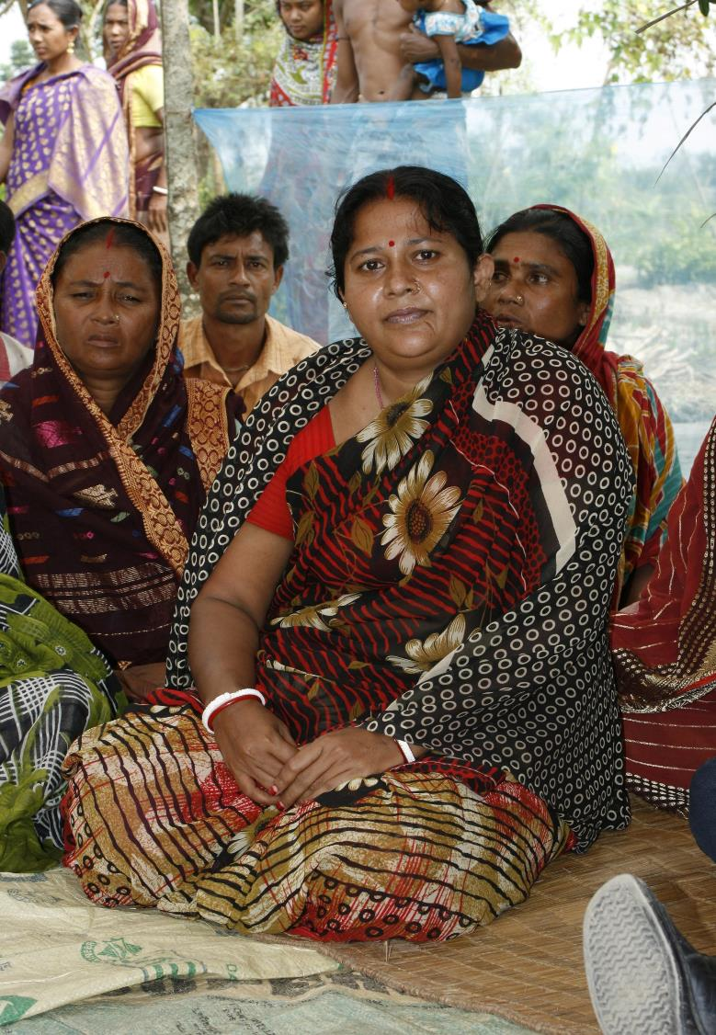

Slide 7
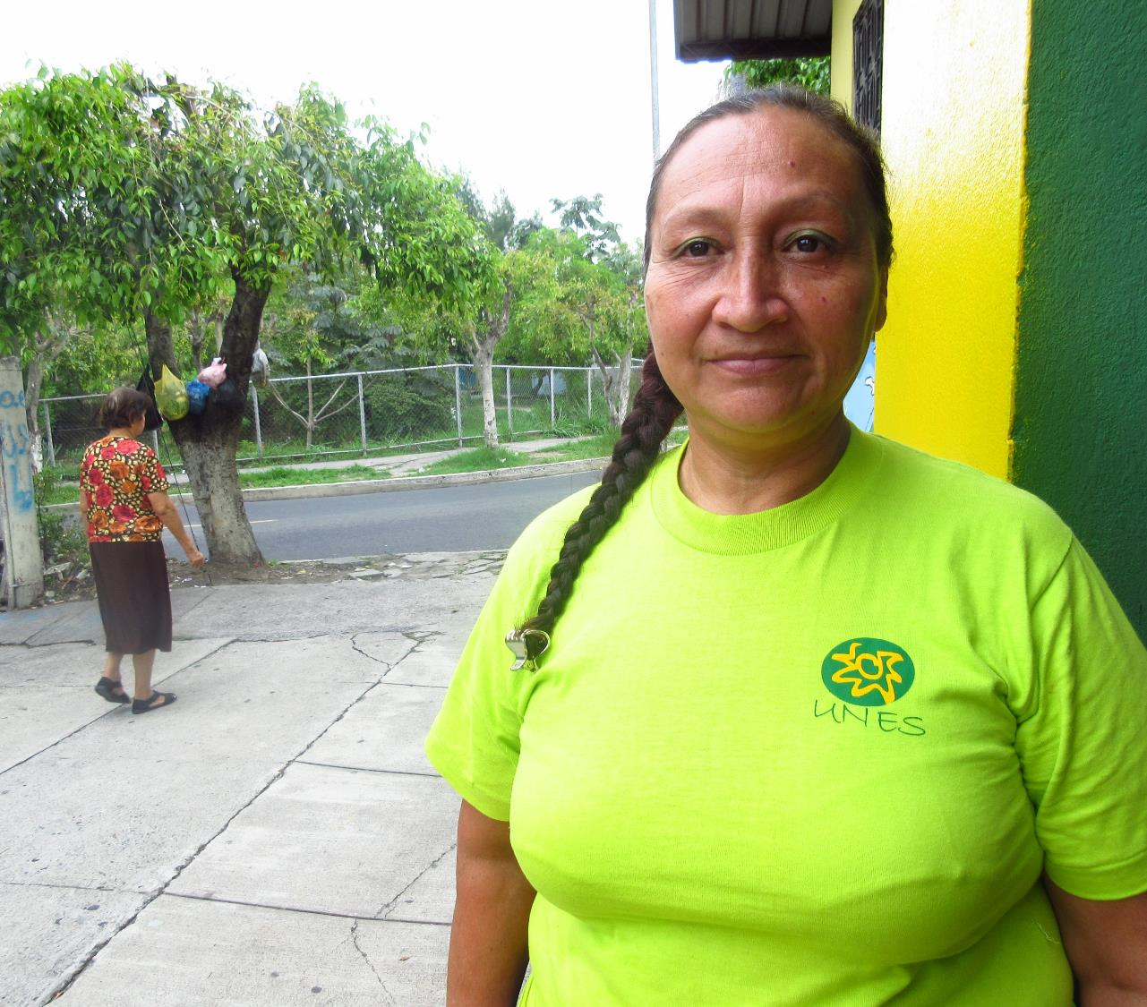

Slide 8
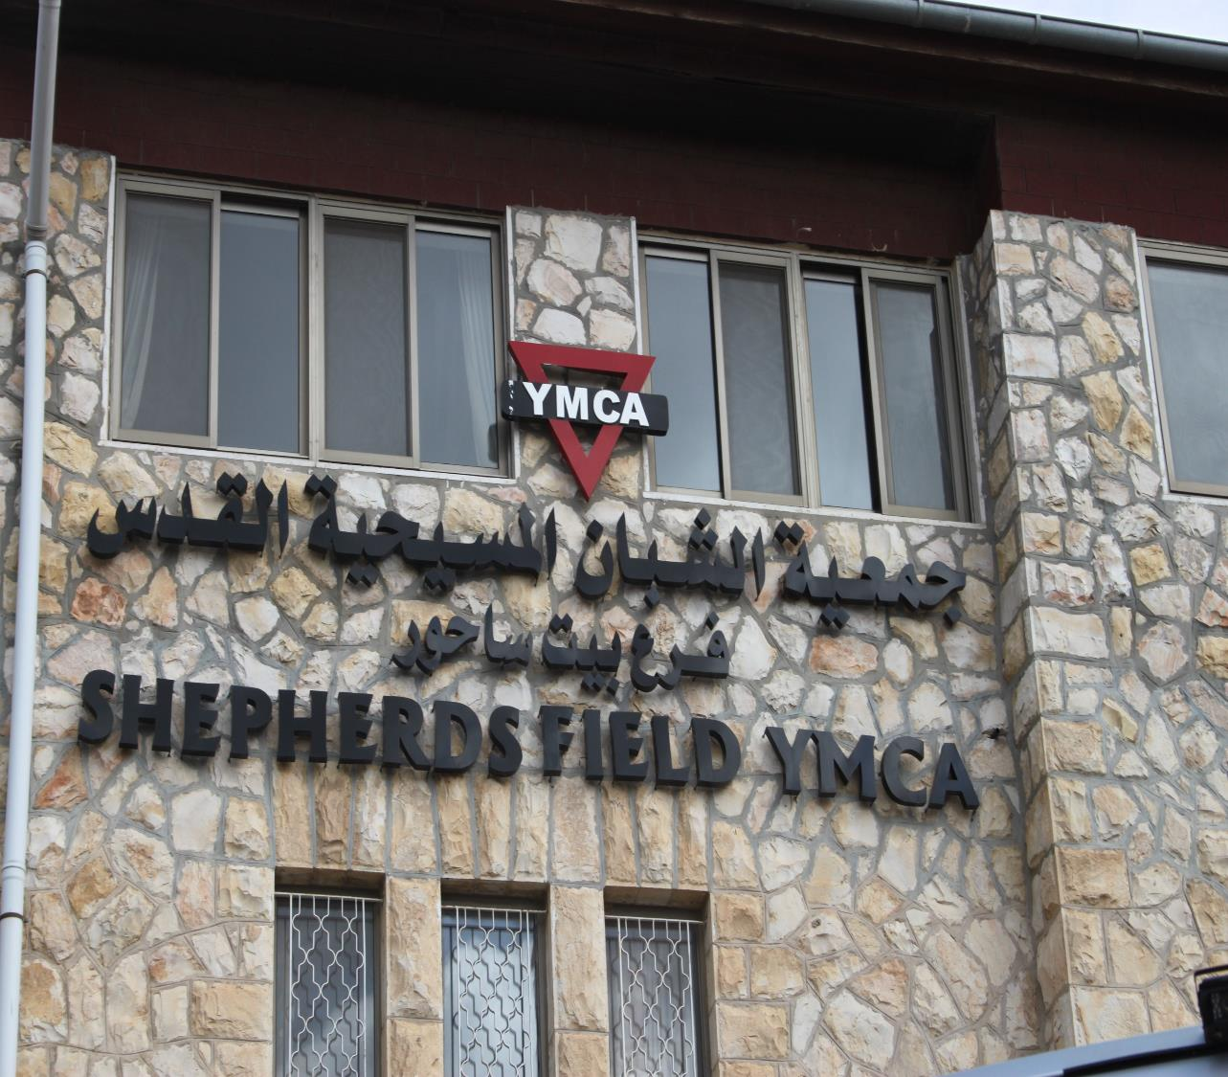

Slide 9
www.cforl.org.uk

