Slide 2
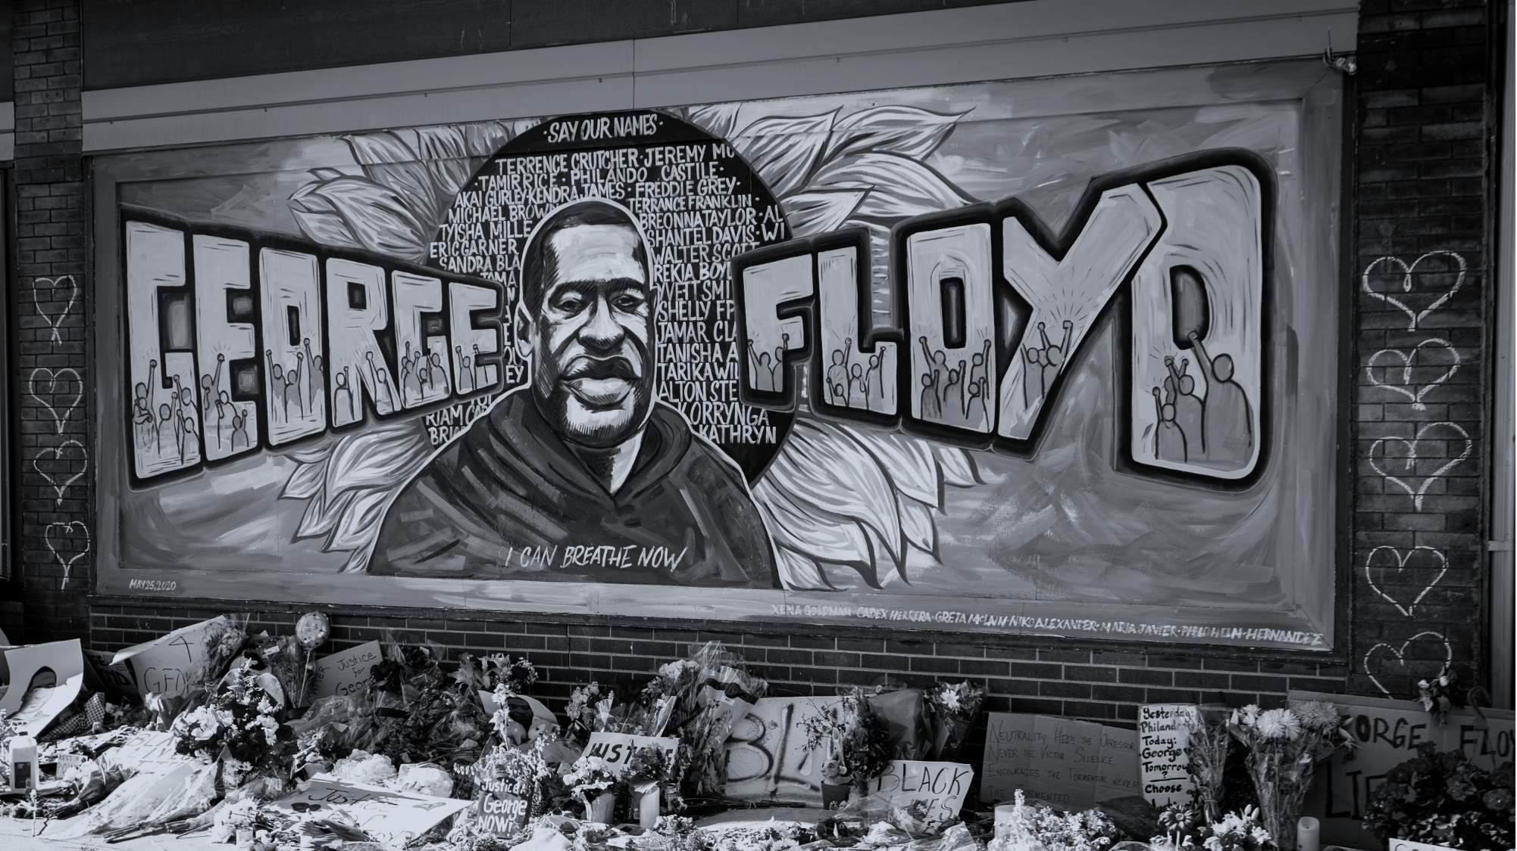

Cry ‘I can’t breathe’
Tune: Woodlands
Lyrics: John Campbell
Image: Munshots/Unsplash

Slide 3
Cry, ‘I can’t breathe!’ with those pinned down to die, when law enforcers kill, all help deny.

Slide 4
Cry, ‘I can’t breathe!’ while racist structures mean so many blighted lives, beyond obscene.

Slide 5
Cry, ‘I can’t breathe!’ rememb’ring times long gone when slave ship holds would stifle and condemn.

Slide 6
Cry, ‘I can’t breathe!’ with those from later days still trapped by aftershocks of slav’ry’s ways.

Slide 7
Cry, ‘End this now!’ with those who’ve had enough who march to end injustice harsh and rough.

Slide 8
Cry, ‘End this now!’ with all who would proclaim that black lives matter; let us end the shame!

Slide 9
Cry, ‘In Christ’s Name!’ till all Christ’s church can see that Jesu’s work’s not done till all are free.

Slide 10
Cry, ‘In Christ’s Name!’ as we commit to share in striving for a world that’s just and fair.

Slide 11
Cry, ‘I can’t breathe!’ with all who seek to build a world where no-one is unjustly killed.

Slide 12
Cry, ‘I can’t breathe!’ till hope begins again, and all are blessed, and peace and justice reign.

Slide 13
The words of George Floyd (and others who died pinned down by police) have become a rallying cry for much wider issues of injustice.
This song seeks to invite Christians to share the cry and join the struggle.
John Campbell, 23 July 2020

