Slide 1



Prayer Pointers 2021/2022
Notes:
R&S 200: The Kingdom of God is Justice & Joy
R&S 620 For the Healing of the Nations
R&S 625 God of Freedom, God of Justice (communion hymn)
The Church is wherever God's people (words changed) tune: Bard of Armagh

Slide 2



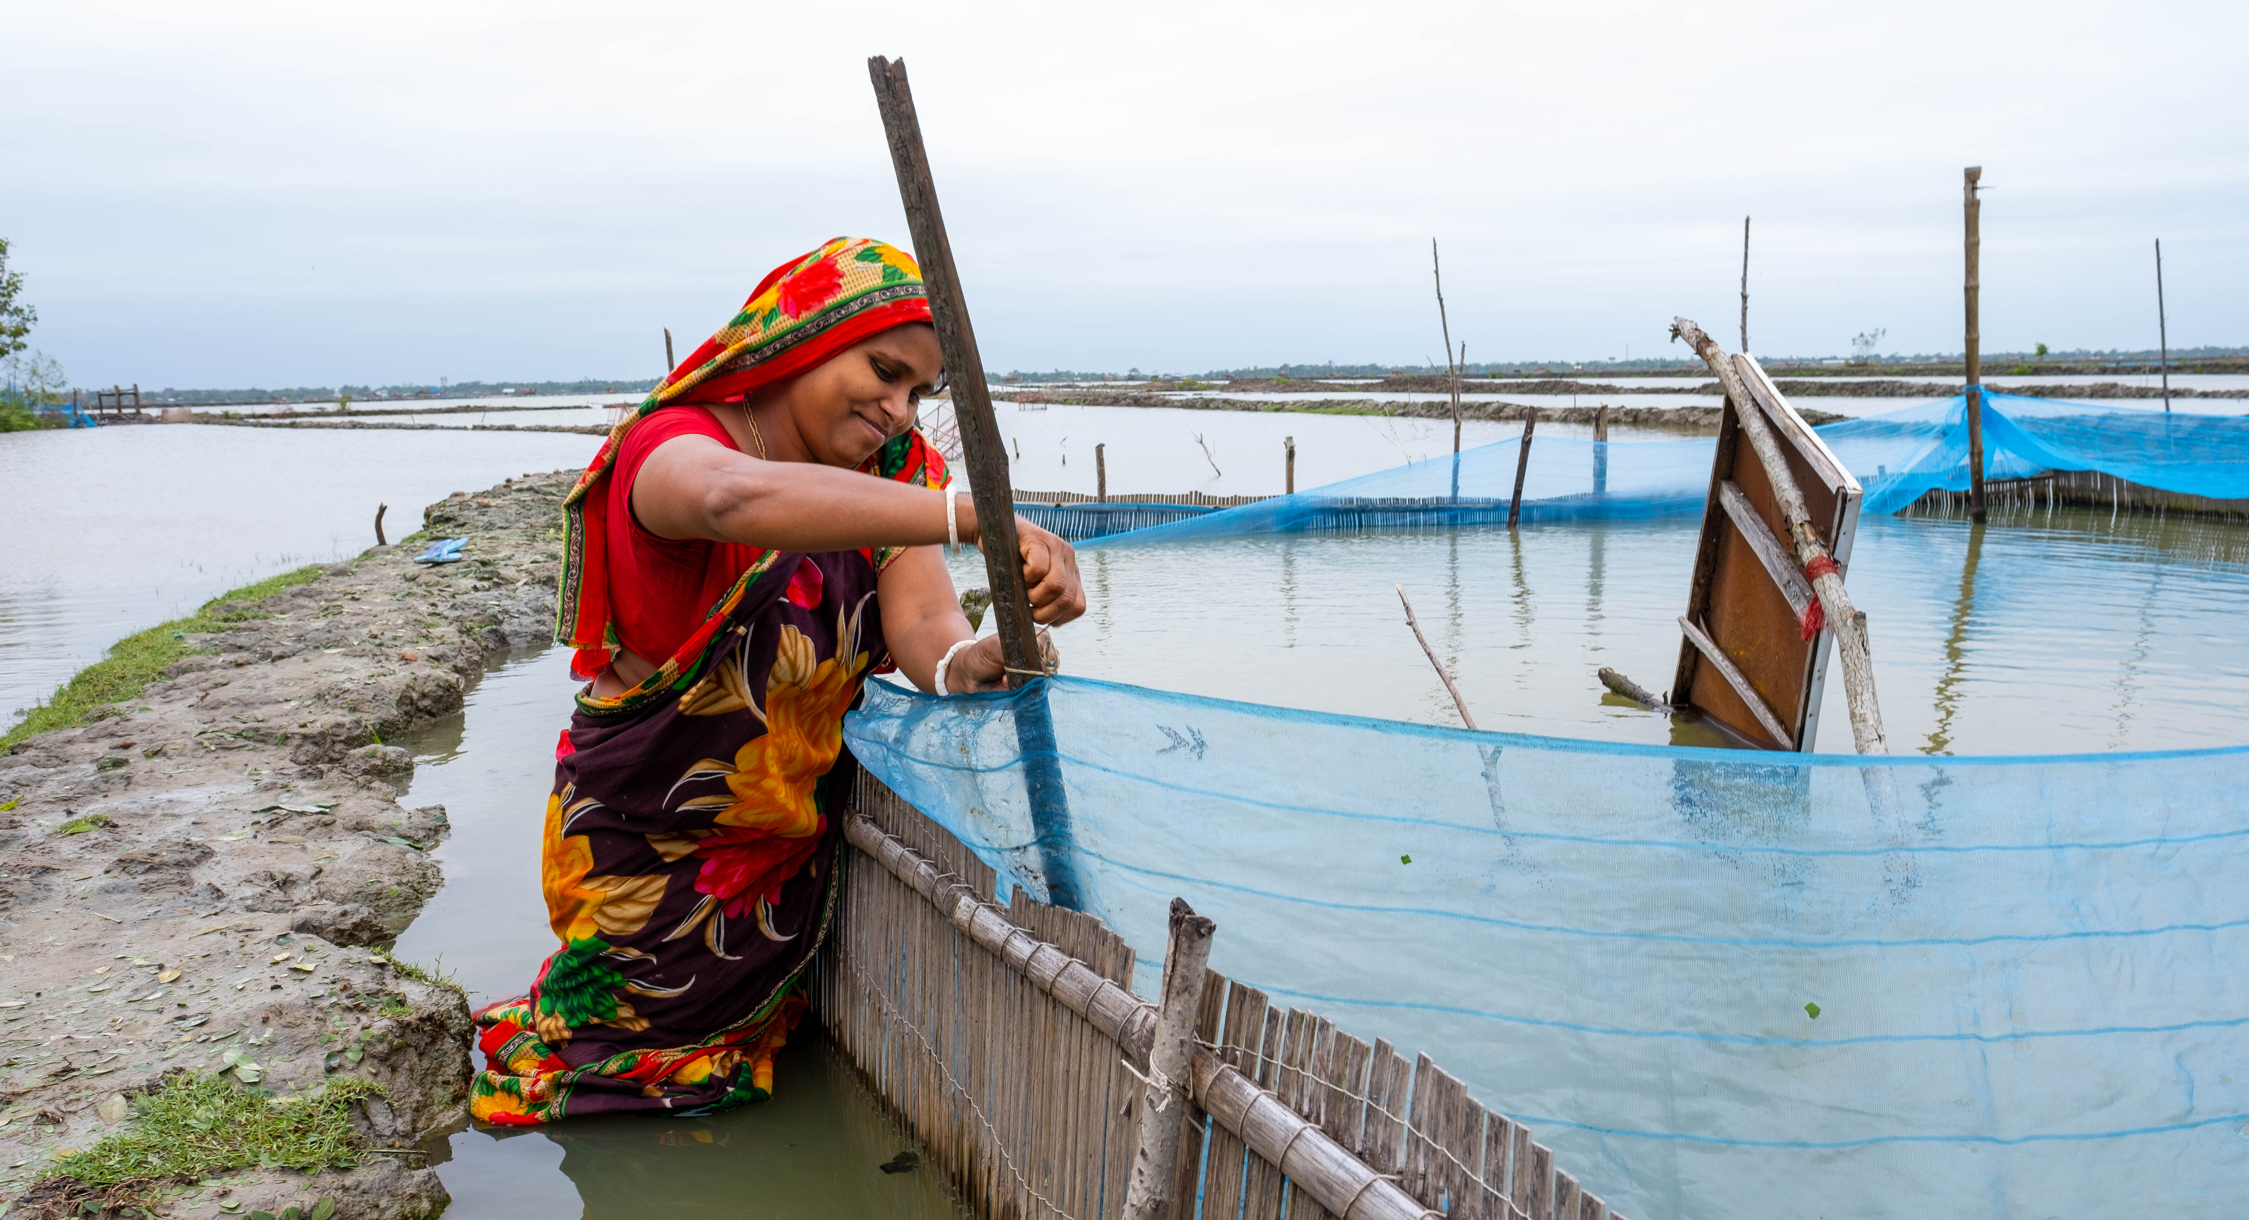
Prayer points:
Pray for Christian Aid’s partner Nowabenki Gonomukhi Foundation, as it supports farmers with training, skills development and resources to set up their own crab fattening businesses.
Pray for farmers as climate change, changes the traditional ways of farming and fishing in the Sundarbans of Bangladesh.
Crab farming to tackle climate change.

Slide 3

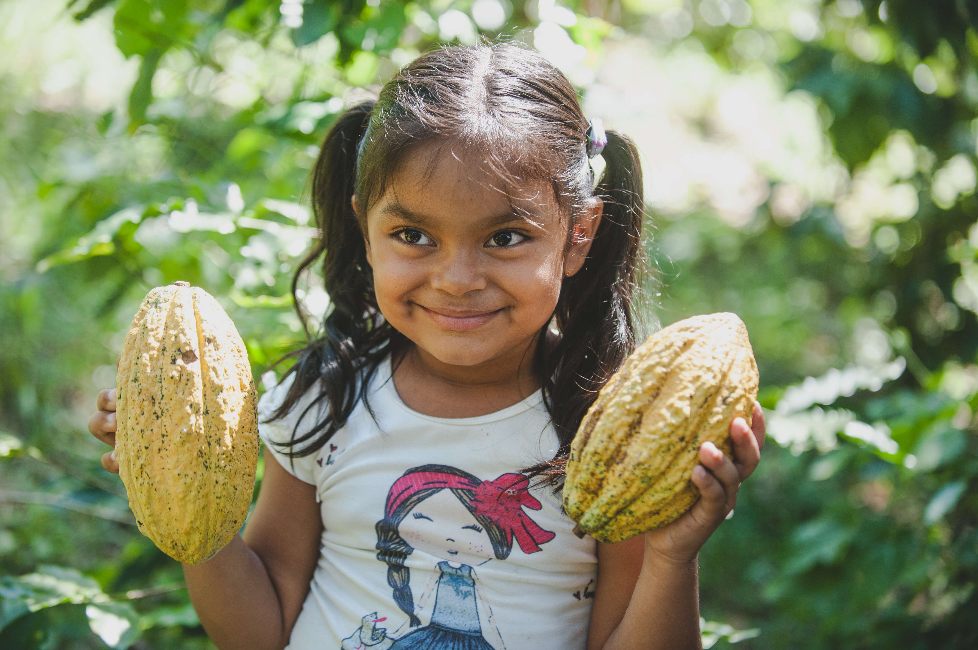
Ariana holding cocoa pods on her family’s farm in Nicaragua
Prayer points:
Pray for farming communities that are being effected by climate change, as it becomes harder to make a living growing crops that used to thrive.
Pray for Christian Aid’s partner Soppexcca as they help families like Ariana’s to diversify their farms from coffee to cocoa.

Slide 4

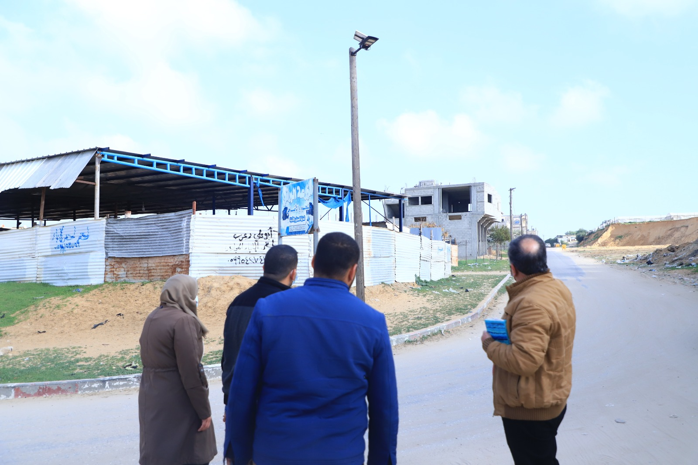
Prayer Points:
Thank God for the new solar panel streetlights and a newly paved road.
Pray for Abu Rashwan, an agricultural community, Where many families live hand to mouth – unemployment is high, and people struggle with food insecurity
Solar panels bring light in the darkness. Members of the CREC with the new solar street lighting

Slide 5

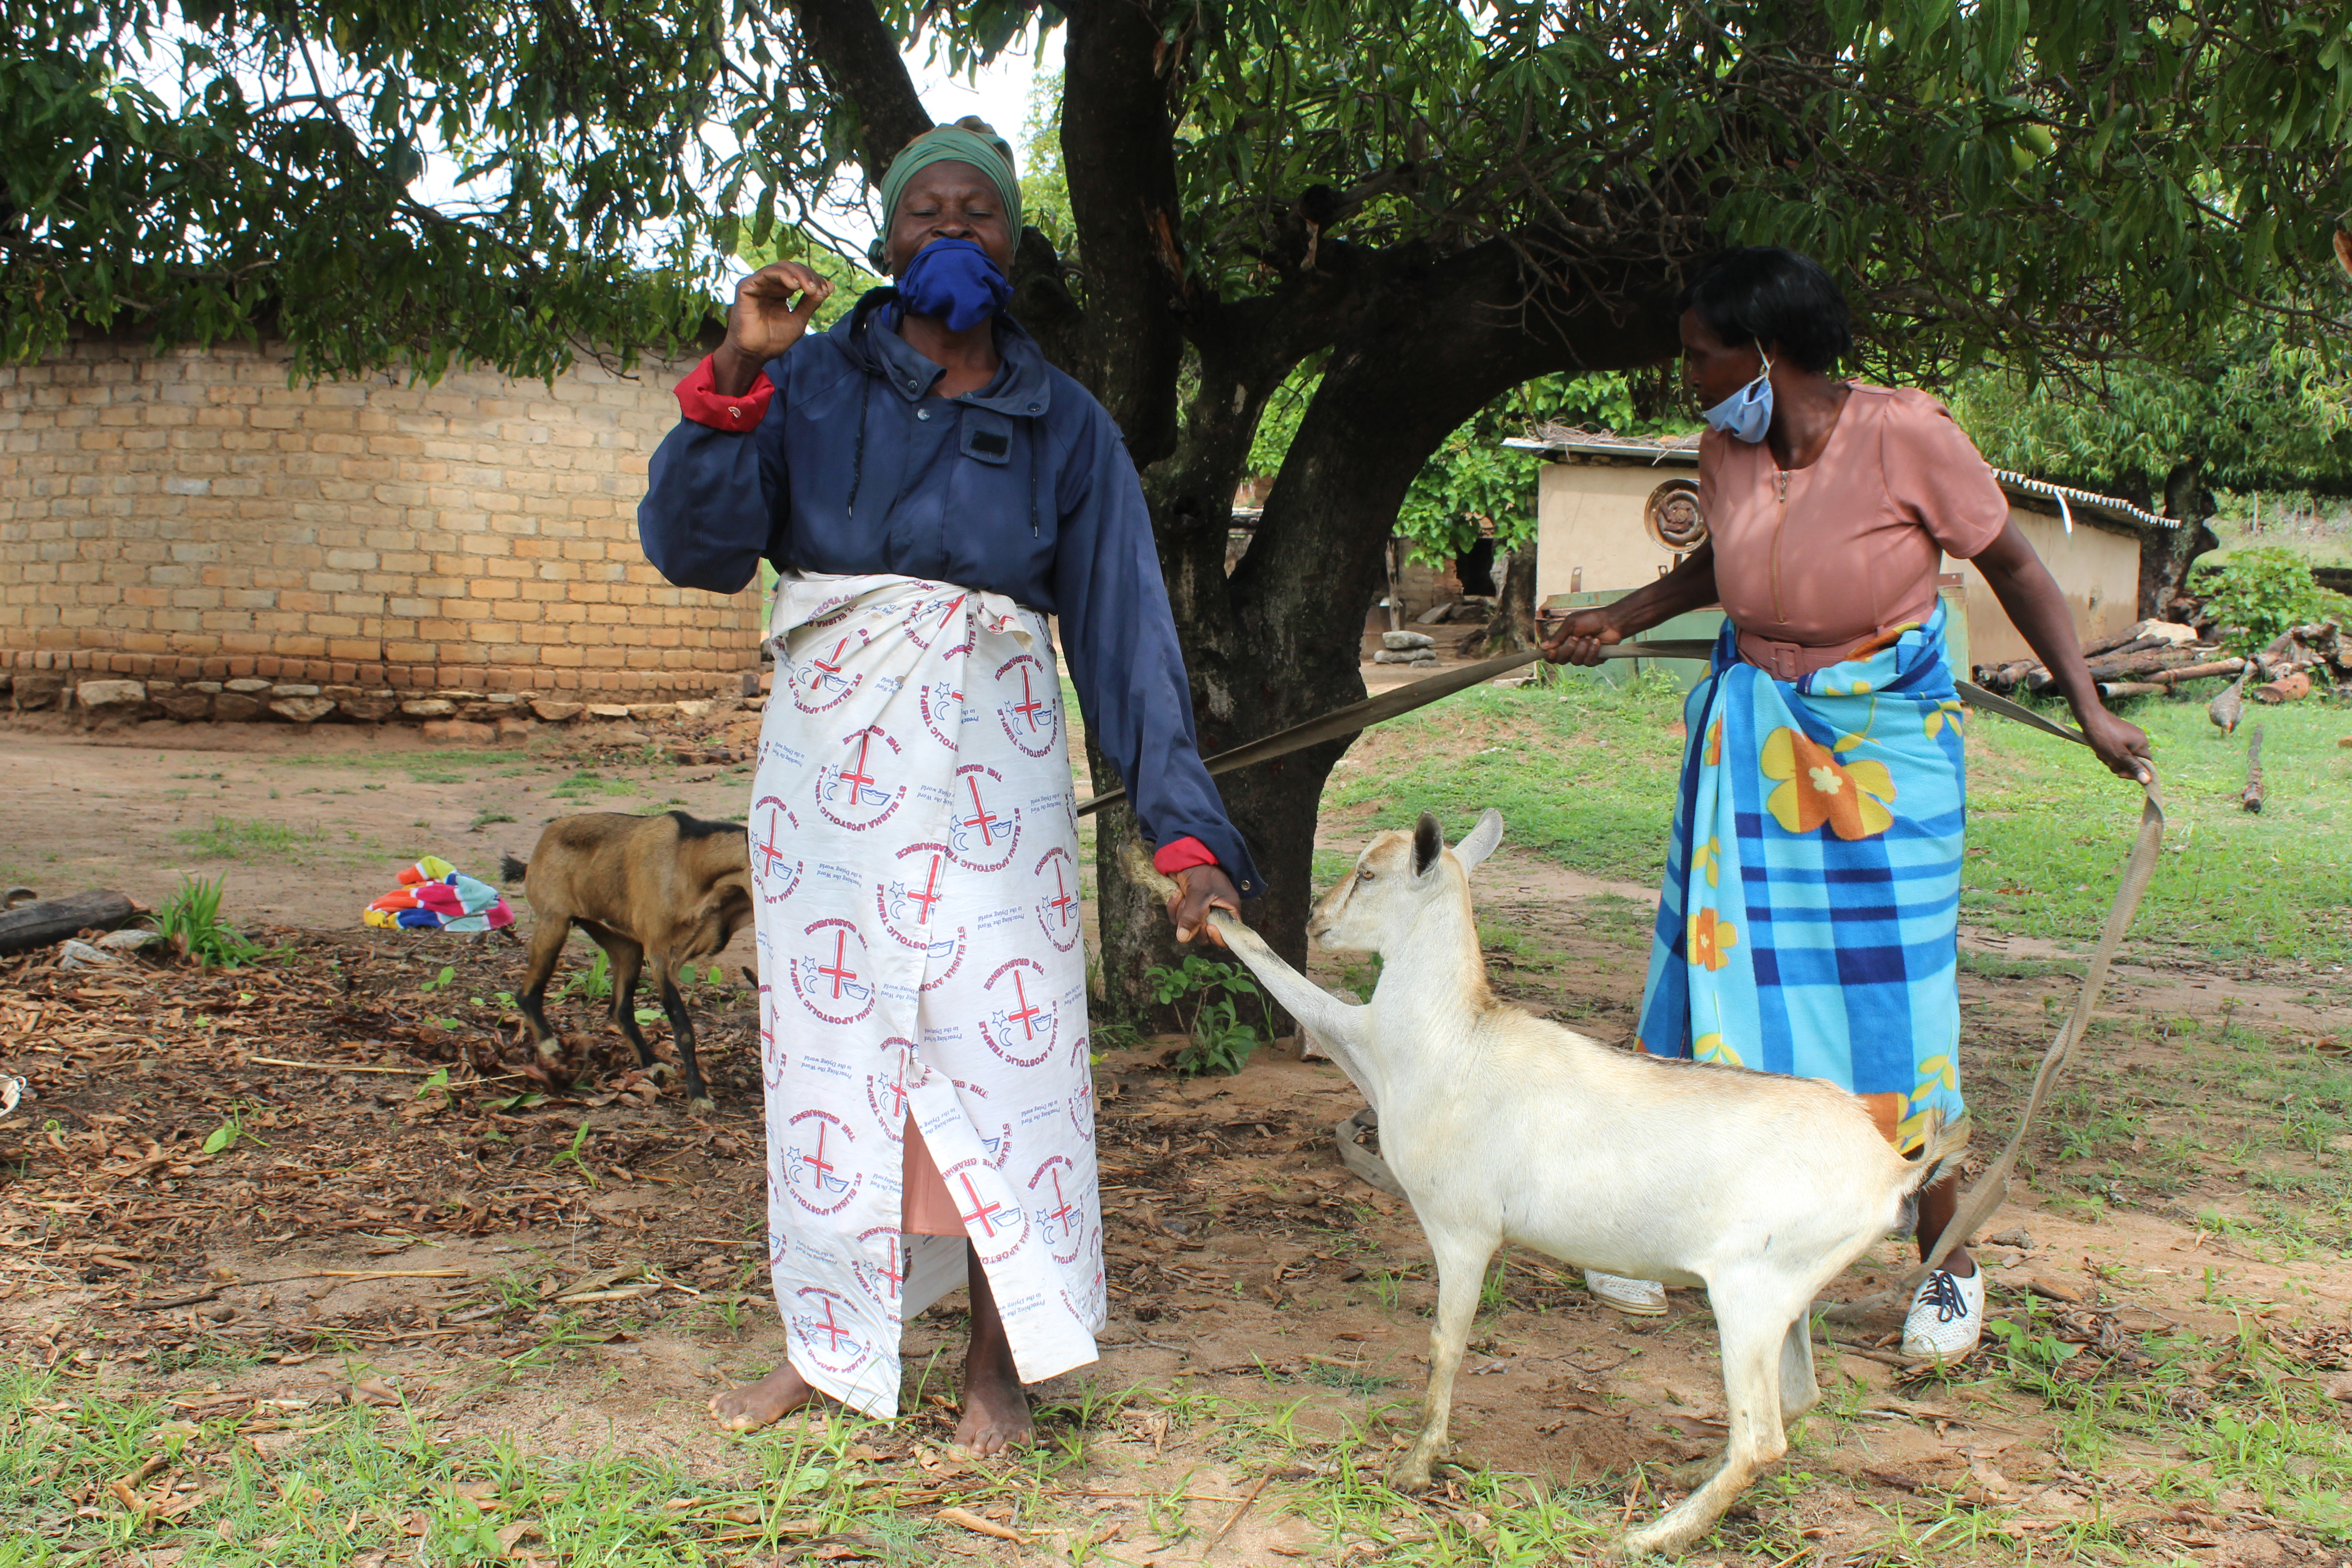
Prayer Points:
Pray for the success of the savings and lending group, to help the Tafunga women set up farming businesses.
Thank God that the women have seen a change in their standing in the community by men and now make decisions together about planting crops and spending money.
Members of the Tafunga group with the first goats purchased through the savings and lending scheme

Slide 6

Prayer points:
Pray for protection for Christian Aid’s partners in the four Regions that we support in Bangladesh, Central America, Israel and the Occupied Palestinian Territory and Zimbabwe.
Pray for wisdom and guidance as Christian Aid seeks to confront the climate emergency and its call upon the UK Government, to effect change as it hosts crucial UN Climate talks, COP26.
Notes:
R&S 200: The Kingdom of God is Justice & Joy
R&S 620 For the Healing of the Nations
R&S 625 God of Freedom, God of Justice (communion hymn)
The Church is wherever God's people (words changed) tune: Bard of Armagh

Slide 7
Prayer points:
Pray for abundant blessing with regards unrestricted finances, so Christian Aid can continue its campaigns, activism, and help the most vulnerable from inequalities.
Notes:
R&S 200: The Kingdom of God is Justice & Joy
R&S 620 For the Healing of the Nations
R&S 625 God of Freedom, God of Justice (communion hymn)
The Church is wherever God's people (words changed) tune: Bard of Armagh

Slide 8
Prayer points:
Pray for wisdom and guidance for Global Justice Now as they seek to continue to work towards a fairer and more equal world.
Pray for the campaign on access to Covid-19 vaccines globally for all.
Notes:
R&S 200: The Kingdom of God is Justice & Joy
R&S 620 For the Healing of the Nations
R&S 625 God of Freedom, God of Justice (communion hymn)
The Church is wherever God's people (words changed) tune: Bard of Armagh

Slide 9
Prayer:
Loving God, creator, provider, and sustainer of all things;
We have not taken good care of the wondrous creation that you asked us to treasure.
We live in a hurting and unjust world. We know that it breaks your heart to see people sick, starving, at war with each other, suffering from climate change, living under bondage, and suffering abuse. Forgive us for our foolish ways.
We pray for organisations like Christian Aid, Global Justice Now, Fairtrade, Jubiliee Debt Campaign, Climate Coalition, and other organisations that respond to moral, social, and economic issues globally in order to make for a fairer and more equal world. Help us to play our part too, through showing care, compassion, advocacy, and loving like you do.
Amen

