Slide 1
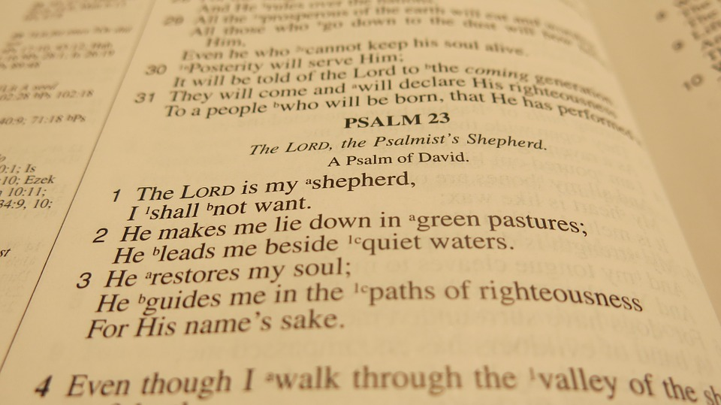

Slide 2
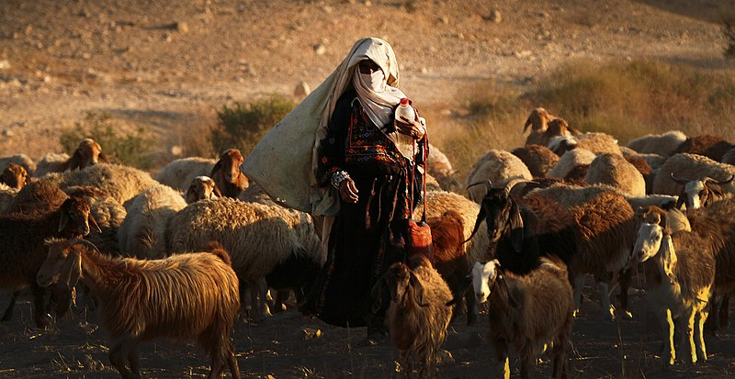
The Lord is my Shepherd, I lack nothing

Slide 3
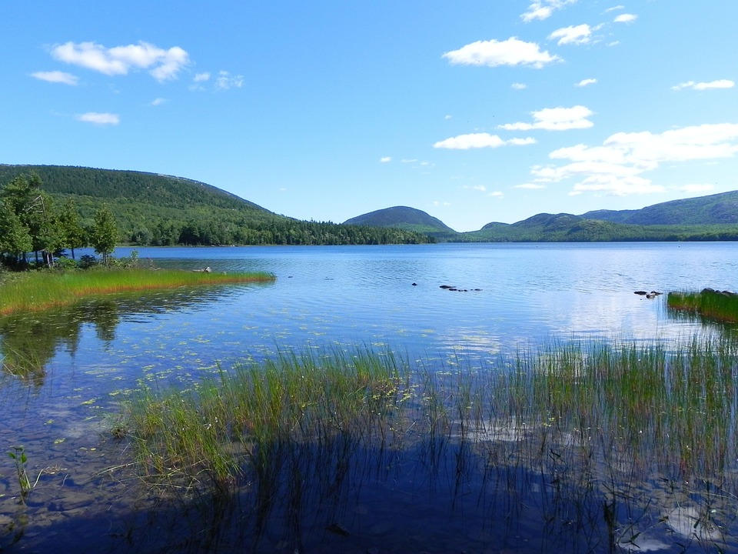
He makes me lie down in green pastures, He leads me besides quiet waters, He refreshes my soul.

Slide 4
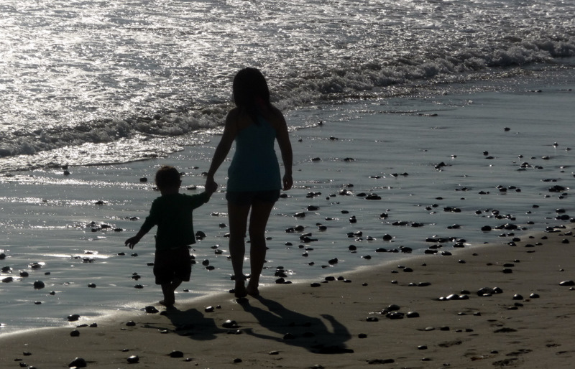
He guides me along the right paths, for His names sake.

Slide 5
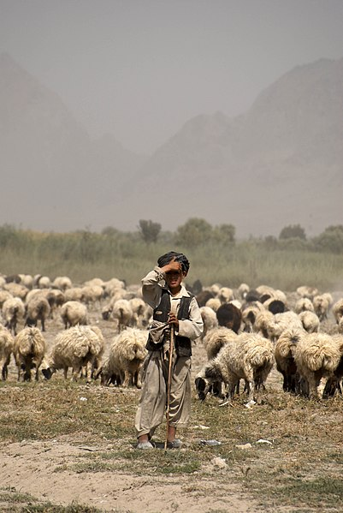
Even though I walk through the darkest valley, I will fear no evil, for you are with me; your rod and your staff, they comfort me.

Slide 6
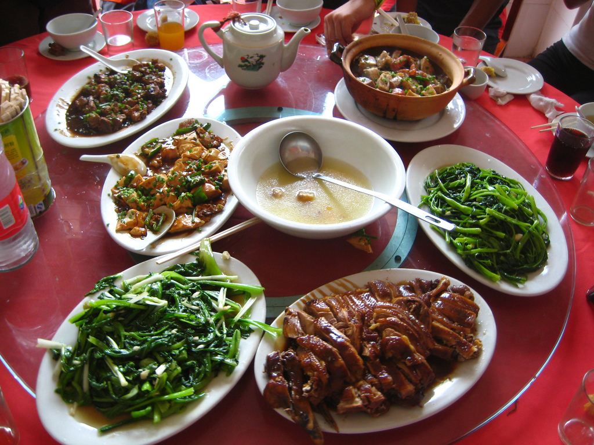
You prepare a table before me in the presence of my enemies.

Slide 7

You anoint my head with oil; my cup overflows.

Slide 8

Surely your goodness and love will follow me all the days of my life, and I will dwell in the house of the Lord forever.

