Slide 1


Where are we? Wisdom in liminal times The Synod Moderators’ Report

Slide 2
In decline
In a pandemic
In death...even in life

Slide 3

These are liminal times – between times … Richard Rohr, a Franciscan spiritual writer, describes liminal space in this way: “…a unique position where human beings hate to be but where the biblical God is always leading them … It is when you are between your old comfort zone and any possible new answer. “If you are not trained in how to entrust and wait, you will run…anything to flee this terrible cloud of unknowing.”

Slide 4

Liminal times are like a threshold

Slide 5


Liminal times are like being in the fog

Slide 6

Liminal times are like pupation –
a caterpillar turning into a butterfly

Slide 7

In liminal times we need to:
Be prepared to wait
Deepen our communal discernment
Shape our institutional memory
Clarify our purpose
See the way forward emerge

Slide 8

Be prepared to wait
Don’t rush to a ‘solution’

Slide 9

Deepen our communal discernment
Listen for God in Bible, prayer & each other

Slide 10
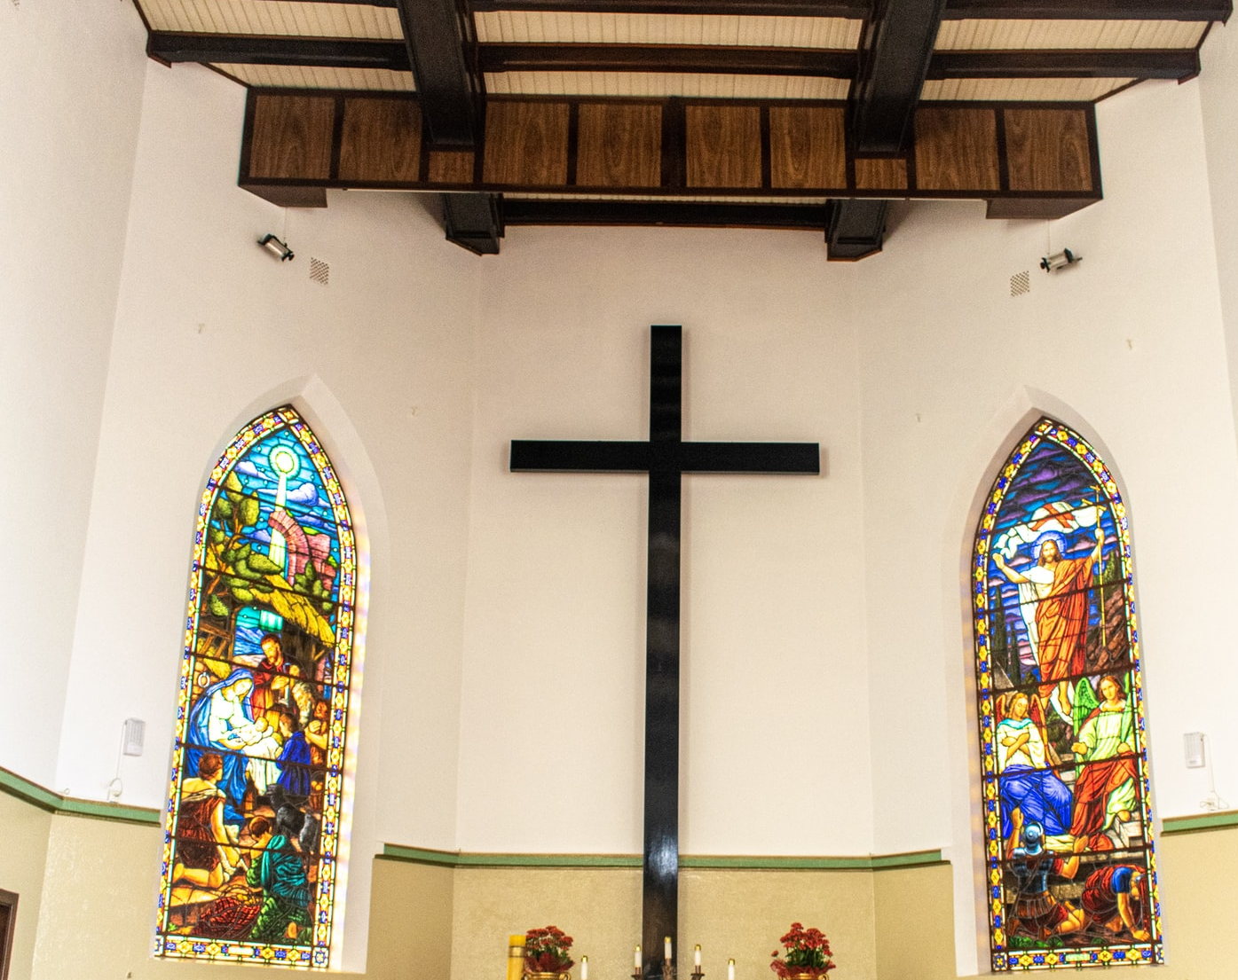
Shape our institutional memory
Tell our story – remember who we are

Slide 11

Clarify our purpose
Ask who God wants us to be NOW

Slide 12

See the way forward emerge
Look for signs of new ways emerging from the chaos

Slide 13
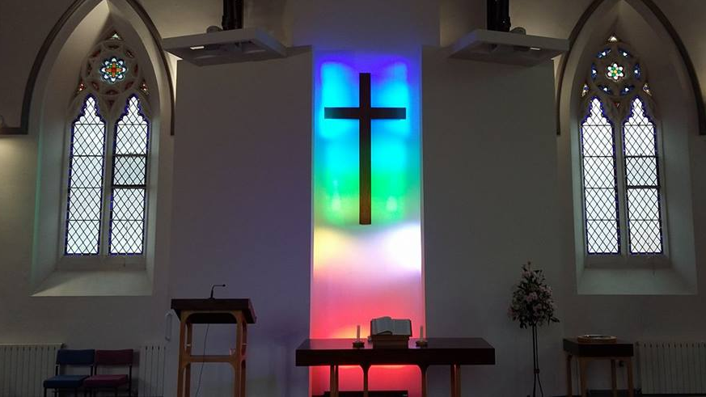
There are examples in the report and questions to help local churches and others to explore your own response to liminal times

Slide 14

Trust God for wisdom in liminal times
“The eternal God is your dwelling place and underneath are the everlasting arms”
Deuteronomy 37: 27a (often used at the start of a funeral service)
Photos: Unsplash.com & Trinity Church, Leek

