Slide 1

Church Life Review
An introduction to key issues surrounding our life, structures and resources.

Slide 2
Review Group Members
John Bradbury
Melanie Campbell
Steve Faber
Tessa Henry-Robinson
Muna Levin-Harris
Lindsey Sanderson
Victoria Turner
Phil Wall
Gordon Woods

Slide 3
The United Reformed Church and the purpose of the Church (From the Basis of Union)
11. Within the one, holy, catholic, apostolic Church the United Reformed Church acknowledges its responsibility under God:- to make its life a continual offering of itself and the world to God in adoration and worship through Jesus Christ;- to receive and express the renewing life of the Holy Spirit in each place and in its total fellowship, and there to declare the reconciling and saving power of the life, death and resurrection of Jesus Christ;- to live out, in joyful and sacrificial service to all in their various physical and spiritual needs, that ministry of caring, forgiving and healing love which Jesus Christ brought to all whom he met;- and to bear witness to Christ's rule over the nations in all the variety of their organised life.

Slide 4

Questions:
Are we one church, 13 churches or 1,300 churches?
Do we need one vision for the United Reformed Church, or 1300 locally contextual visions?

Slide 5

Some statistics and numbers…
Congregations, Members and ministry

Slide 6
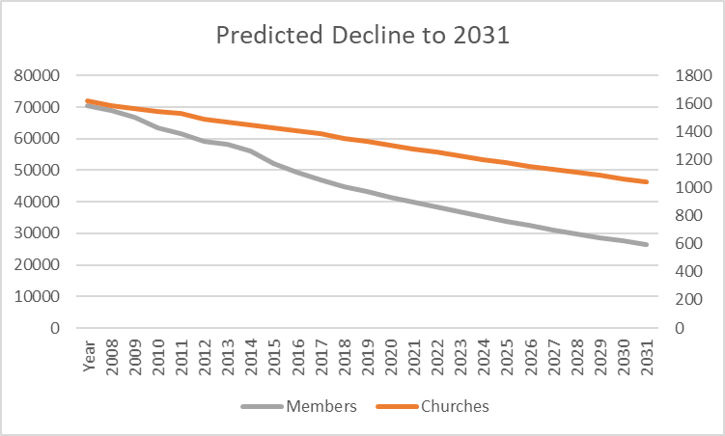
Decline of membership…

Slide 7
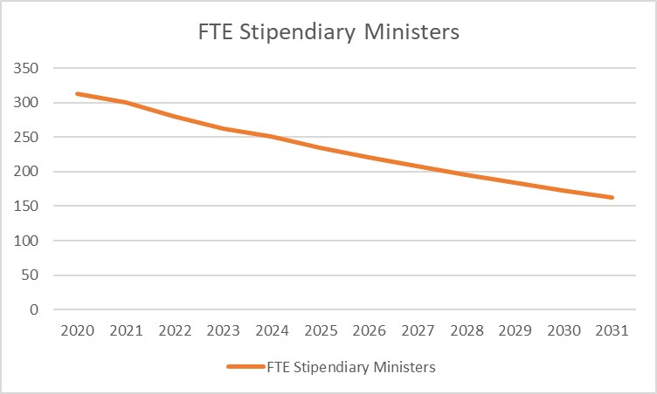
Decline in stipendiary ministry…

Slide 8
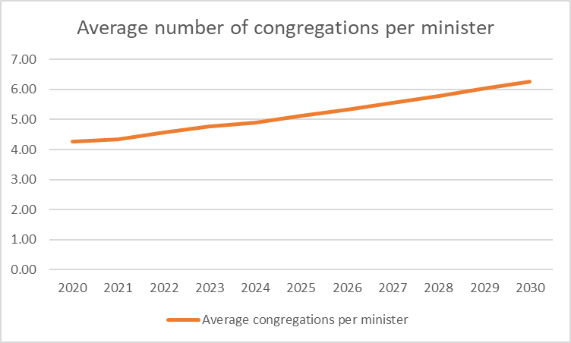
Average number of congregations per stipdendiary minister…

Slide 9
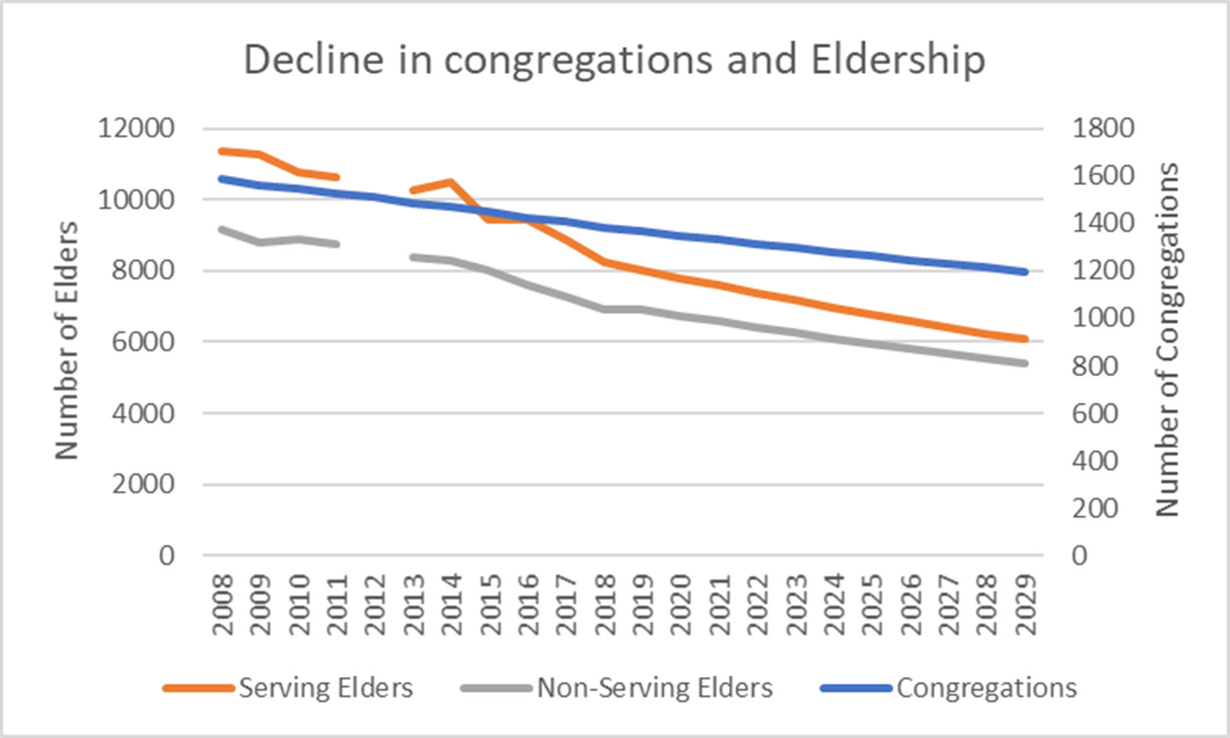

Slide 10
What we are missing:
Any demographic data about the membership of the URC
Any demographic data about the communities in which our congregations are set (anecdotal evidence would suggest we have withdrawn hugely from deprived areas)
Any data concerning what local congregations most would welcome from the wider church to support their worship, witness, evangelism and service.

Slide 11

General Assembly Structures

Slide 12
General Assembly Committee Structure

Slide 13
Assembly Executive Advisory Groups

Slide 14
Discipleship Department

Slide 15
Mission Department

Slide 16
Administration and Resources Department

Slide 17
URC Trust Structures

Slide 18
United Reformed Church Family Financial Resources

Slide 19
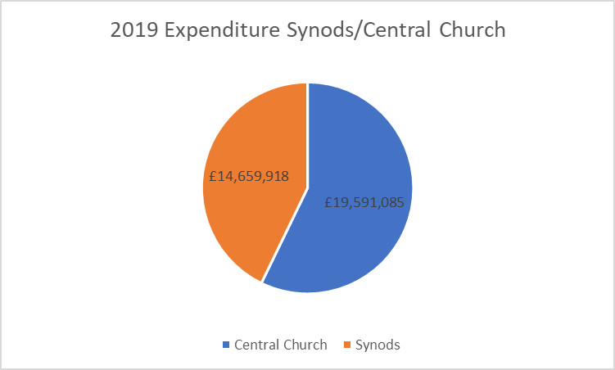

Slide 20
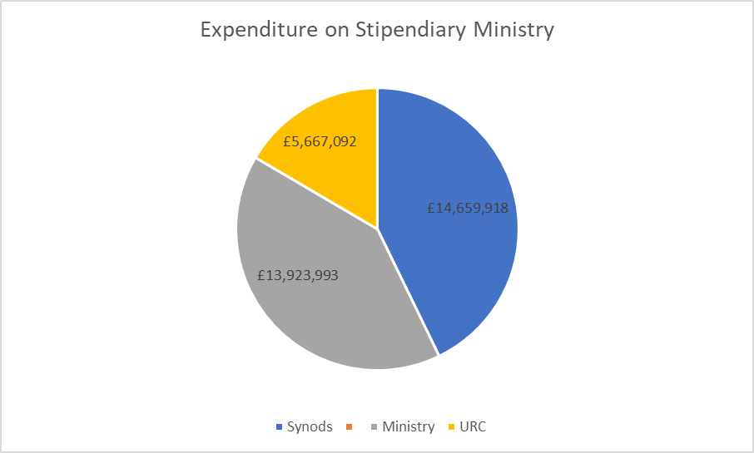

Slide 21
Synod Assets

Slide 22
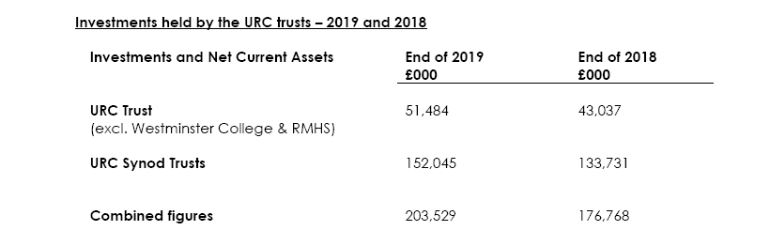
Trust and Synod Assets

Slide 23
Where from here…
What research do we need to do?
Detailed financial investigation?
Hopes and dreams of congregations?
Demographic research?
Who might assist with research?
Theos?
Forensic Accountant?

Slide 24
Questions to ponder
What gives you hope for the life of the United Reformed Church?
What do you think we might most helpfully need to find out about our existing life to help us think about our future life?
What would make the biggest difference to your local congregation in terms of support from the wider church?
What new work would you love to see us engage with?
Does anything surprise you that you’ve heard in the presentation?

