Slide 1

Closed
Churches
2018
Notes:
7.40 minutes running time

Slide 2
Closed Churches
Resolution 20
General Assembly notes the closures listed, with praise to God for the worship and witness offered by these fellowships across the years.
Page 77

Slide 3
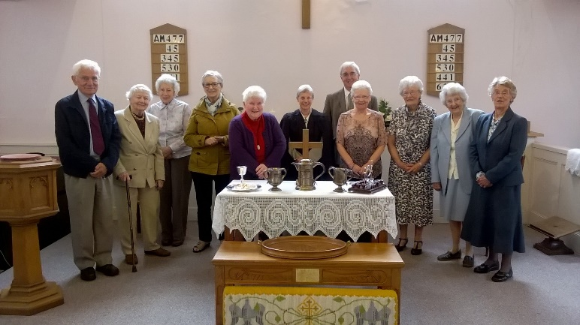
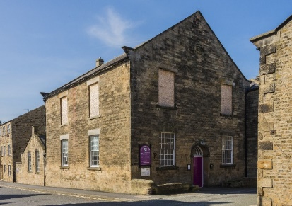
^{Synod 1: Northern}
Barnard Castle United Reformed Church
^{Barnard Castle}
^{2 October 2016}

Slide 4
^{Synod 1: Northern}
^{Oxclose LEP}
^{Washington}
^{1 September 2017} continues as an Anglican Church

Slide 5
^{Synod 2: North Western}
^{Mossley Abney}
^{Aston-under-Lyne}
^{23 April 2017}

Slide 6
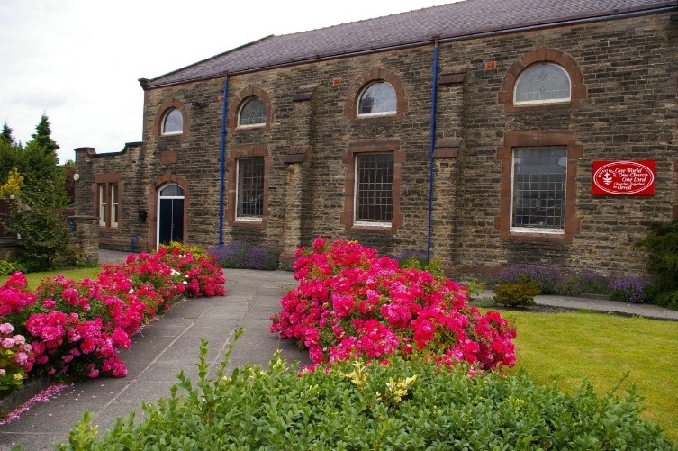
^{Synod 3: Mersey}
^{Salem United Reformed Church}
^{Orrell}
^{24 September 2017}

Slide 7
^{Synod 5: East Midlands}
^{Danesholme Community Church}
^{Corby}
^{15 January 2017}

Slide 8
^{Synod 6: West Midlands}
Brierley United Reformed Church
^{Brierley}
^{6 August 2017}

Slide 9
^{Synod 6: West Midlands}
^{Gorsty Hill United Church}
^{Stoke-on-Trent}
^{31 August 2016} continues as a Methodist church

Slide 10
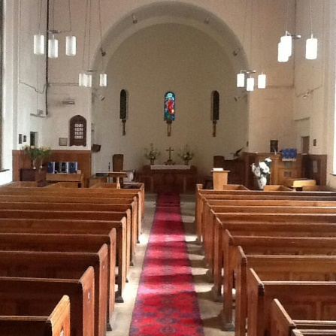
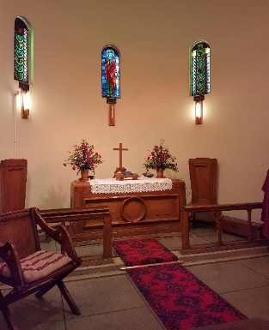
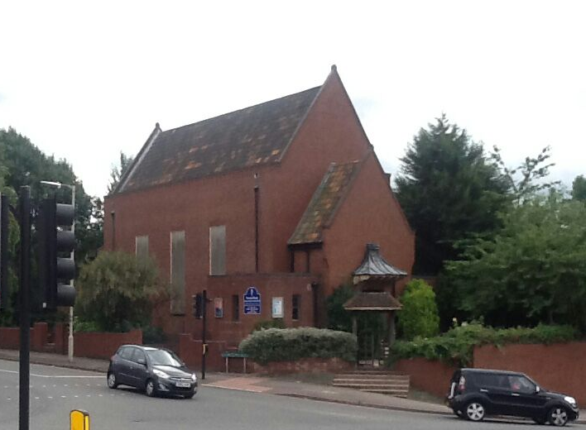
^{Synod 6: West Midlands}
Newton Road United Reformed Church
^{Birmingham}
^{31 December 2017}

Slide 11
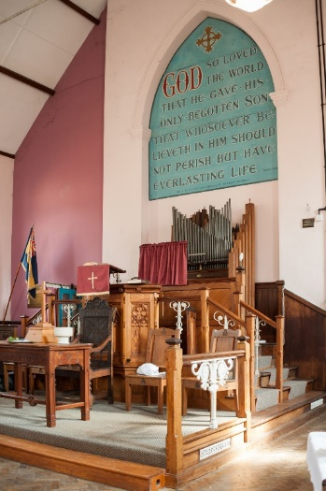
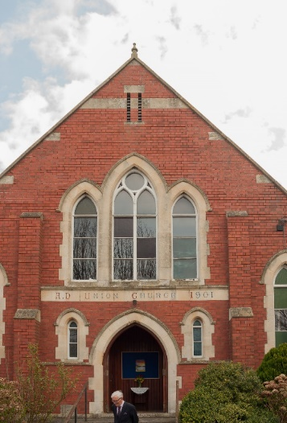
^{Synod 6: West Midlands}
Sharpness United Reformed Church
^{Sharpness}
^{4 April 2016}

Slide 12
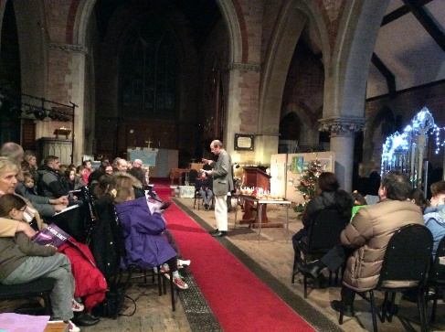
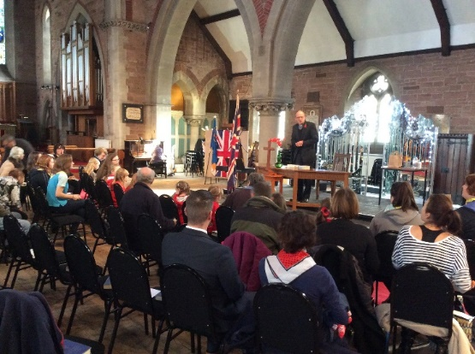
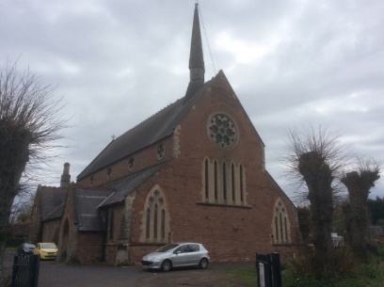
^{Synod 6: West Midlands}
St John’s United Reformed Church
^{Stourbridge}
^{31 December 2016}

Slide 13
^{Synod 6: West Midlands}
^{St Michael’s & All Angels}
^{Stourport-on-Severn}
^{31 August 2016} continues as an Anglican Church

Slide 14
^{Synod 6: West Midlands}
^{Union Free Church}
^{Wellington}
^{31 March 2018}

Slide 15
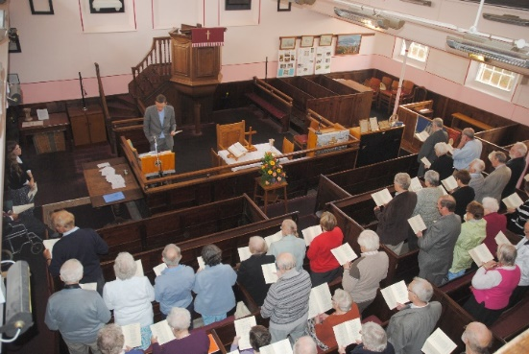
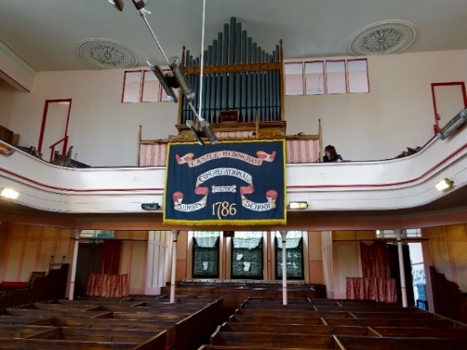
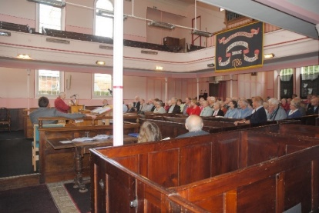
^{Synod 7: Eastern}
Castle Hedingham United Reformed Church
^{Castle Hedingham}
^{4 June 2016}

Slide 16
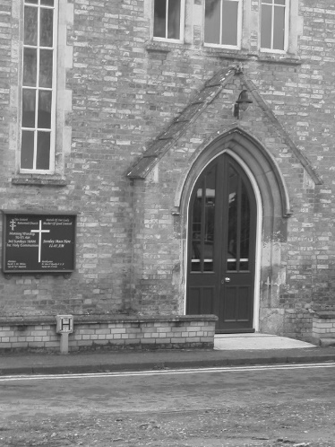
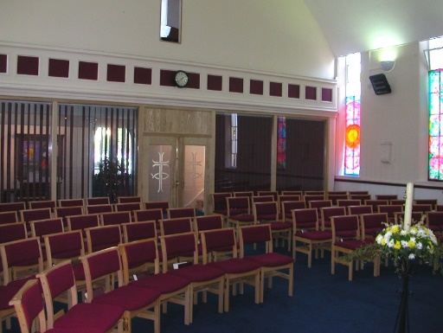
^{Synod 7: Eastern}
Cavendish United Reformed Church
^{Cavendish}
^{15 October 2017}

Slide 17
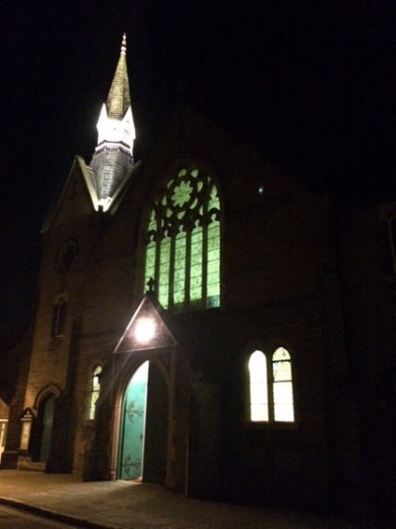
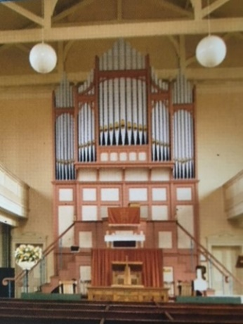
^{Synod 7: Eastern}
Christ Church United Reformed Church
^{Sudbury}
^{7 January 2018}

Slide 18
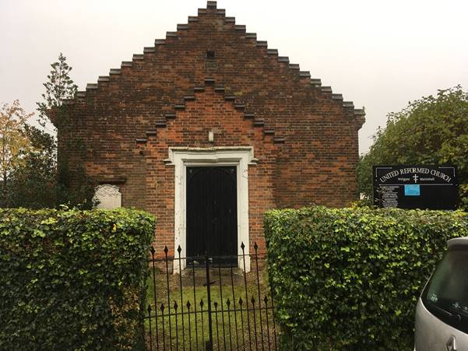
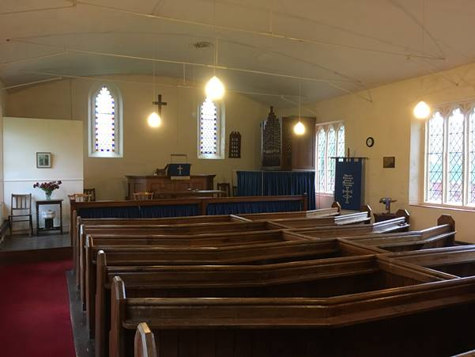
^{Synod 7: Eastern}
Mattishall United Reformed Church
^{Mattishall}
^{31 December 2016}

Slide 19
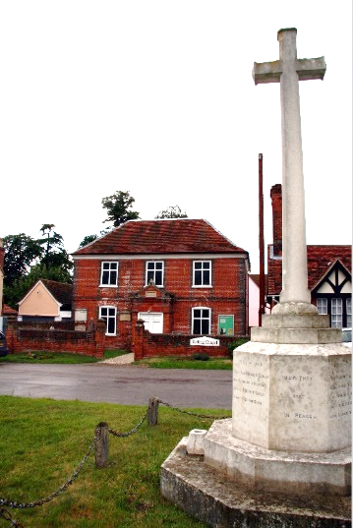
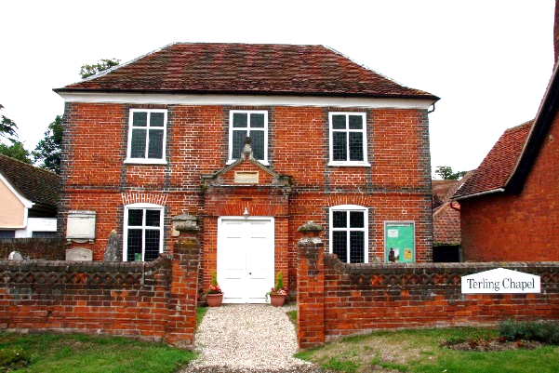
^{Synod 7: Eastern}
^{Terling United Reformed Church}
^{Terling}
^{31 March 2017}

Slide 20
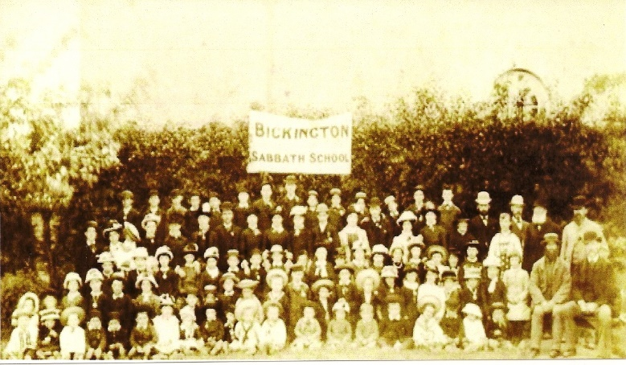
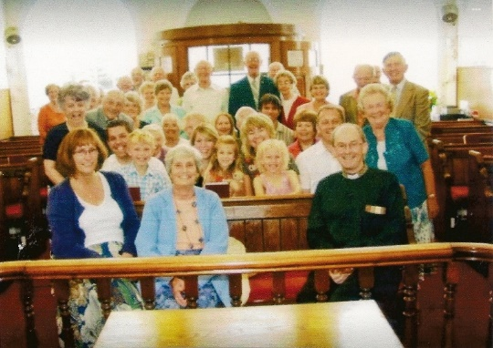
^{Synod 8: South Western}
Bickington United Reformed Church
^{Bickington}
^{28 January 2018}

Slide 21
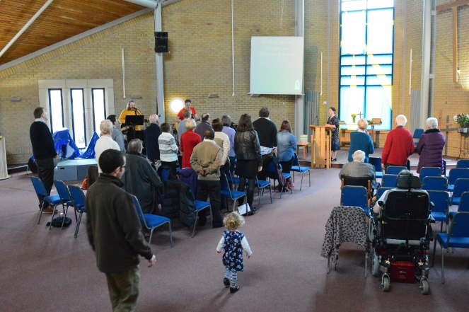
^{Synod 8: South Western}
^{Bradley Stoke, Holy Trinity}
^{Bristol}
^{10 September 2017}
^{continues with Methodist}
^{and Anglican involvement}

Slide 22
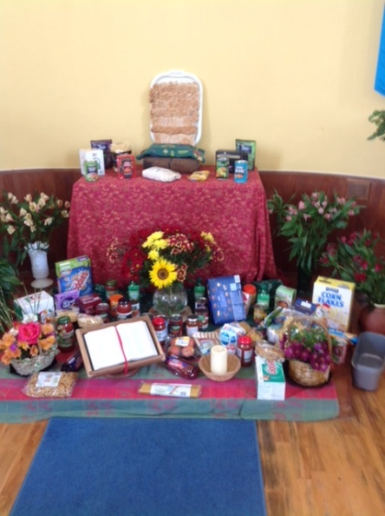
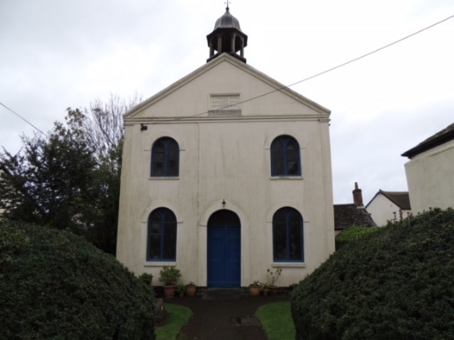
^{Synod 8: South Western}
Christchurch United Reformed Church
^{Charmouth}
^{27 November 2016}

Slide 23
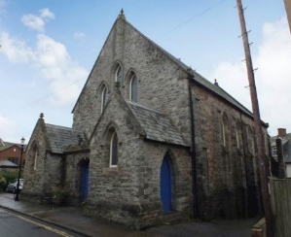
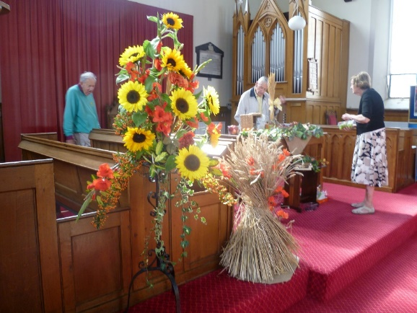
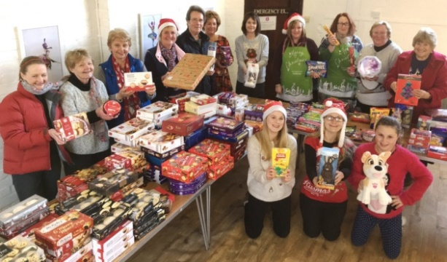
^{Synod 8: South Western}
Sidmouth United Reformed Church
^{Sidmouth}
^{1 January 2017}

Slide 24
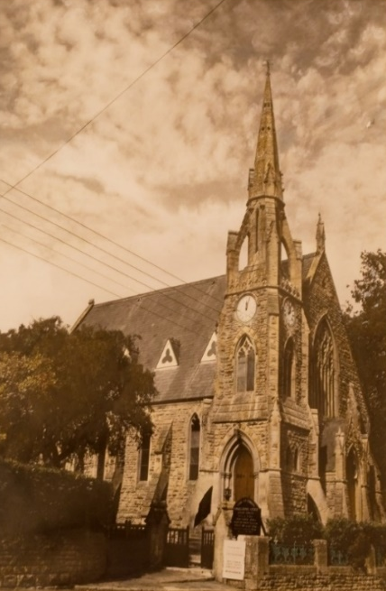
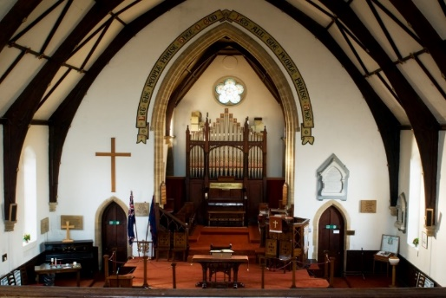
^{Synod 8: South Western}
^{Stoke sub Hamdon}
^{United Reformed Church}
^{Stoke sub Hamdon}
^{31 December 2016}

Slide 25
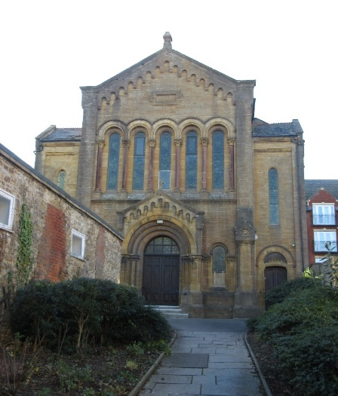
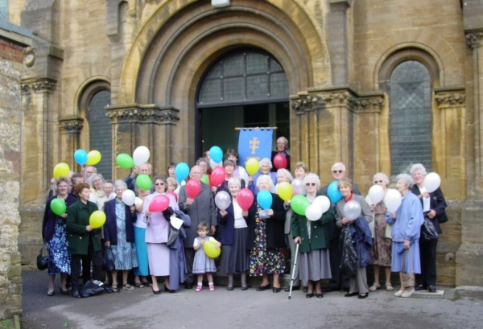
^{Synod 8: South Western}
^{Yeovil United Reformed Church}
^{Yeovil}
^{10 June 2017}

Slide 26
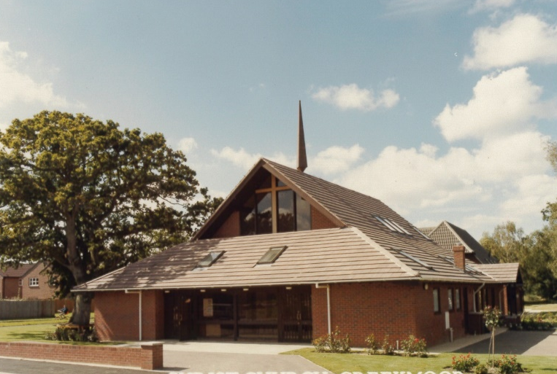
^{Synod 9: Wessex}
^{Christ Church}
^{Creekmoor}
^{2 October 2016}
^{continues as an}
^{Anglican church}

Slide 27
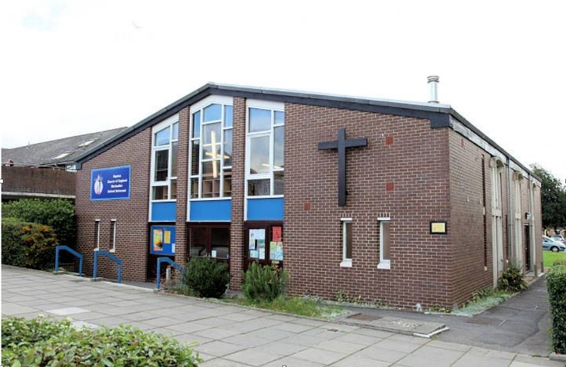
^{Synod 9: Wessex}
^{Lordshill Ecumenical Church}
^{Southampton}
^{16 July 2016}
^{continues as an}
^{ecumenical Church}

Slide 28
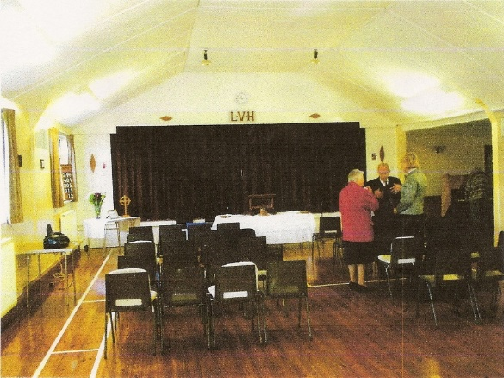
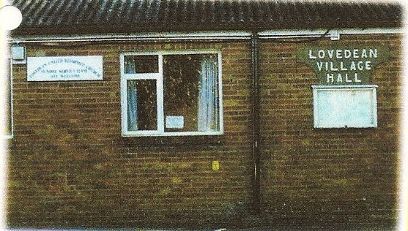
^{Synod 9: Wessex}
Lovedean United Reformed Church
^{Lovedean}
^{16 October 2016}

Slide 29
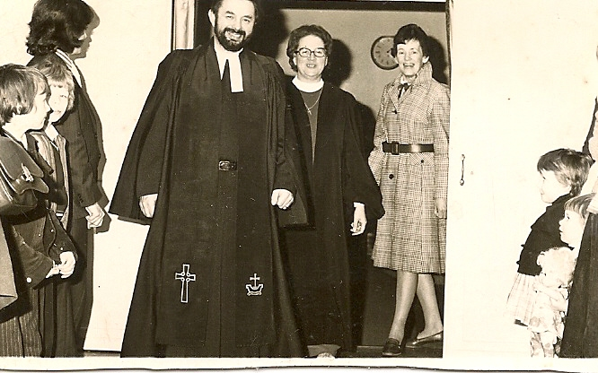
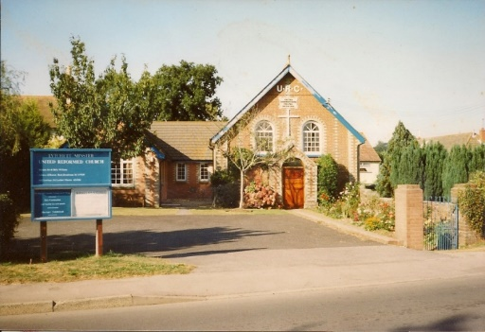
^{Synod 9: Wessex}
Lytchett Minster United Reformed Church
^{Lytchett Minster}
^{30 June 2016}

Slide 30
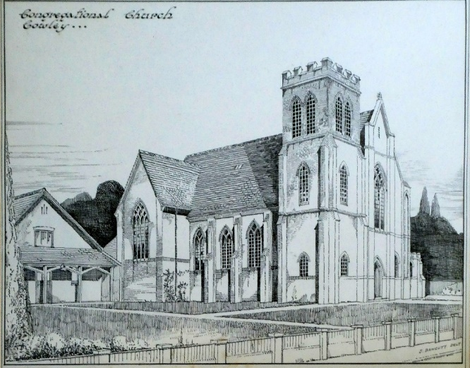
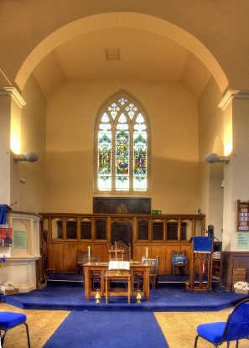
^{Synod 9: Wessex}
Temple Cowley United Reformed Church
^{Oxford}
^{5 November 2017}

Slide 31
^{Synod 10: Thames North}
Chigwell Row United Reformed Church
^{Chigwell}
^{30 September 2016}

Slide 32
^{Synod 10: Thames North}
^{Feltham United Free Church}
^{Feltham}
^{28 January 2018}

Slide 33
^{Synod 10: Thames North}
Queens Park United Reformed Church
^{London}
^{20 March 2016}

Slide 34
^{Synod: 11 Southern}
Folkestone United Reformed Church
^{Folkstone}
^{10 December 2016}

Slide 35
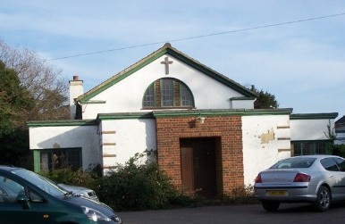
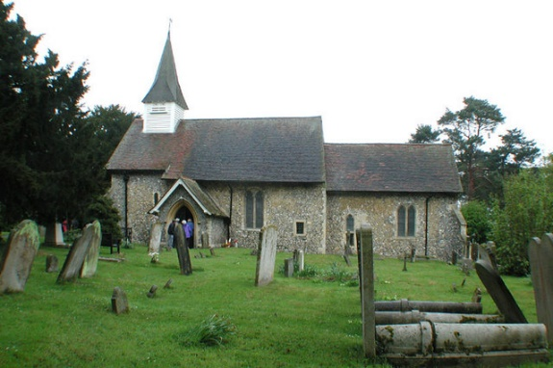
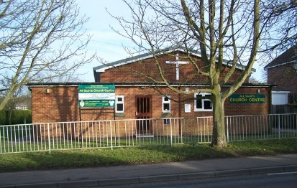
^{Synod 11 Southern}
^{Hartley United Reformed Church}
^{Hartley}
^{25 September 2016}

Slide 36
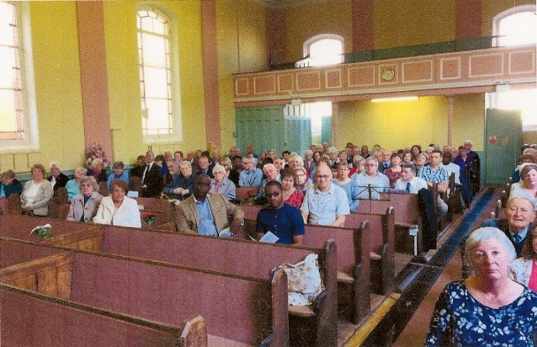
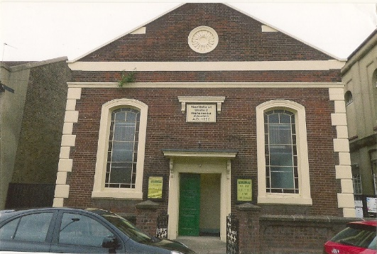
^{Synod 11 Southern}
Northfleet United Reformed Church
^{Northfleet}
^{2nd April 2017}

Slide 37
^{Synod 12: Wales}
^{Caersalem United Church}
^{Ebbw Vale}
^{18 April 2017}
Noting that the URC withdrew from the local ecumenical partnership on 18 April 2017 but that it continues as a
^{Baptist church}

Slide 38
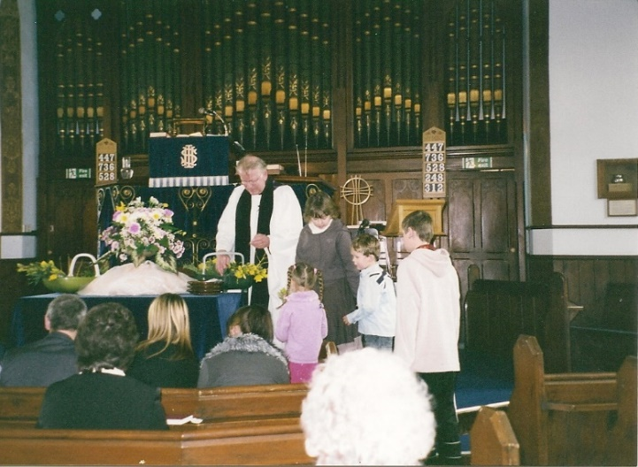
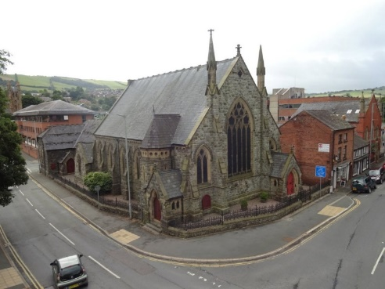
^{Synod 12: Wales}
^{Newtown United Reformed Church}
^{Newtown}
^{24 July 2016}

Slide 39
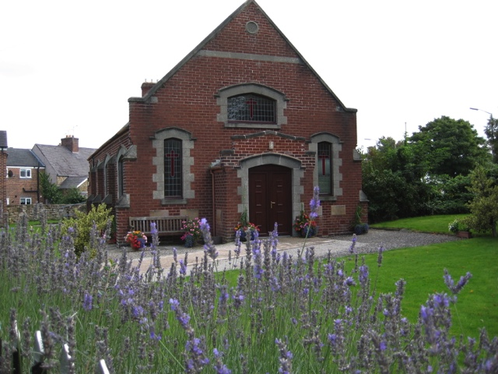
^{Synod 12: Wales}
^{Northop United Reformed Church}
^{Northop}
^{5 November 2017}

Slide 40

^{Synod 12: Wales}
^{Porth United Reformed Church}
^{Porth}
^{15 May 2016}

Slide 41

^{Synod 12: Wales}
^{Wesley United Reformed Church}
^{Abercynon}
^{14 January 2017}

Slide 42



^{Synod 13: Synod of Scotland}
Portobello United Reformed Church
^{Edinburgh}
^{30 April 2016}

Slide 43



^{Synod 13: Synod of Scotland}
^{Selkirk United Reformed Church}
^{Selkirk}
^{17 December 2017}

