Slide 1

Jubilee Ministers 2018
Notes:
11.36 minutes.

Slide 2
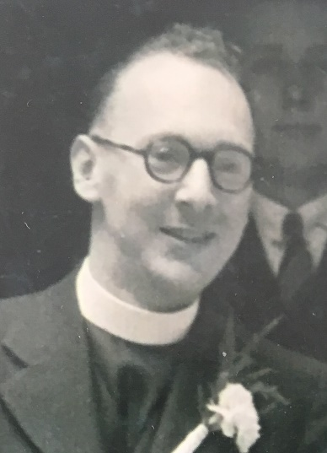
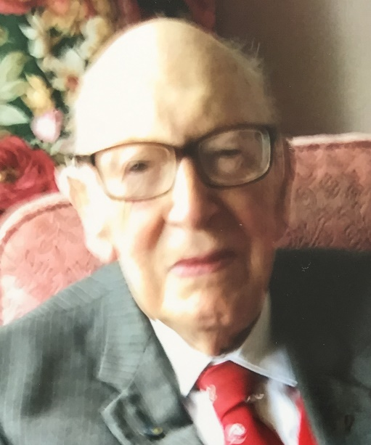
70 years Norman Jenkinson Synod 11 Southern 27/6/1948

Slide 3
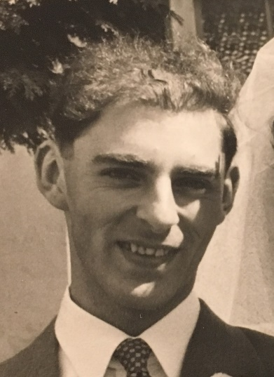
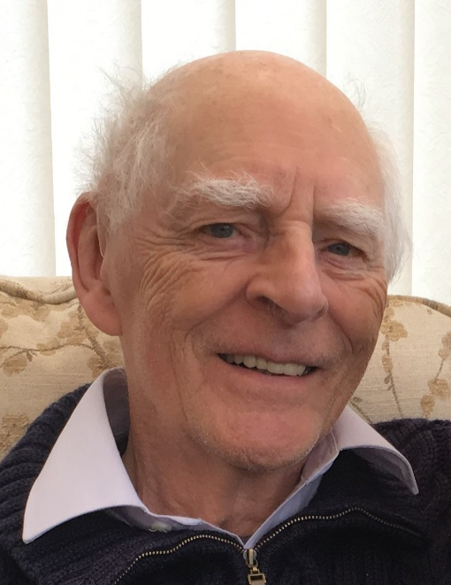
61 years John Cohen Synod 8 South Western 5/3/1957

Slide 4
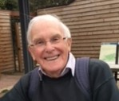
61 years John Sutcliffe Synod 6 West Midlands 27/6/1957

Slide 5
61 years Brian Bailey Synod 2 North Western 1/7/1957

Slide 6
61 years Vivian Buddle Synod 1 Northern 1/7/1957

Slide 7
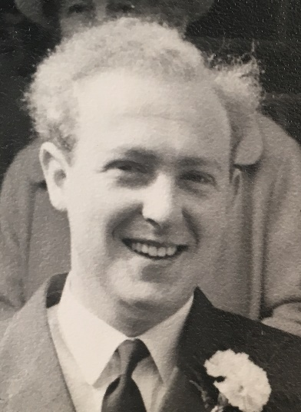
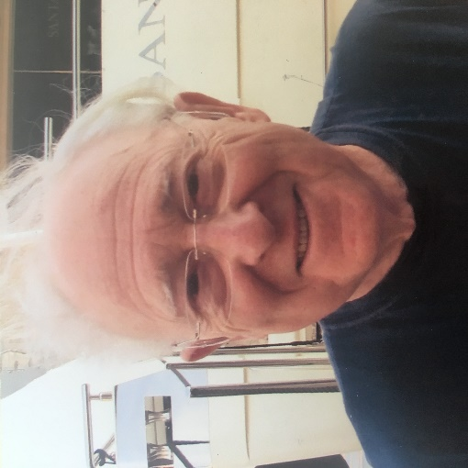
61 years Alan Coles Synod 2 North Western 1/7/1957

Slide 8
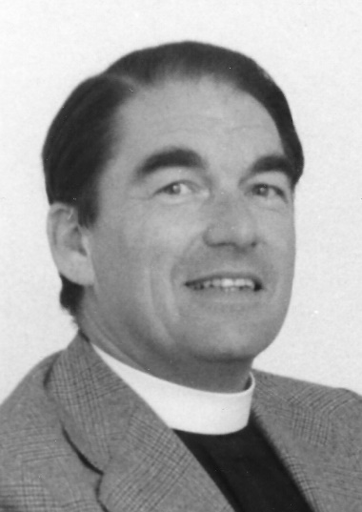
61 years Michael Lay Synod 10 Thames North 1/7/1957

Slide 9
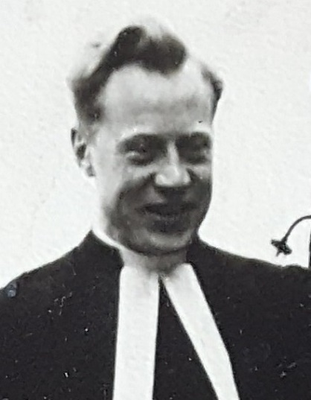
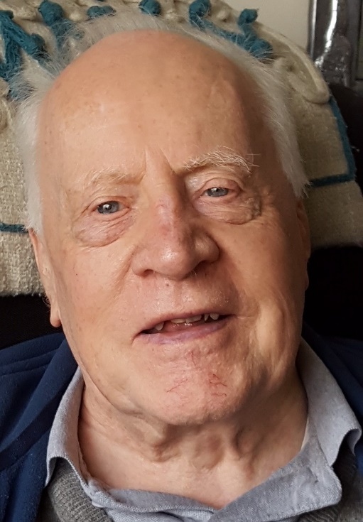
61 years Brian Pavitt Synod 11 Southern 1/7/1957

Slide 10
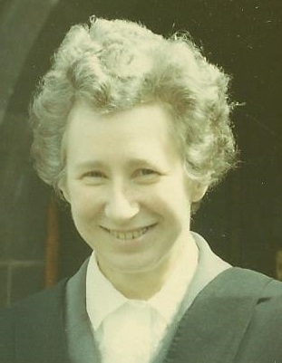
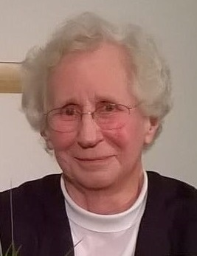
61 years Jean Wilkinson Synod 10 Thames North 1/7/1957

Slide 11
61 years Kenneth Hall Synod 2 North Western 4/7/1957

Slide 12
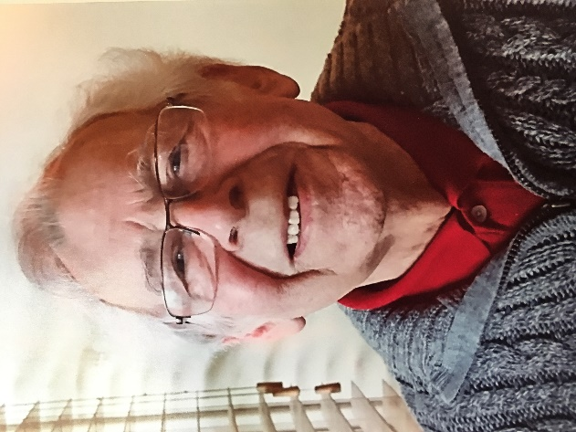
61 years Ambrose Wright Synod 8 South Western 12/7/1957

Slide 13
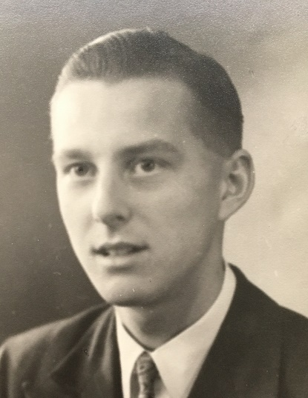
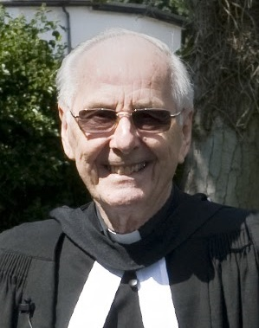
61 years Roy Bones Synod 9 Wessex 20/7/1957

Slide 14
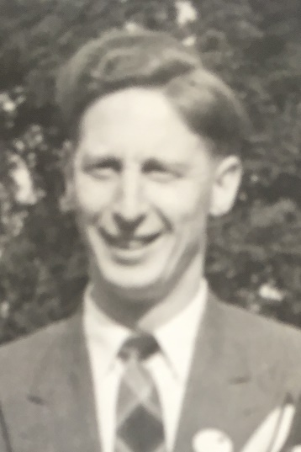
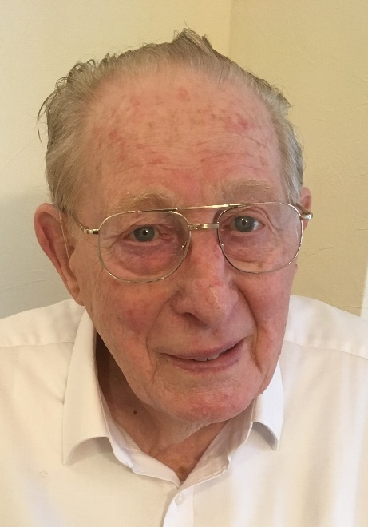
61 years James Garrow Synod 6 West Midlands 4/8/1957

Slide 15
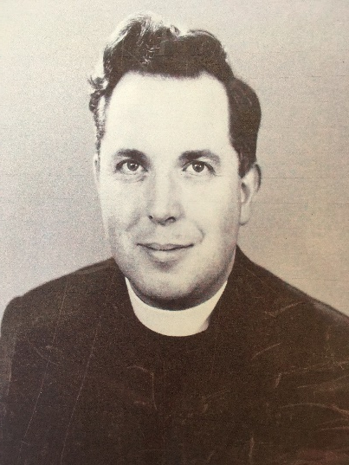
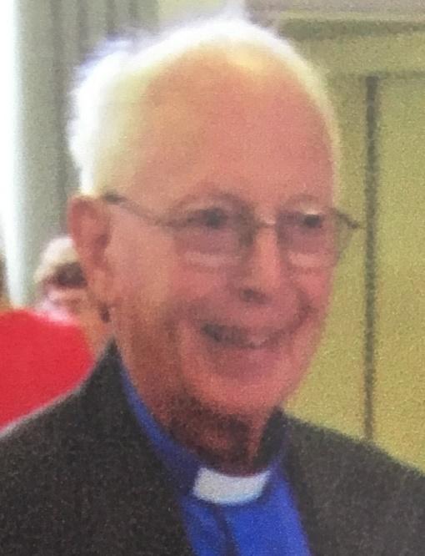
61 years John Slow Synod 5 East Midlands 31/8/1957

Slide 16
61 years Hamish Walker Synod 13 Scotland 1/9/1957

Slide 17
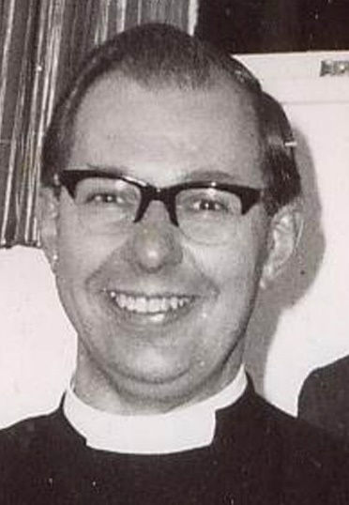
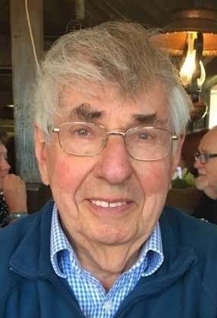
61 years Paul Fuller Synod 5 East Midlands 14/9/1957

Slide 18
60 years George Towson Synod 13 Scotland 1/3/1958

Slide 19
60 years Samuel Williams Synod 9 Wessex 18/6/1958

Slide 20
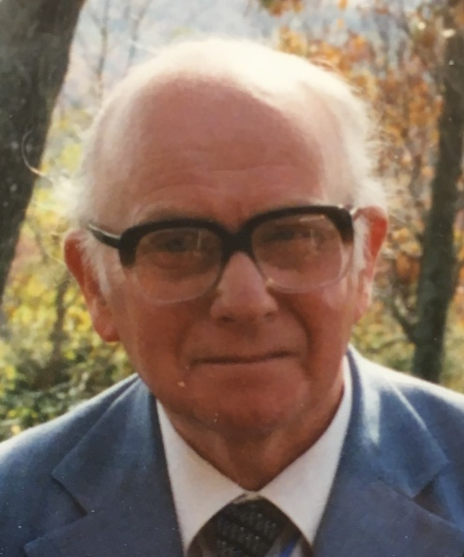
60 years Keith Havers Synod 11 Southern 1/7/1958

Slide 21
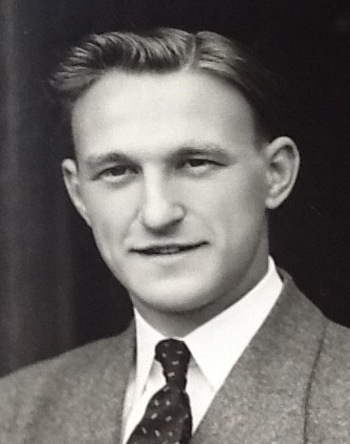
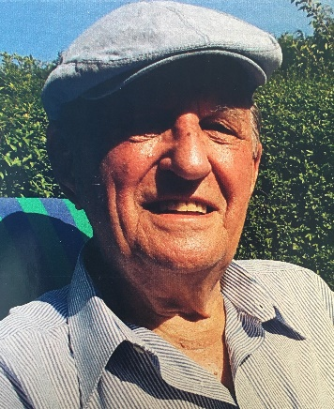
60 years Raymond Royston-Bishop Synod 4 Yorkshire 1/7/1958

Slide 22
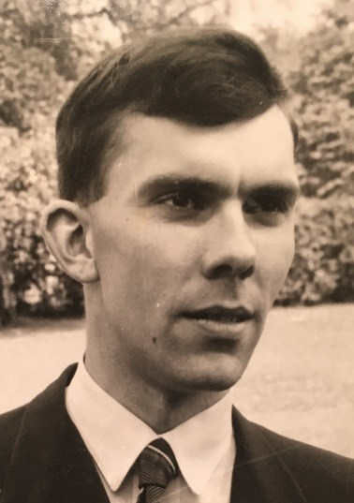
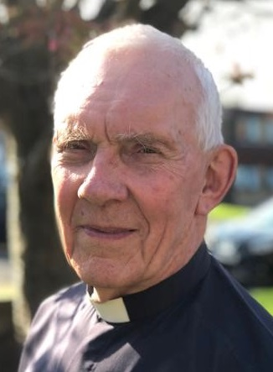
60 years George Sharpe Synod 2 North Western 1/7/1958

Slide 23
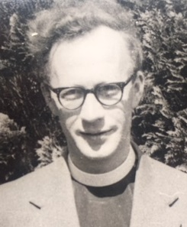
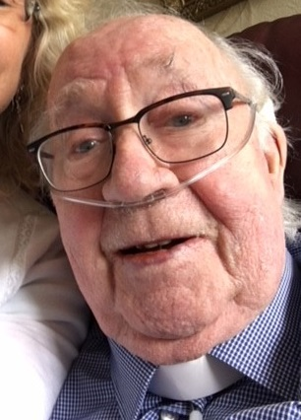
60 years Geoffrey Tillison Synod 4 Yorkshire 1/7/1958

Slide 24
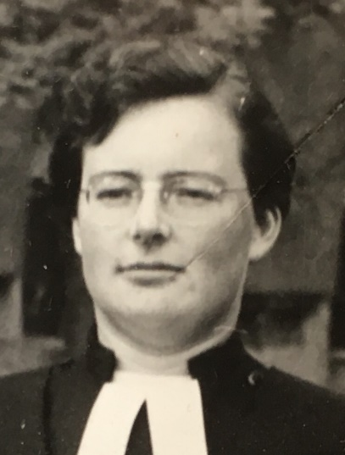
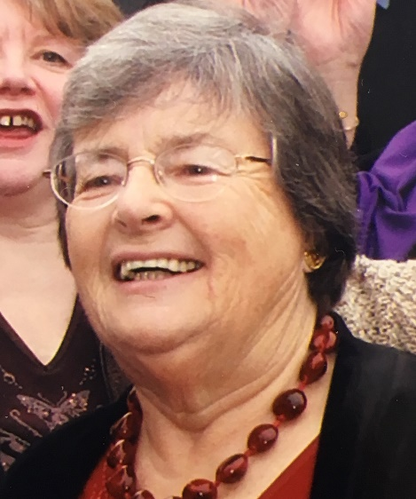
60 years Janet Webber Synod 8 South Western 2/7/1958

Slide 25
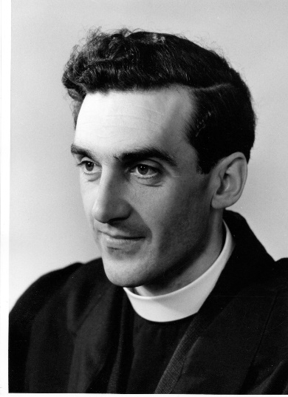
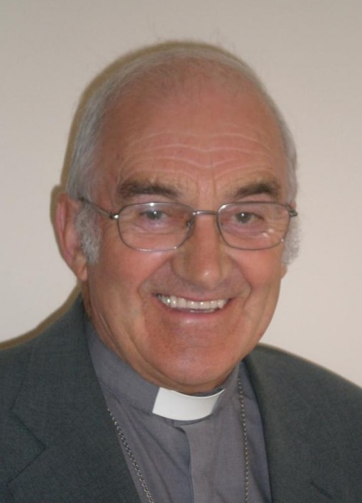
60 years John Carrier Synod 6 West Midlands 5/7/1958

Slide 26
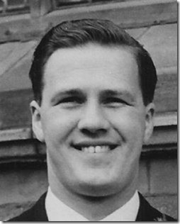
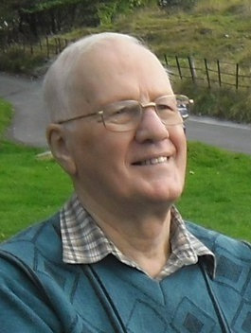
60 years Alan Gaunt Synod 3 Mersey 9/7/1958

Slide 27
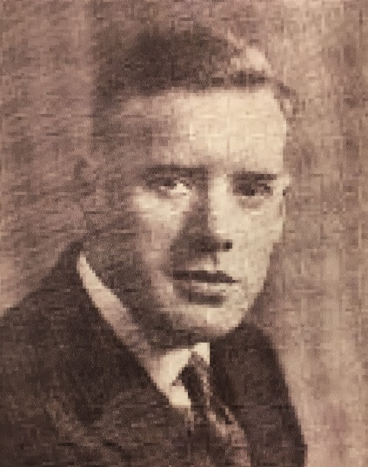
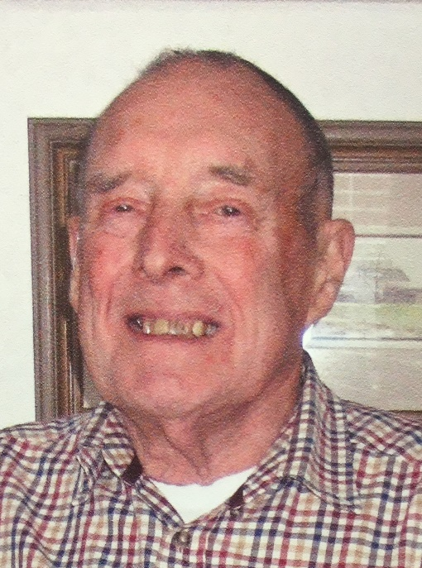
60 years Anthony R Ashcroft Synod 13 Scotland 2/9/1958

Slide 28
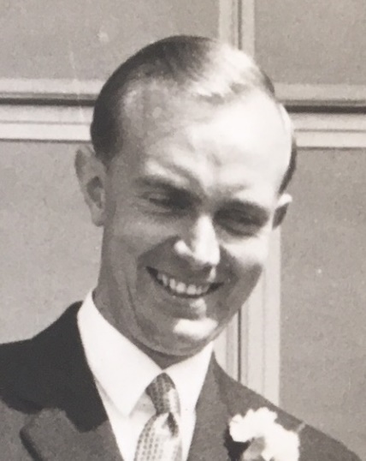
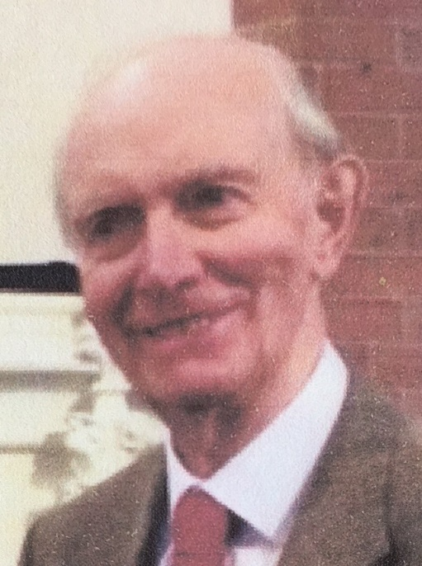
60 years Alan Green Synod 9 Wessex 17/9/1958

Slide 29
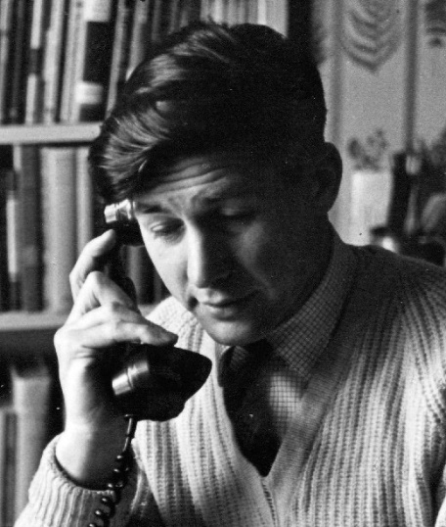
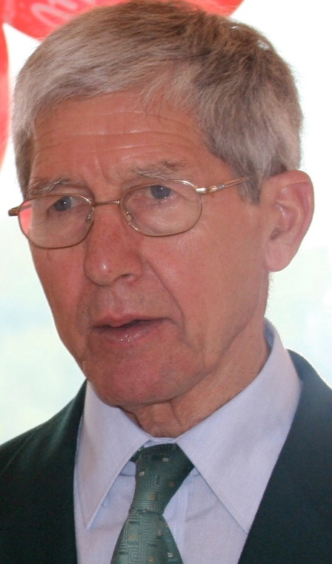
51 years Derek Wales Synod 11 Southern 18/2/1967

Slide 30
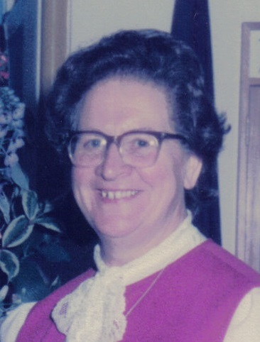
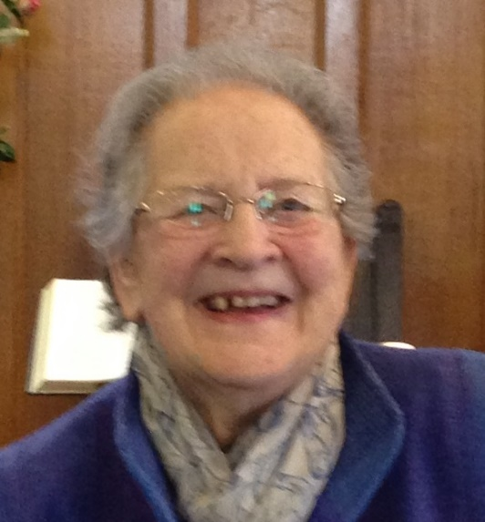
51 years Betty Williams Synod 9 Wessex 5/5/1967

Slide 31
51 years Stephen Haine Synod 10 Thames North 1/7/1967

Slide 32
51 years John Heywood-Thomas Synod 12 Wales 1/7/1967

Slide 33
51 years Thomas Lowe Synod 7 Eastern 1/7/1967

Slide 34
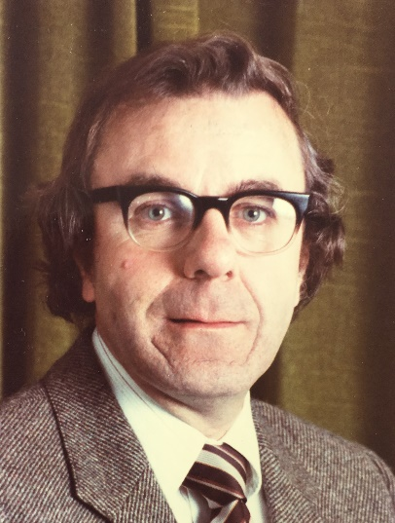
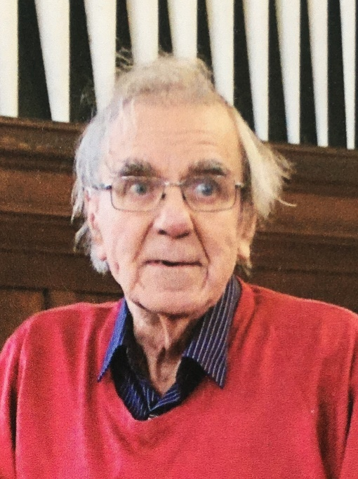
51 years Derek Nuttall Synod 11 Southern 1/7/1967

Slide 35
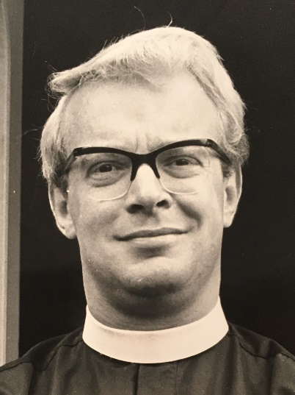
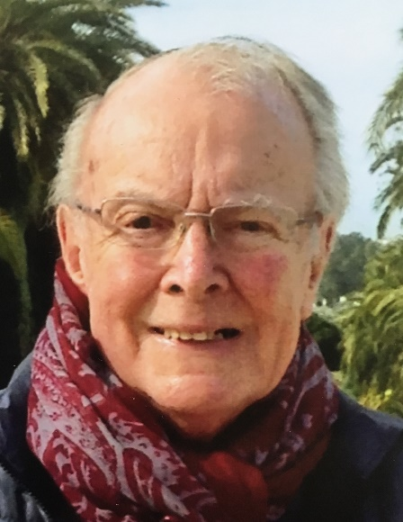
51 years Kenneth Wilkinson Synod 8 South Western 15/7/1967

Slide 36
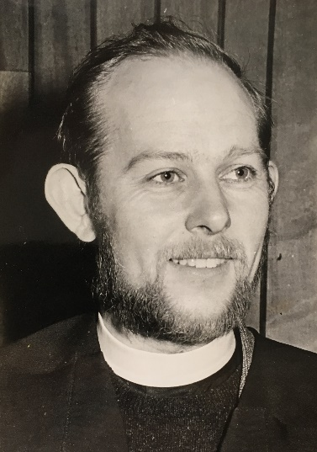
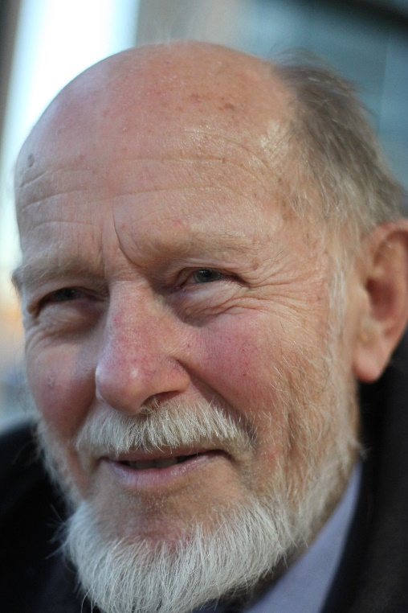
51 years Brian Eyles Synod 8 South Western 18/7/1967

Slide 37
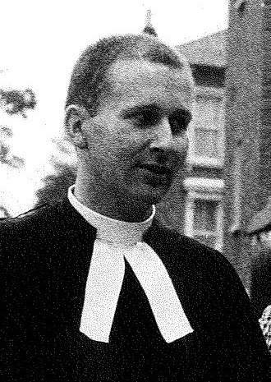
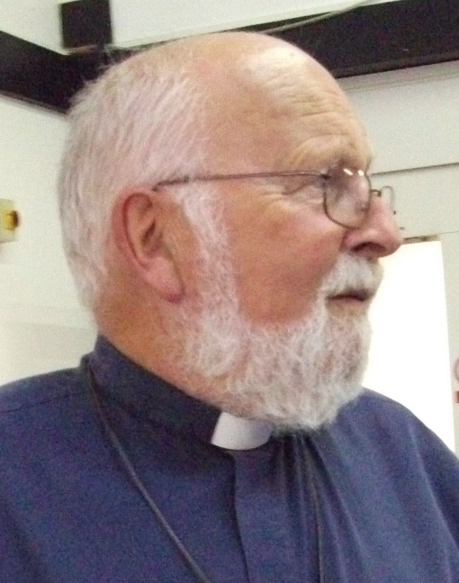
51 years Michael Playdon Synod 5 East Midlands 28/7/1967

Slide 38


51 years Geoffrey Tolley Synod 2 North Western 28/7/1967

Slide 39


51 years Eric Kirkman Synod 3 Mersey 8/8/1967

Slide 40


51 years David Hudston Synod 4 Yorkshire 20/8/1967

Slide 41


51 years Bill Mahood Synod 7 Eastern 4/9/1967

Slide 42

51 years Patrick Lidgett Synod 5 East Midlands 9/9/1967

Slide 43


51 years Brian Holroyd Synod 3 Mersey 16/9/1967

Slide 44


51 years Christopher Baker Synod 7 Eastern 23/9/1967

Slide 45


51 years Norman Edsall Synod 9 Wessex 23/9/1967

Slide 46


51 years John Marsh Synod 6 West Midlands 23/9/1967

Slide 47

51 years Peter Poulter Synod 4 Yorkshire 28/9/1967

Slide 48
51 years Tony Bradshaw Synod 5 East Midlands 7/10/1967

Slide 49


51 years Brian Rawling Synod 9 Wessex 6/12/1967

Slide 50


51 years John Morgans Synod 12 Wales 7/12/1967

Slide 51


50 years David Jenkins Synod 2 North Western 6/1/1968

Slide 52


50 years Peter McIntosh Synod 11 Southern 27/2/1968

Slide 53
50 years Gerrit Bakker Synod 5 East Midlands 17/4/1968

Slide 54


50 years David Laing Synod 13 Scotland 31/5/1968

Slide 55


50 years Keith Jones Synod 12 Wales 7/6/1968

Slide 56
50 years David Russell Synod 10 Thames North 1/7/1968

Slide 57
50 years Peter Thomas Synod 5 East Midlands 1/7/1968

Slide 58


50 years Clifford Wilton Synod 4 Yorkshire 1/7/1968

Slide 59


50 years Julian Macro Synod 9 Wessex 7/7/1968

Slide 60


50 years Jeffrey Evans Synod 9 Wessex 9/7/1968

Slide 61

50 years Duncan Wilson Synod 9 Wessex 13/7/1968

Slide 62


50 years David Netherwood Synod 9 Wessex 16/7/1968

Slide 63


50 years Michael Diffey Synod 8 South Western 2/8/1968

Slide 64
50 years Frank Beattie Synod 9 Wessex 3/8/1968

Slide 65


50 years David Langford Synod 9 Wessex 31/8/1968

Slide 66


50 years John Robinson Synod 8 South Western 31/8/1968

Slide 67
50 years Bill Boyd Synod 6 West Midlands 1/9/1968

Slide 68


50 years John Hall Synod 6 West Midlands 1/9/1968

Slide 69


50 years Keith Argyle Synod 2 North Western 4/9/1968

Slide 70


50 years Richard Wells Synod 7 Eastern 14/9/1968

Slide 71


50 years Peter Brain Synod 8 South Western 19/9/1968

Slide 72


50 years Bill Wright Synod 3 Mersey 1/10/1968

Slide 73


50 years Stephen Orchard Synod 5 East Midlands 5/10/1968

Slide 74

50 years Margaret Howard Synod 8 South Western 8/12/1968

Slide 75
And finally…

Slide 76

100 years old Geoffrey Beck Synod 11 Southern 16/06/1918

