Slide 1


Thought that Stewardship
was just about money?

Slide 2
Stewardship is about the relationship between
Christian living and Christian giving
Stewardship is the response to God’s giving in Jesus Christ.
It is about giving, about giving ourselves, without reserve,
to achieve God’s purposes of love.
Stewardship acknowledges that all that we have first comes
from God and then poses the question how do we respond
and use the gifts that He has given us?
Stewardship identifies ten main areas relating to God’s gifts
and our responses. This leaflet is an introduction to them.

Slide 3


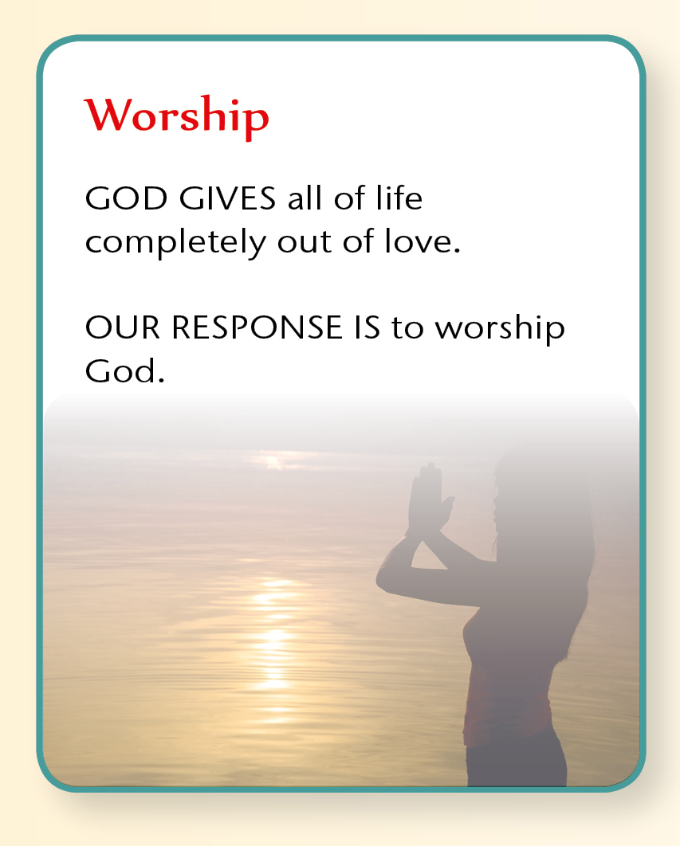


Slide 4

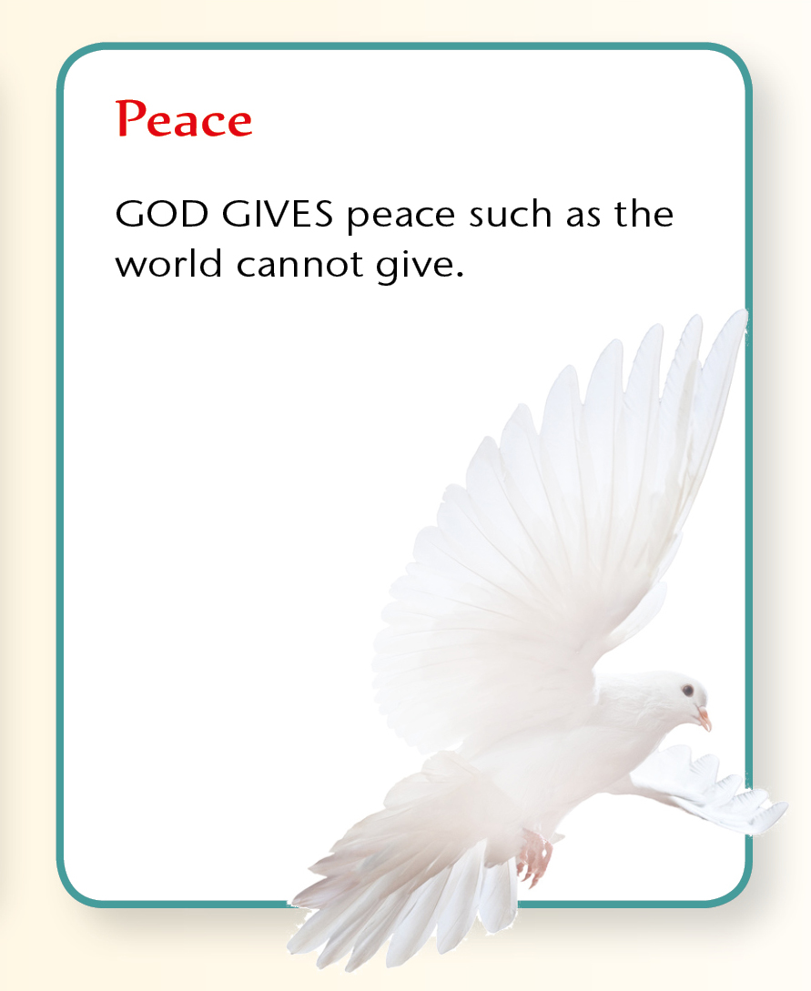
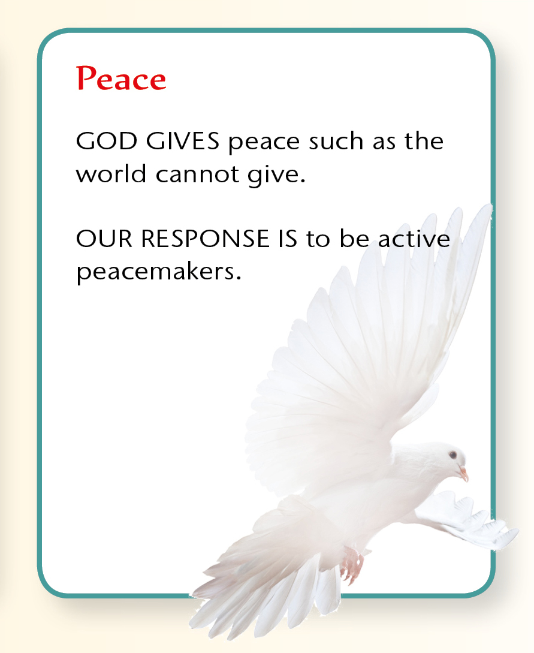


Slide 5
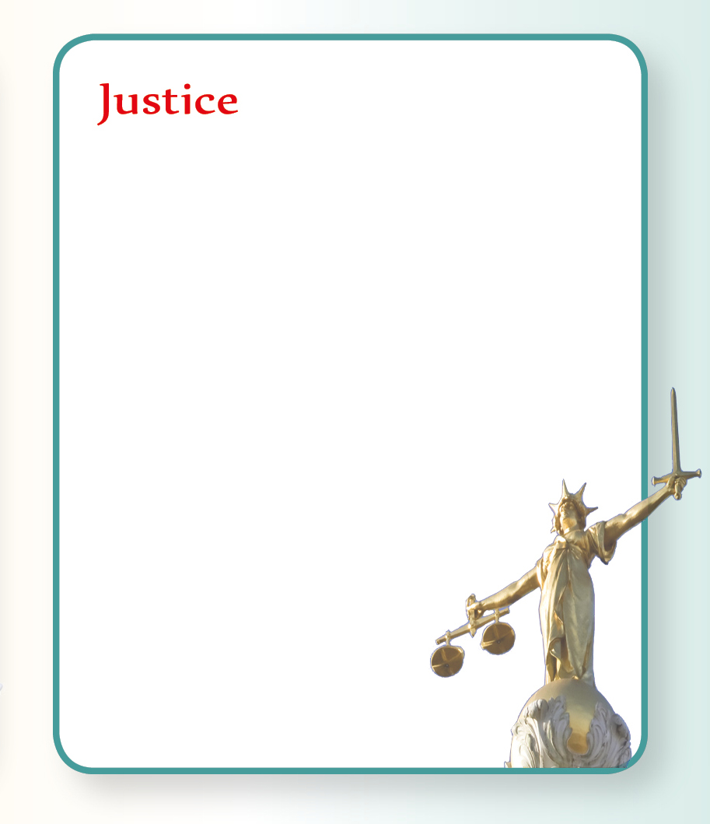
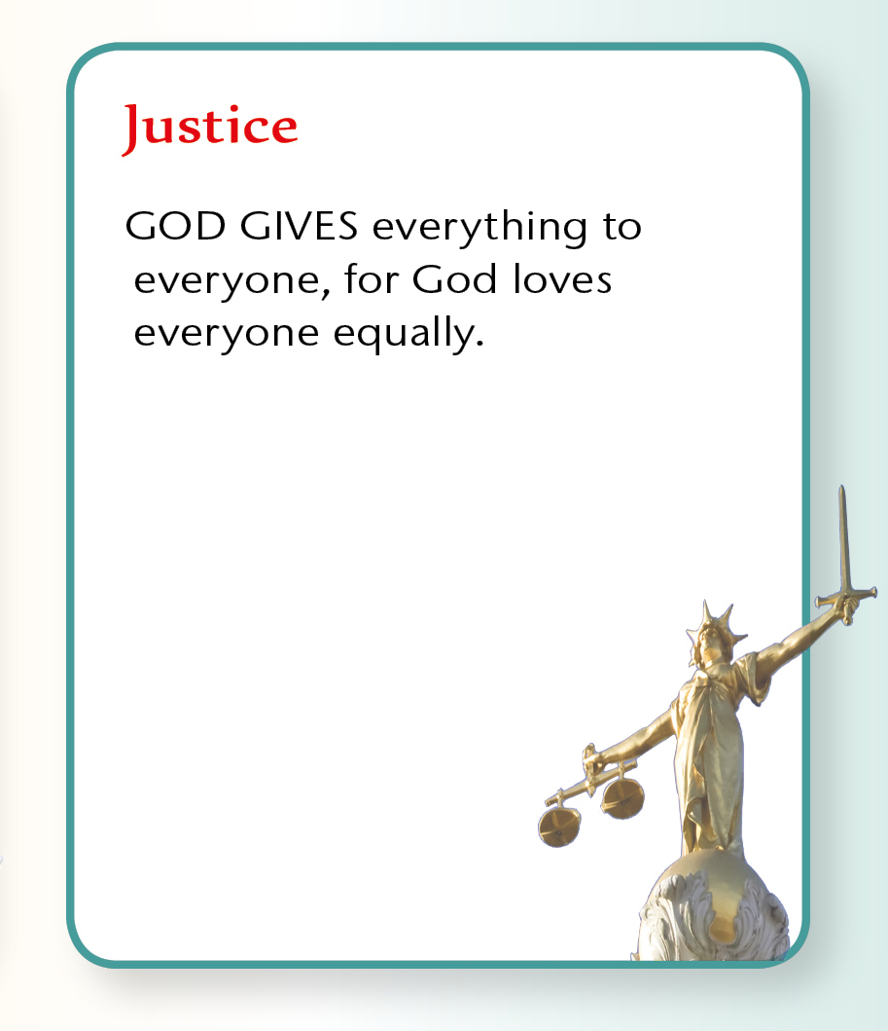
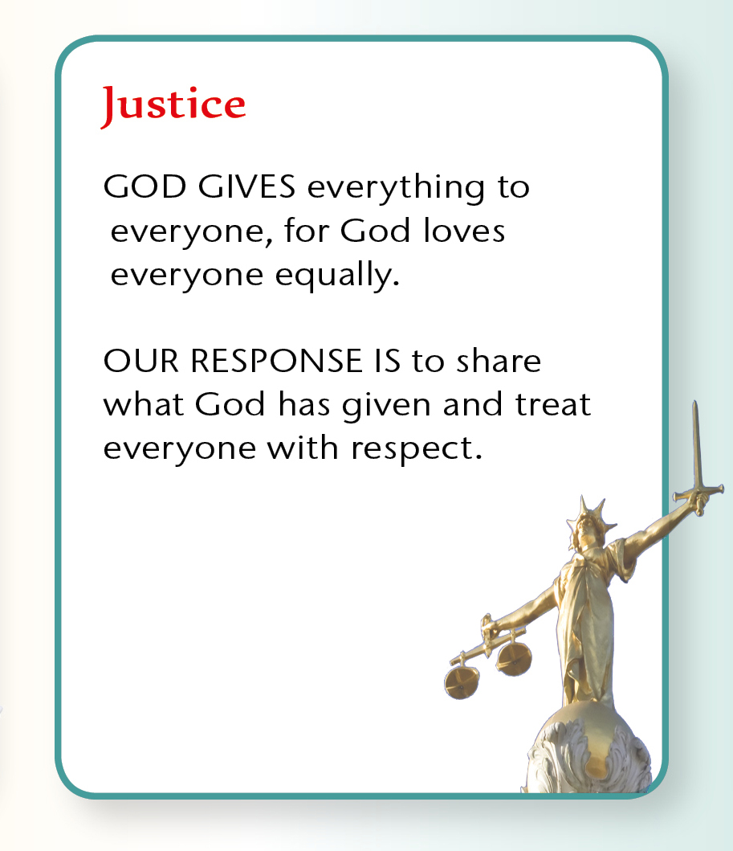


Slide 6

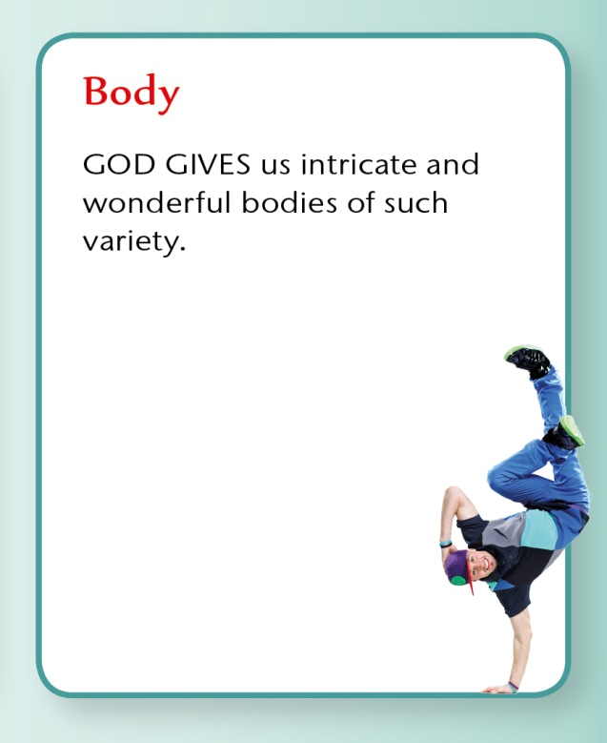
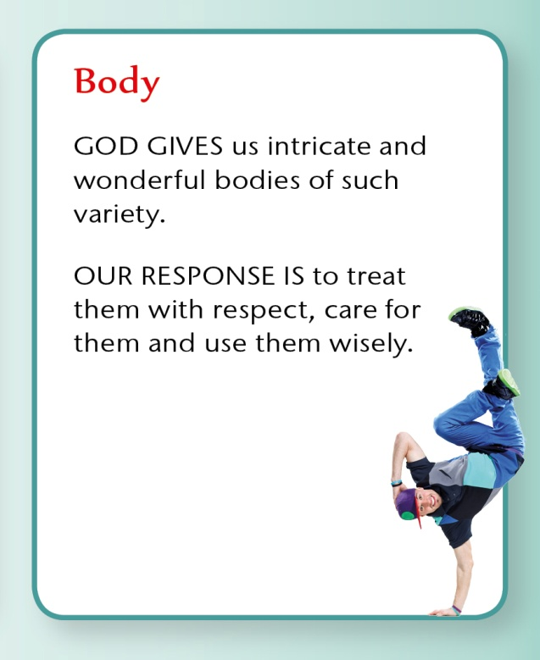
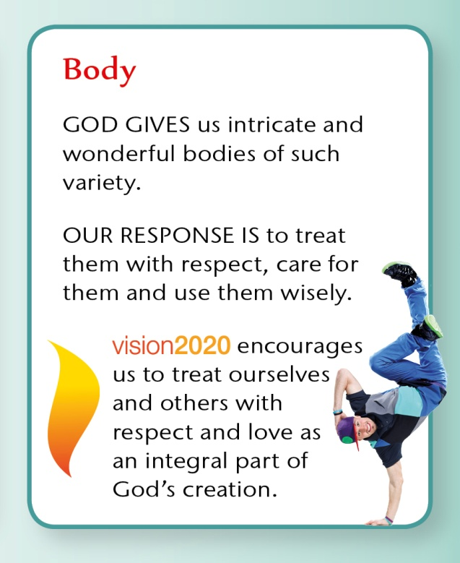

Slide 7

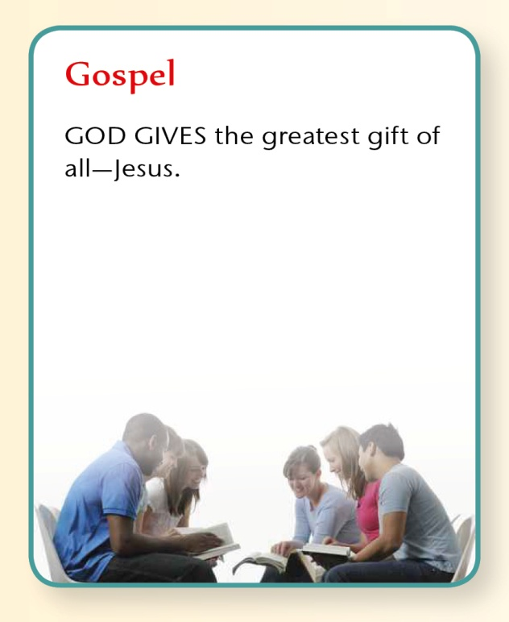
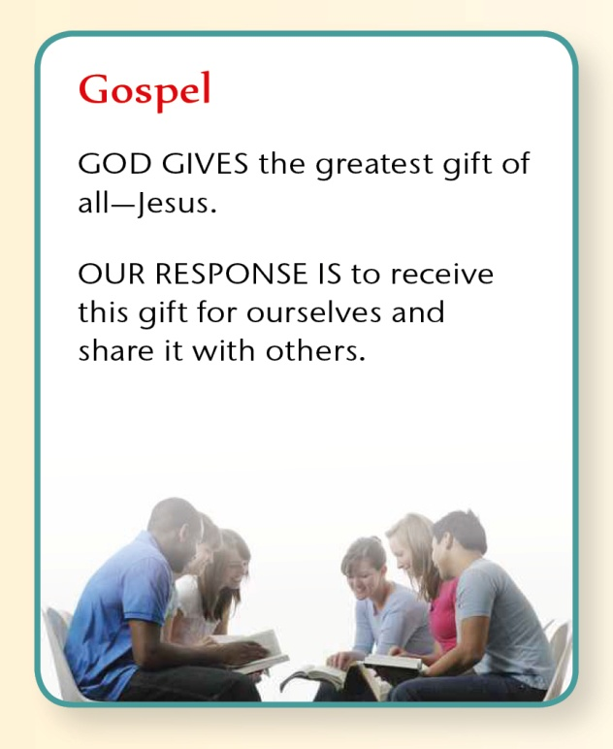


Slide 8

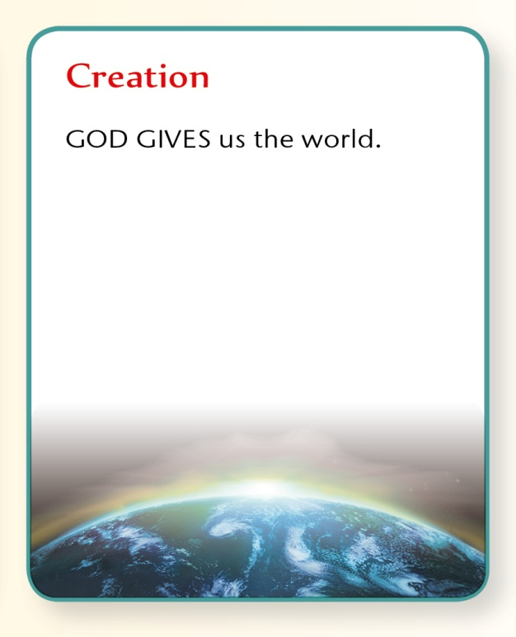
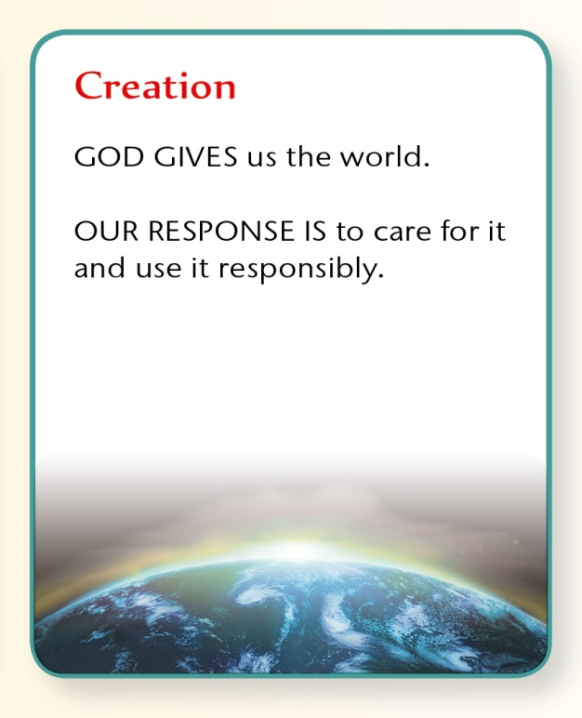


Slide 9
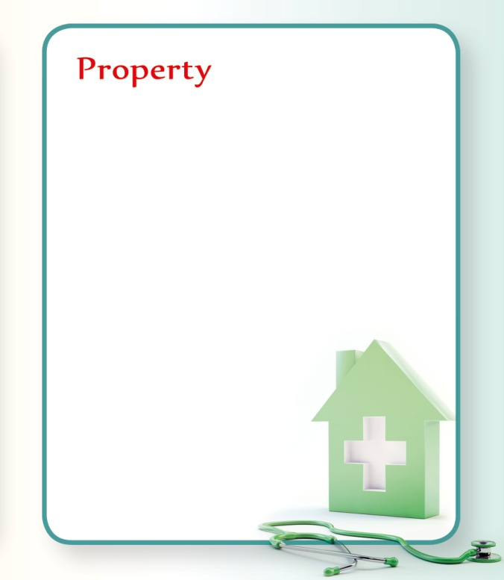
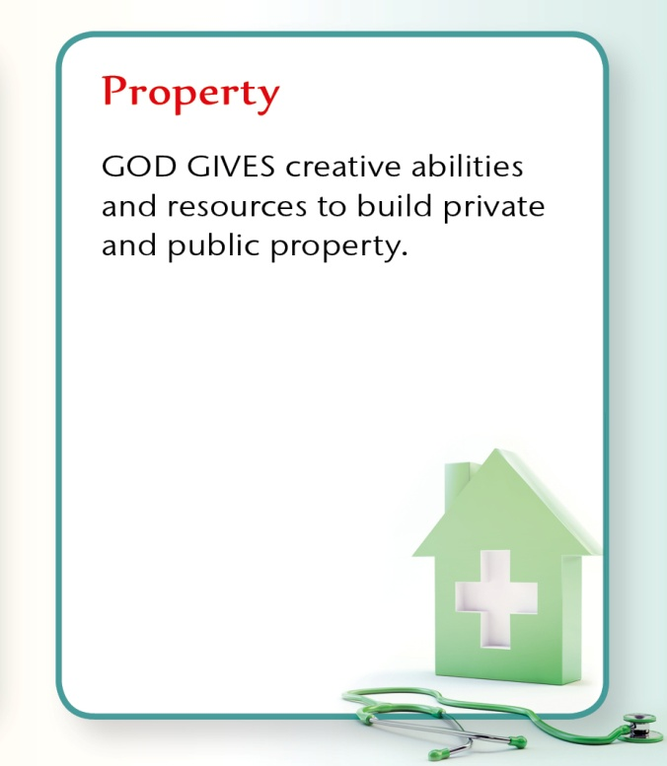
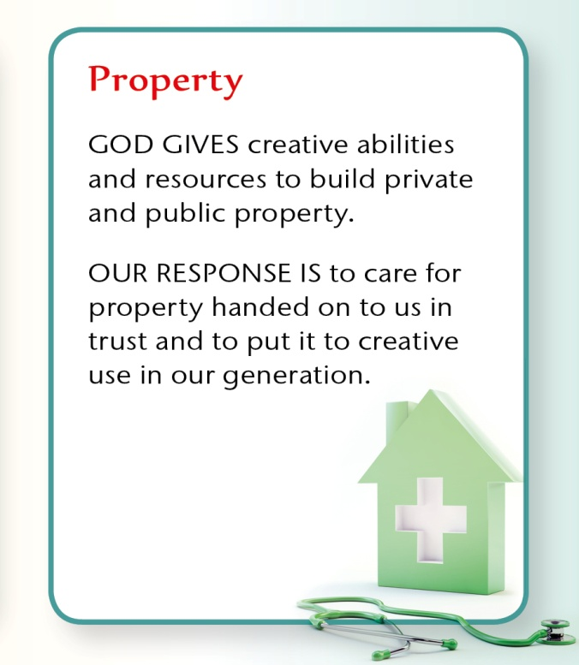


Slide 10

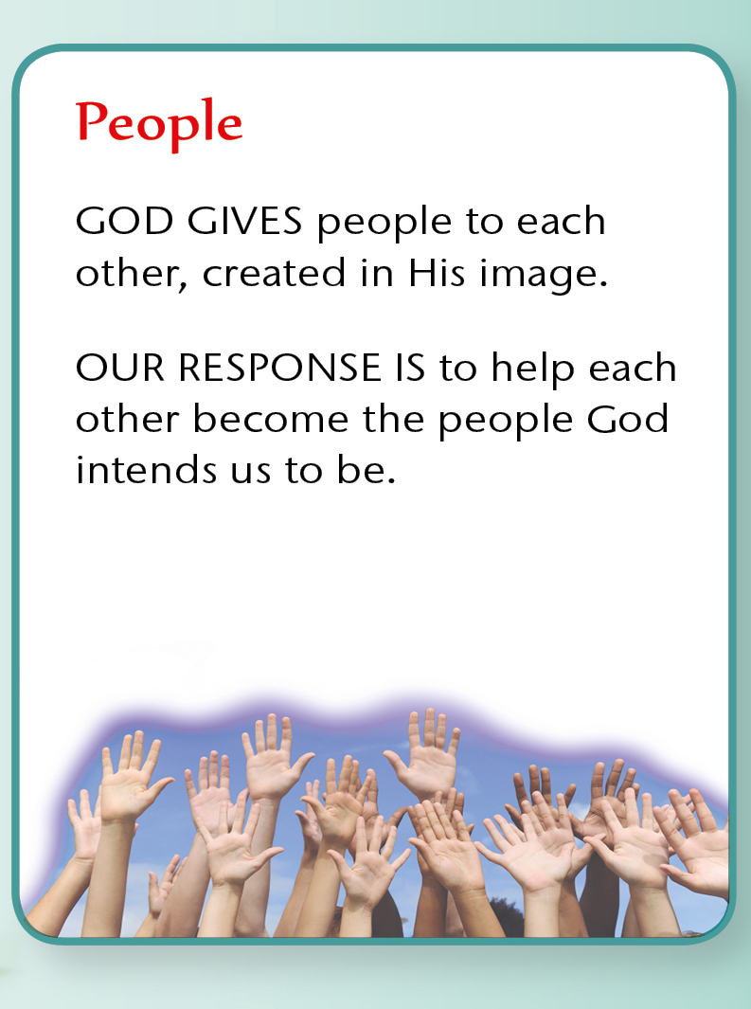

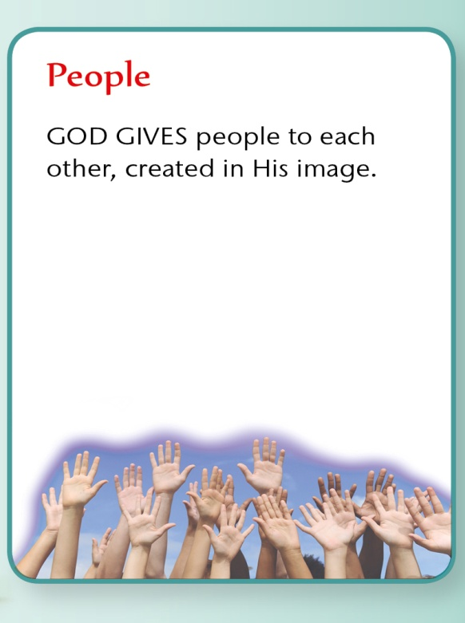

Slide 11

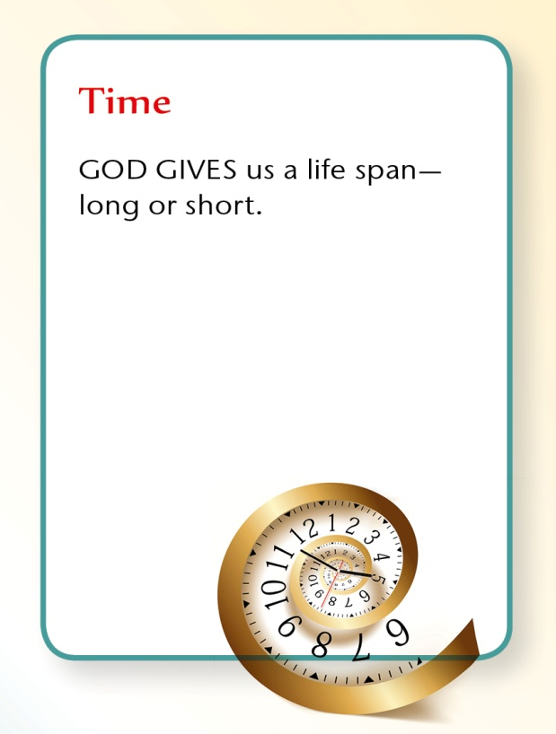
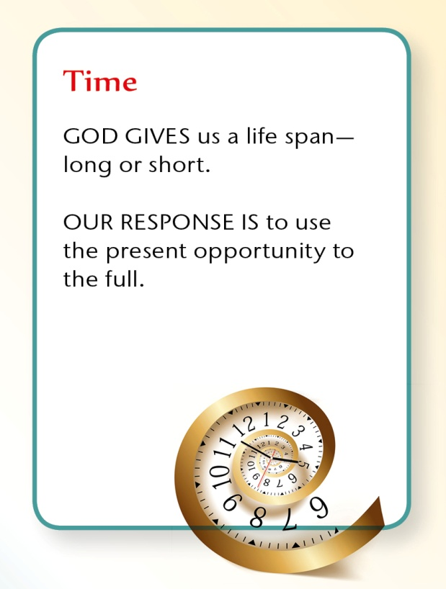
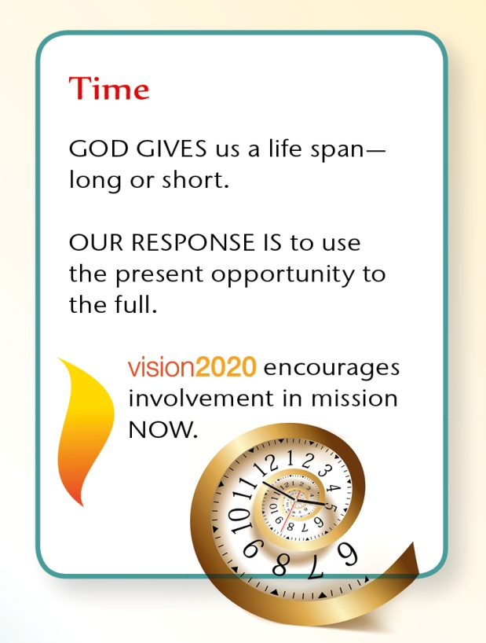

Slide 12

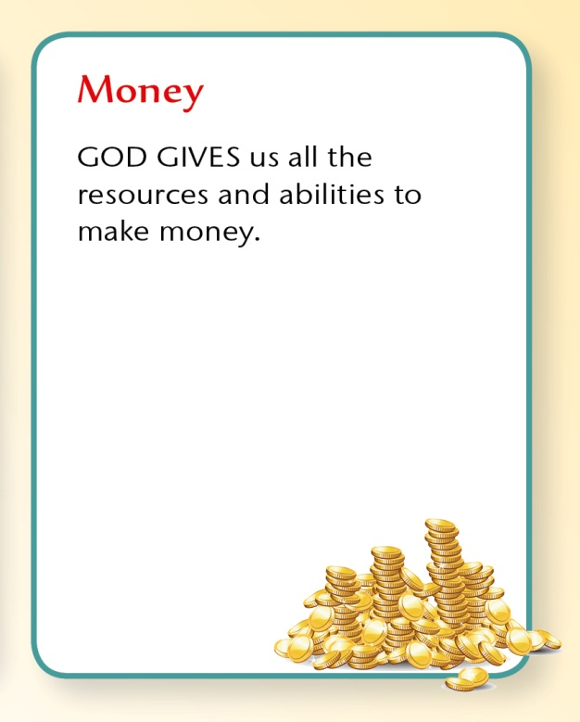
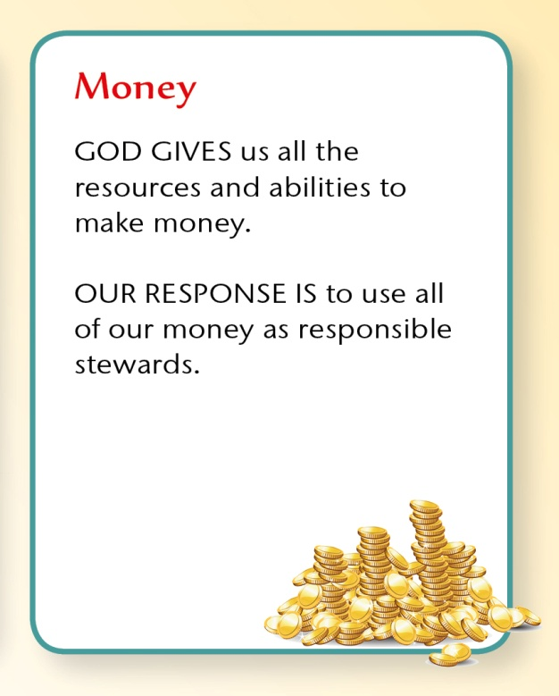
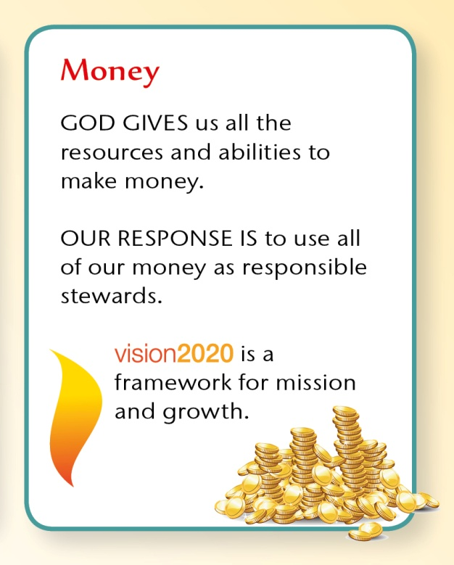

Slide 13
And God is able to make all grace abound toward you, that you, always having all sufficiency in all things, may have an abundance for every good work.
^{2 Corinthians 9 v 8}
For information about stewardship resources, Bible studies, giving programmes and much more contact: stewardship@urc.org.uk
For information about vision2020 visit: www.urc.org.uk

