Slide 1


Dr whatSit’s
Detective Challenge
Notes:
Mini challenge instructions
This is an identification game. Timothy was young person who with encouragement of others was able to things he did not think he could do. How many gift and talents can they spot from the pictures in a minute and what can people in the group do(it does not have to be one of the pictures!)

Slide 2
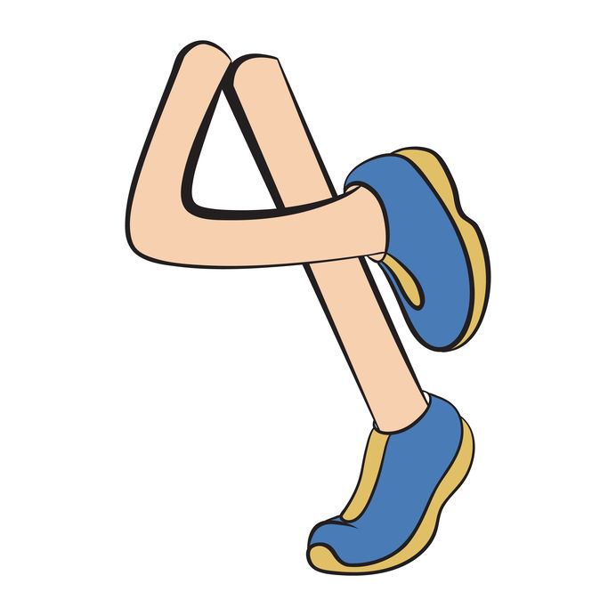

Hands and Feet
What gifts and talents can you spot?

Slide 3


