Slide 1


Dr whatsit’s Detective Challenge
Notes:
Mini challenge instructions

Slide 2
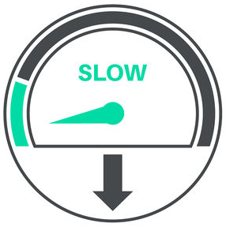

Fast and slow
Can you identify the doing and the sitting activities?
Notes:
Challenge
Which items are full speed ahead and which items are slow down? Set the minute timer going and see how many you can identify from the photos. I wonder if some are both ?

Slide 3
