Slide 1
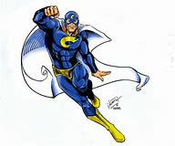
A hero is somebody who stops things being bad,
A villain is the opposite and that is really sad.
So listen to me now and I will show you how,
You don’t need a cape to be a hero.

Slide 2
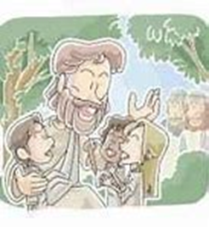
Chorus You don’t need a cape to be a hero,
Or wear your underpants over your tights.
Just try to do some good, cos Jesus thinks you should,
No, you don’t need a cape to be a hero

Slide 3
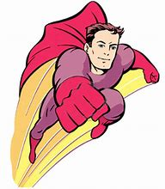
You don’t need to fly to be a hero,
Your feet they can stay firmly on the ground.
You can’t fly like a bird, cos that would be absurd.
You don’t need to fly to be a hero

Slide 4
Chorus You don’t need a cape to be a hero,
Or wear your underpants over your tights.
Just try to do some good, cos Jesus thinks you should,
No, you don’t need a cape to be a hero

Slide 5
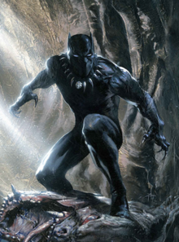
You don’t need a mask to be a hero.
It doesn’t matter folk know who you are.
To undertake the task you don’t need to wear a mask.
You don’t need a mask to be a hero

Slide 6
Chorus You don’t need a cape to be a hero,
Or wear your underpants over your tights.
Just try to do some good, cos Jesus thinks you should,
No, you don’t need a cape to be a hero

Slide 7
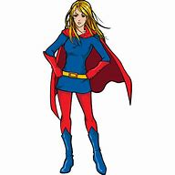
You don’t need special clothes to be a hero.
Just wear the clothes that you wear every day.
I’m telling you the truth, you are not bulletproof,
You don’t need special clothes to be a hero

Slide 8
Chorus You don’t need a cape to be a hero,
Or wear your underpants over your tights.
Just try to do some good, cos Jesus thinks you should,
No, you don’t need a cape to be a hero

Slide 9
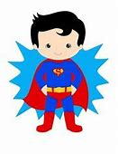
You don’t need superpowers to be a hero.
For God has made you perfect as you are.
I don’t think you oughta try to breathe while underwater.
You don’t need superpowers to be a hero.
Words and music by Leo Roberts

Slide 10

Chorus You don’t need a cape to be a hero,
Or wear your underpants over your tights.
Just try to do some good, cos Jesus thinks you should,
No, you don’t need a cape to be a hero

