Slide 1


Dr whatsit’s
Detective Challenge
Notes:
Mini challenge instructions

Slide 2
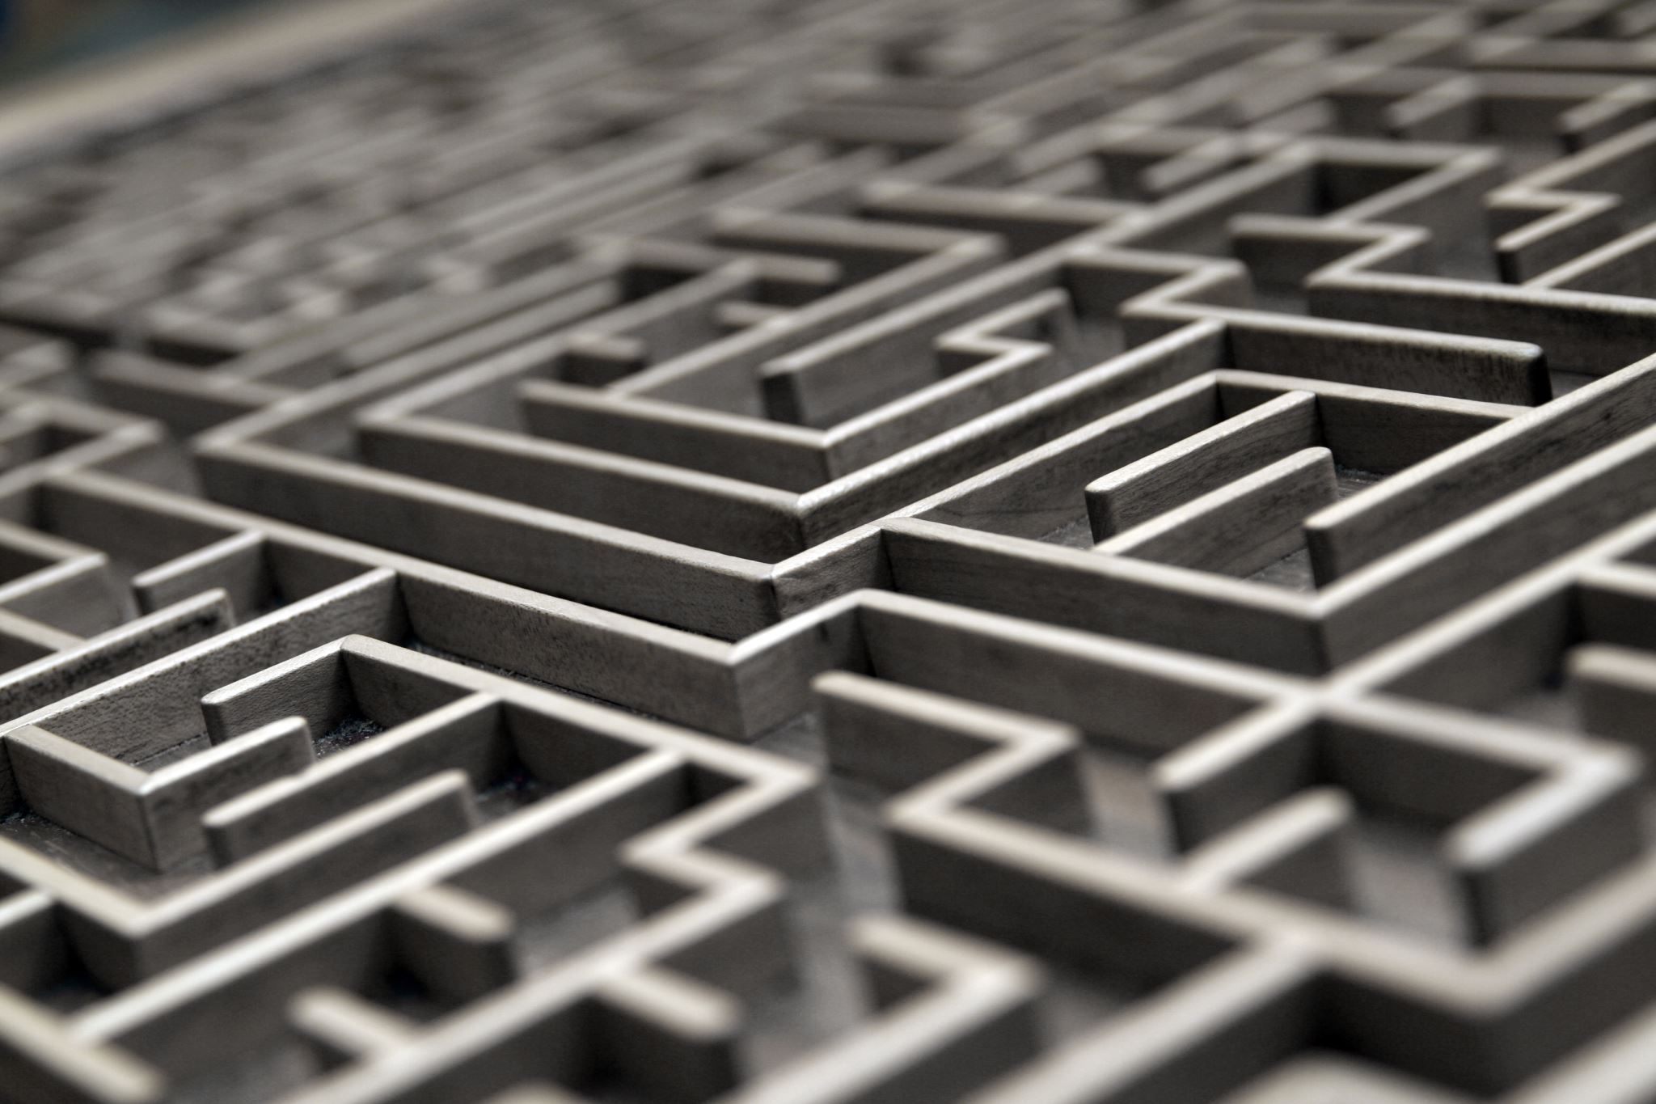
Seeing things differently
Can you detect what the item is?
Notes:
Challenge
Seeing things differently thinking about how Esther saw things in a different way. There are a series of items shown from a different angle or a zoomed in pictures. How many can you identify?

Slide 3
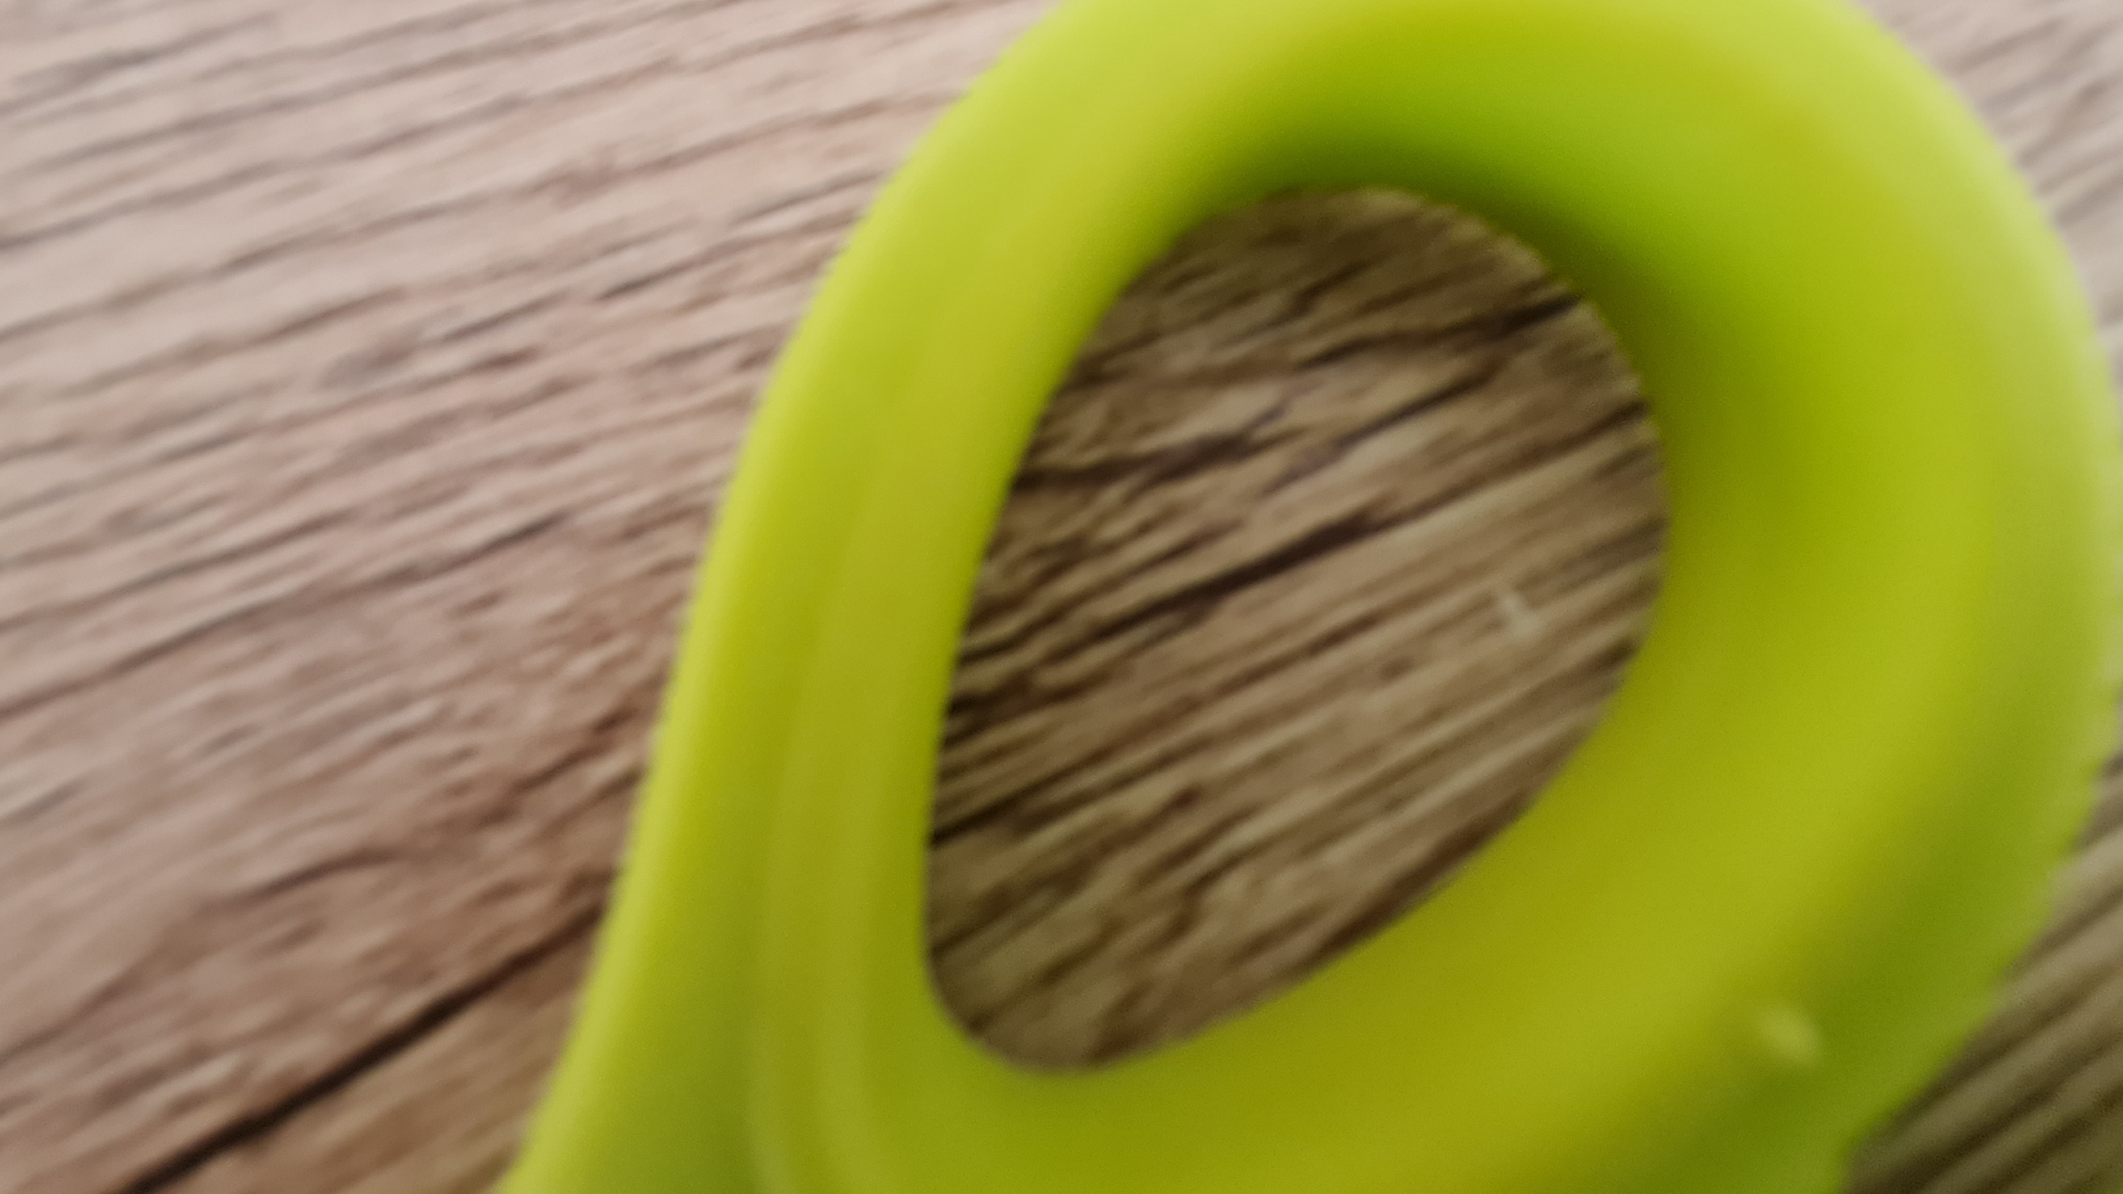

Slide 4
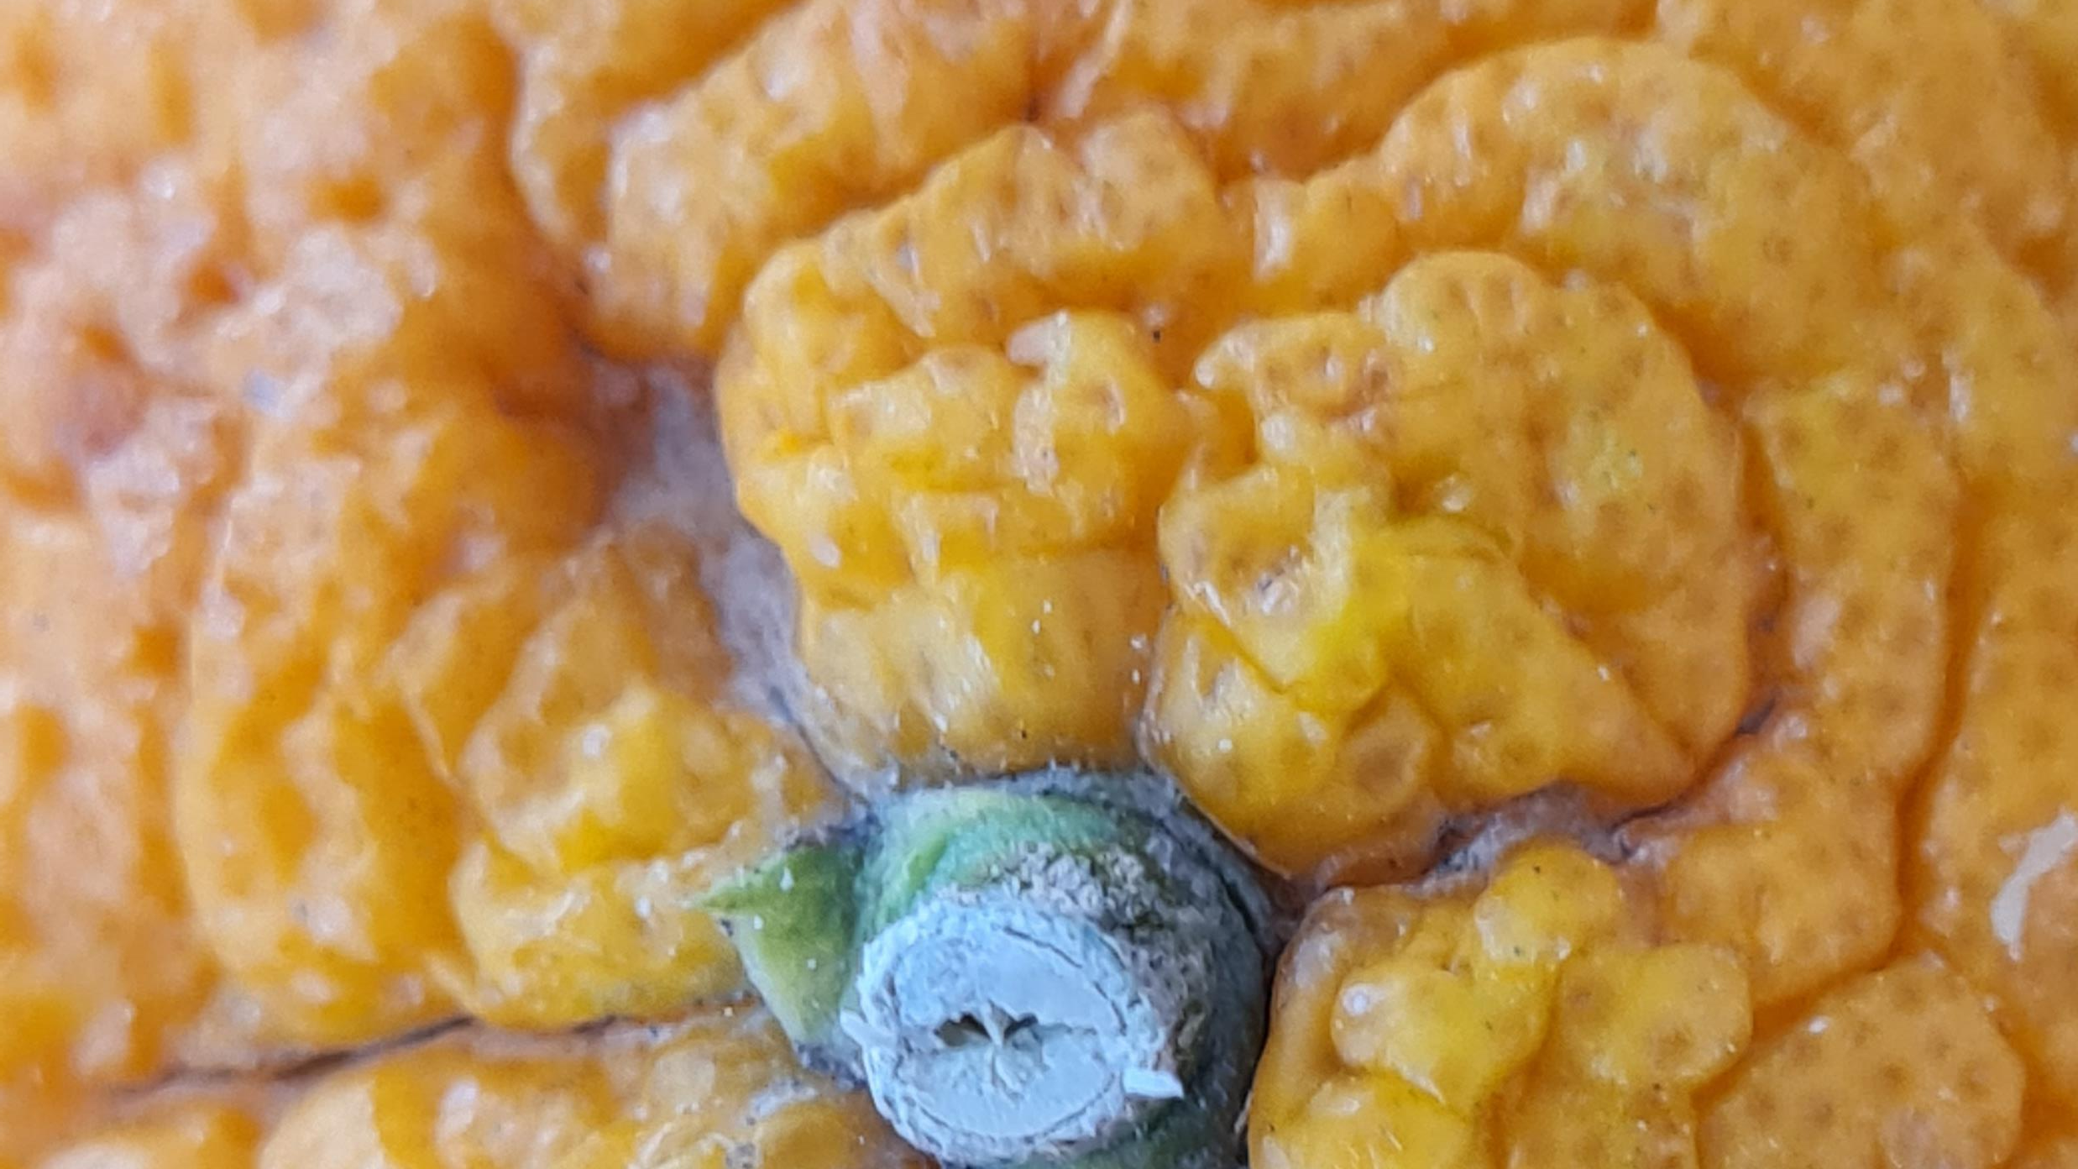

Slide 5
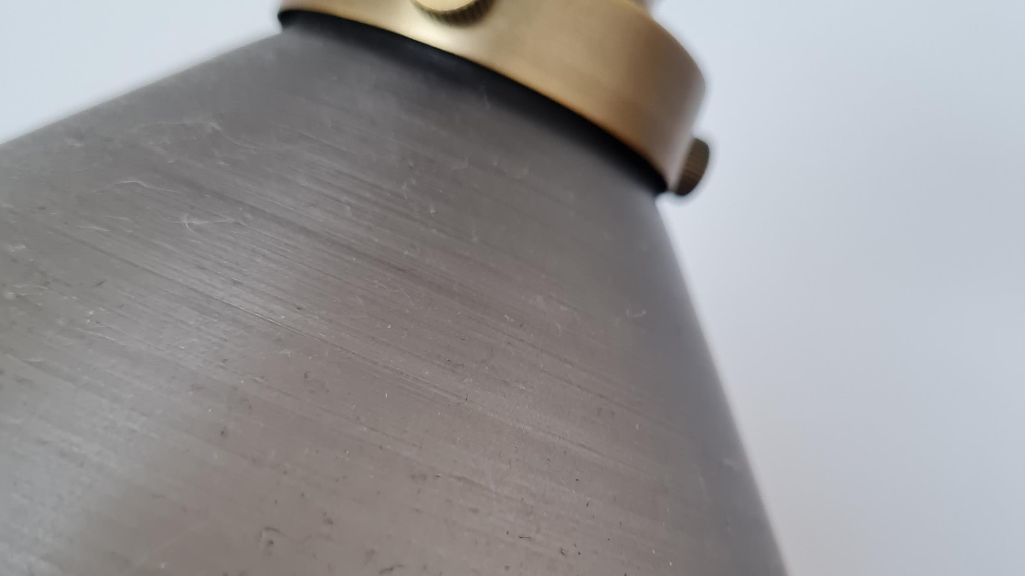

Slide 6
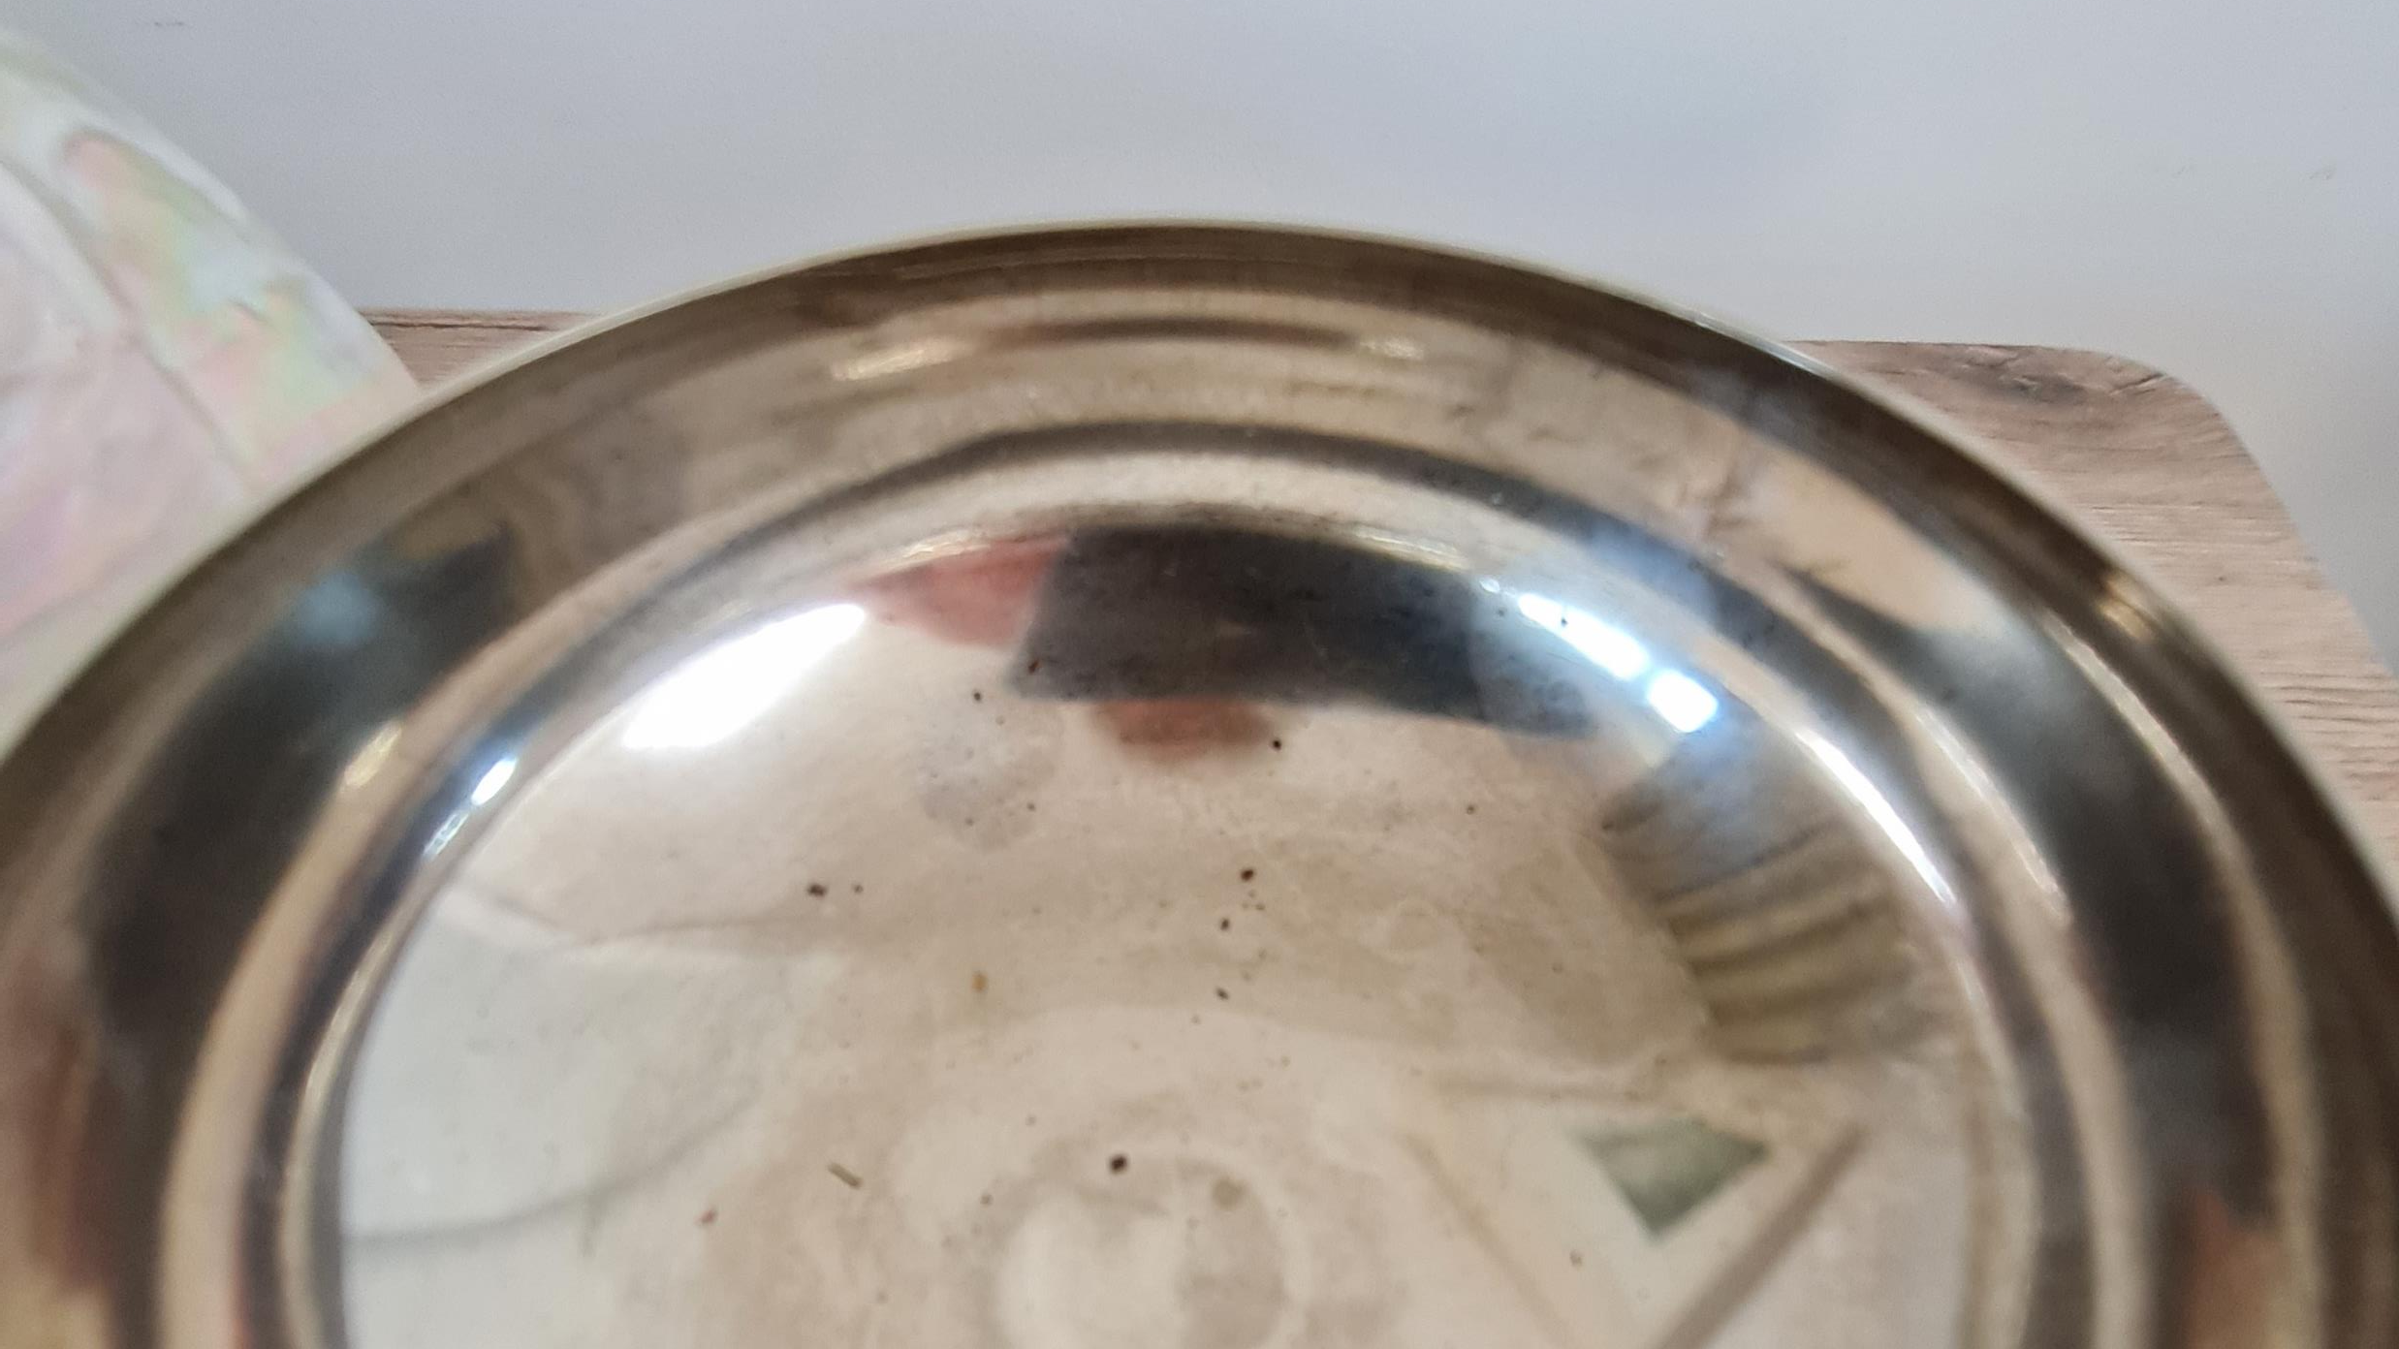

Slide 7
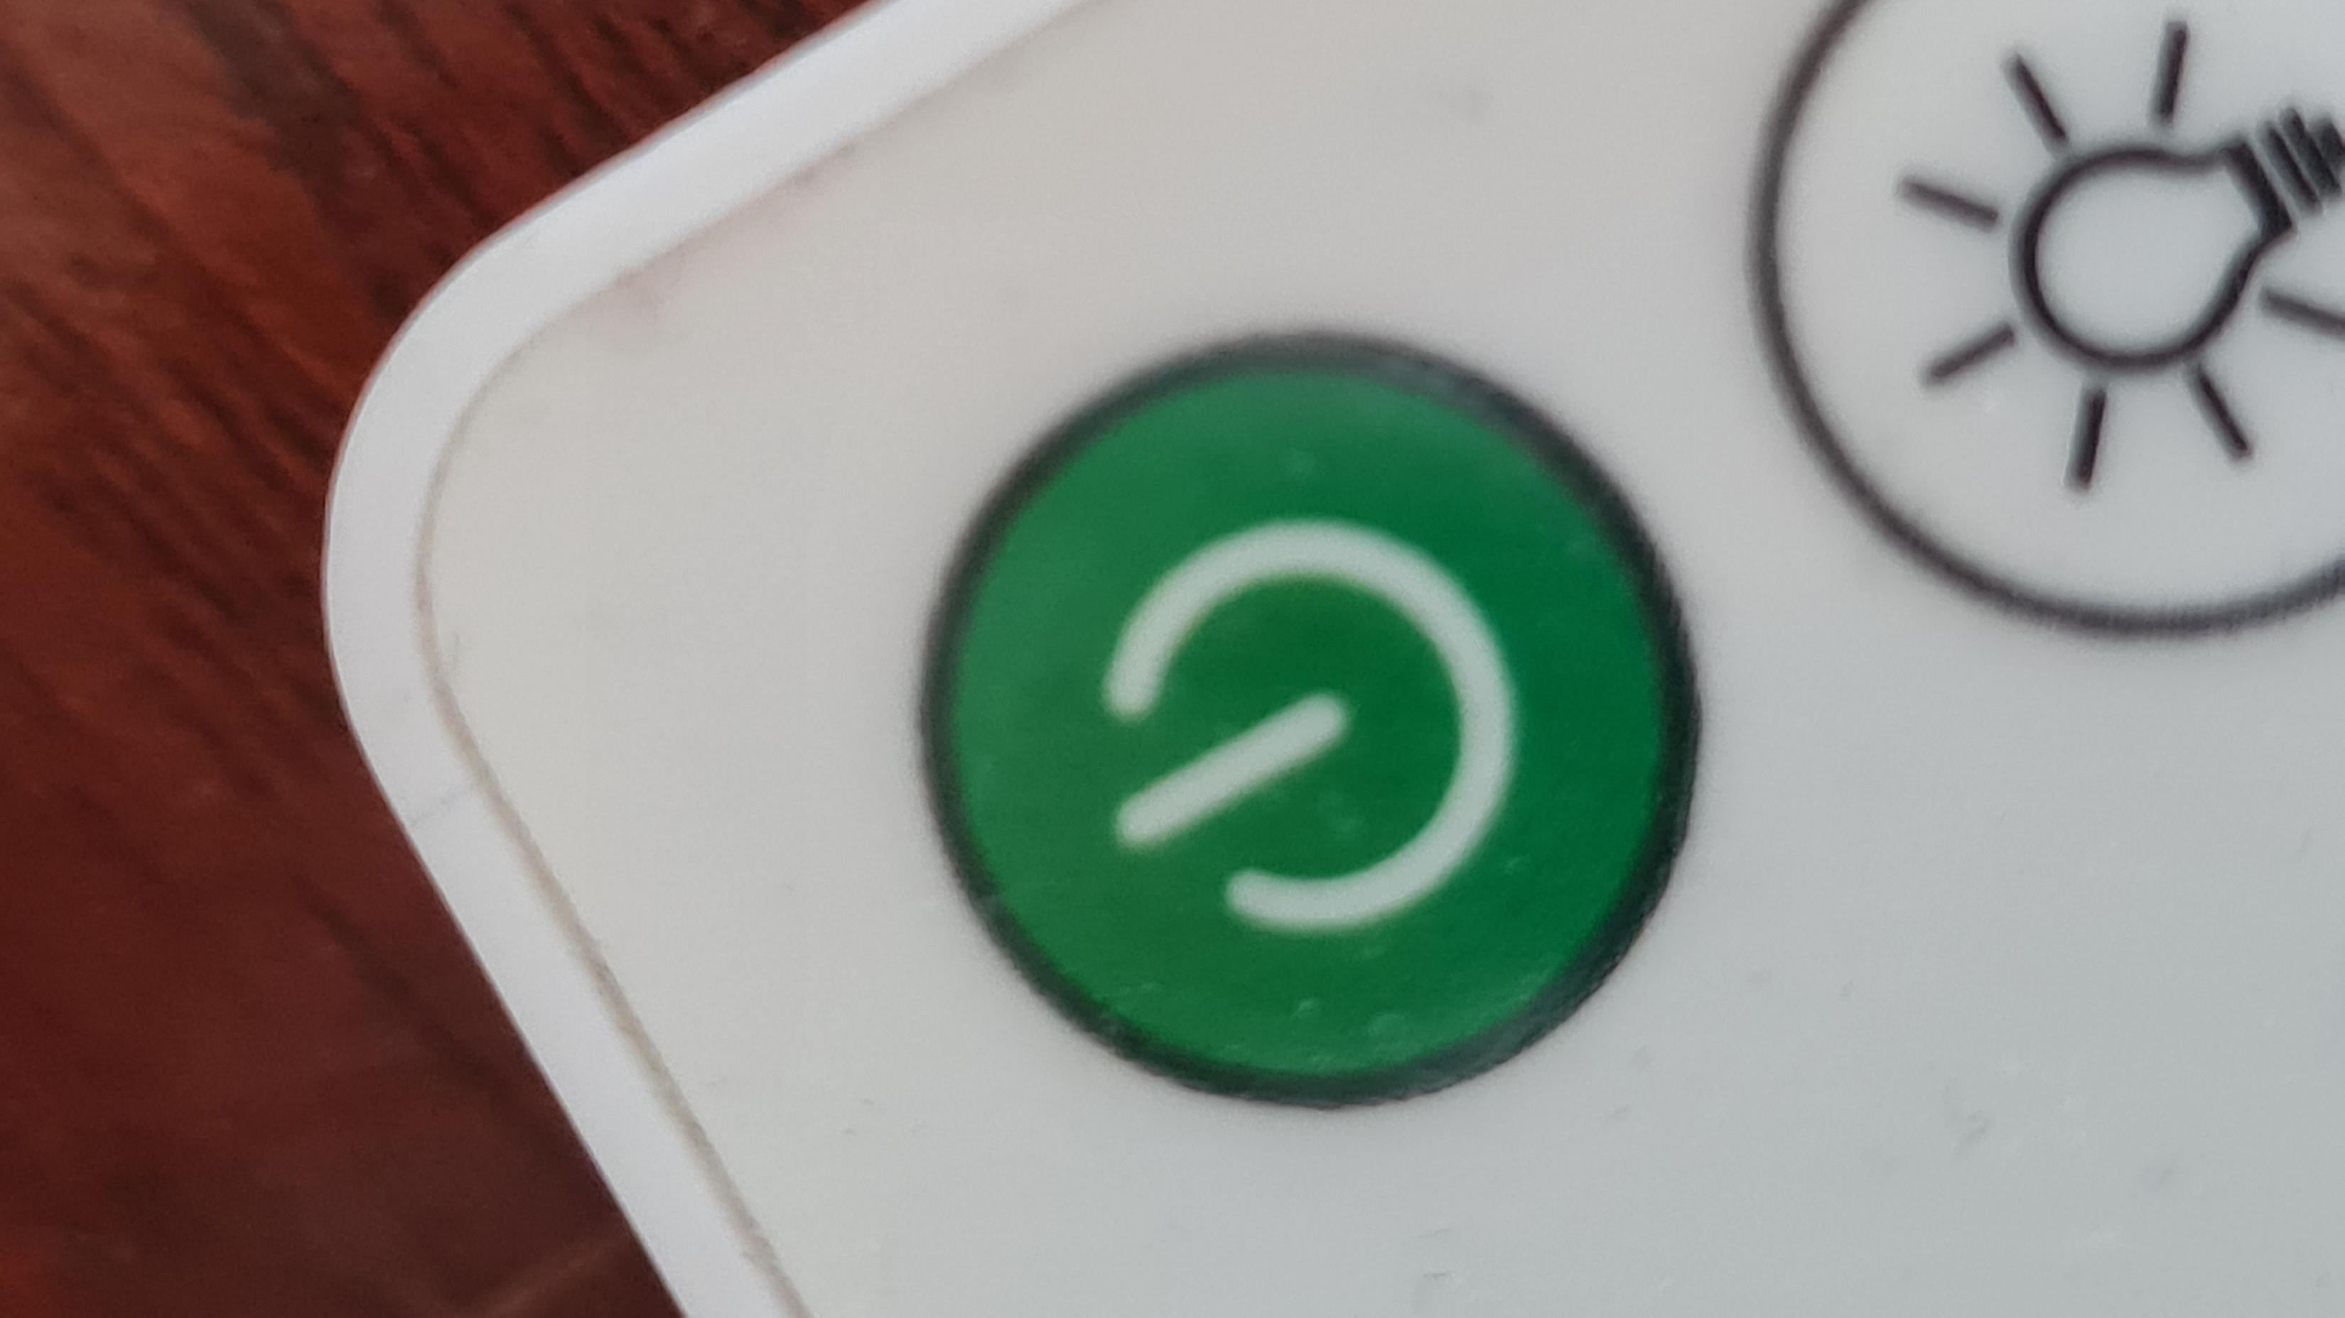

Slide 8
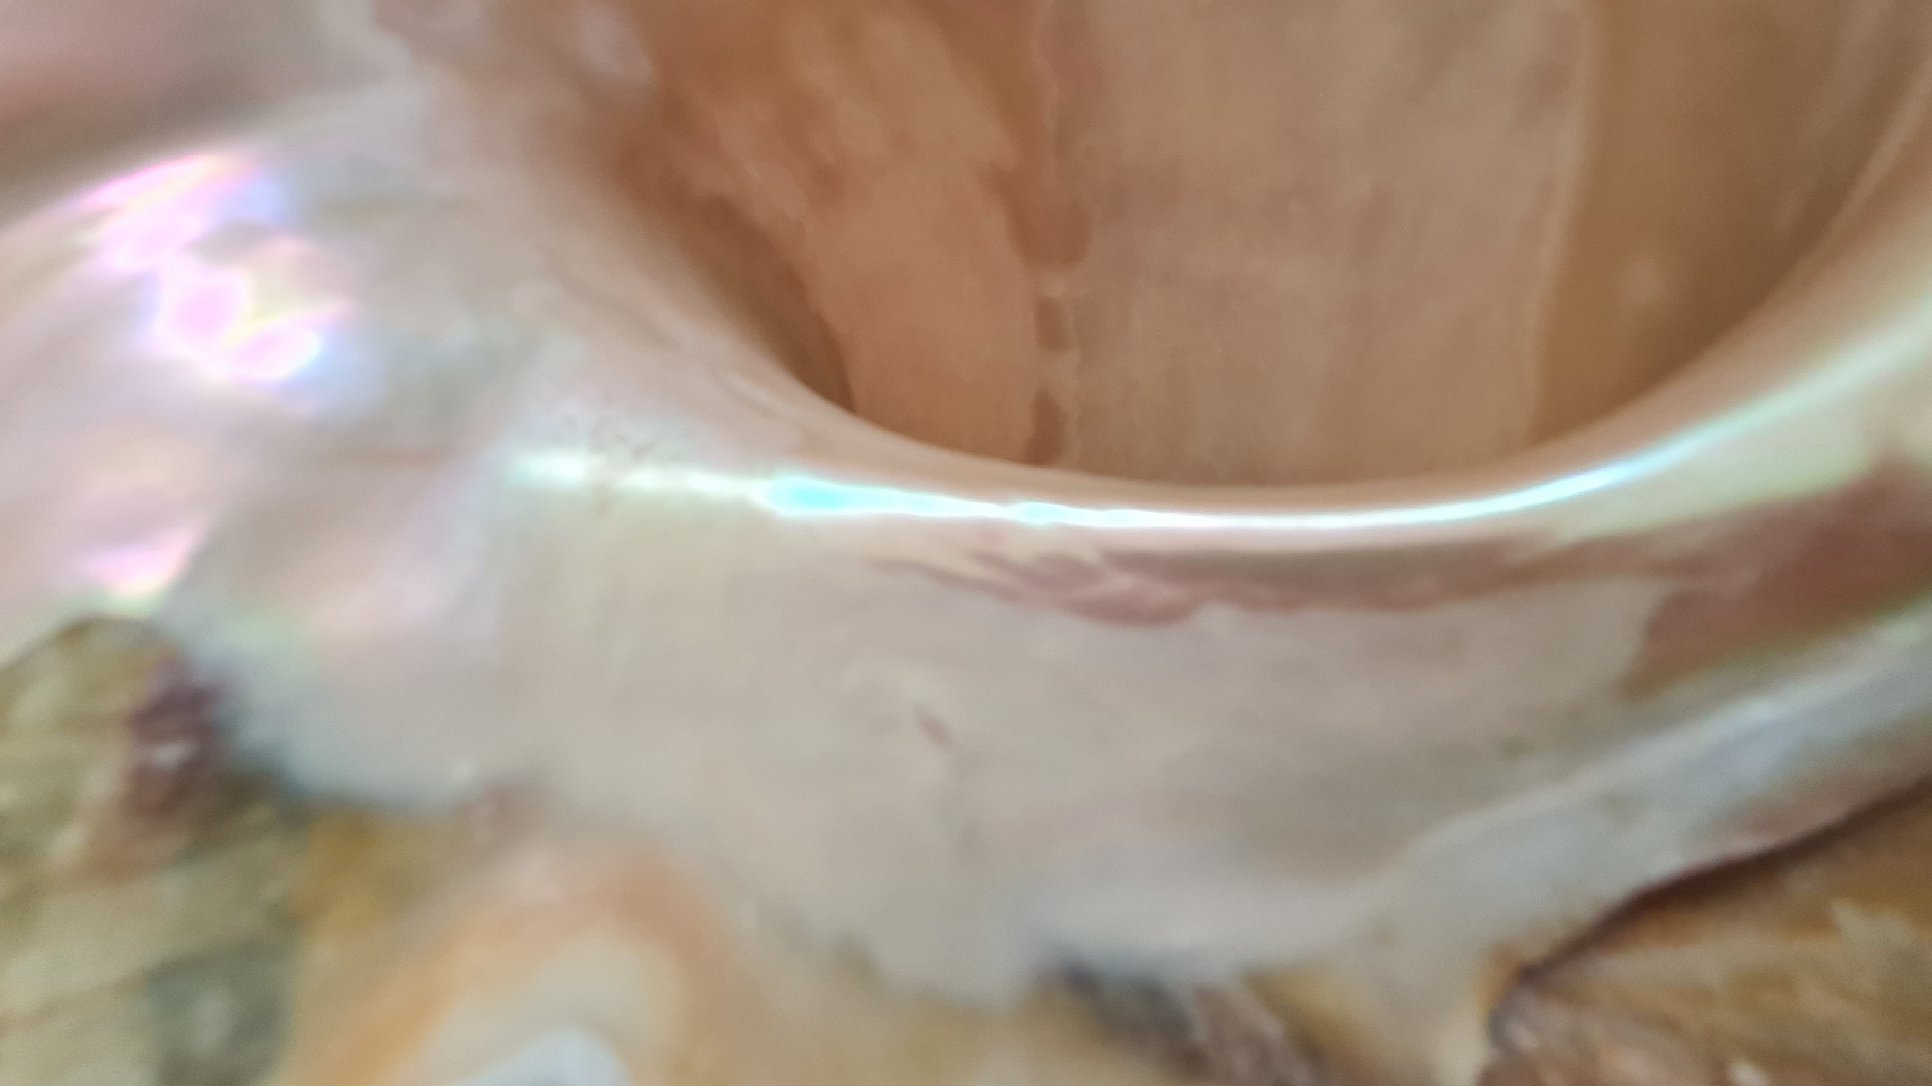

Slide 9
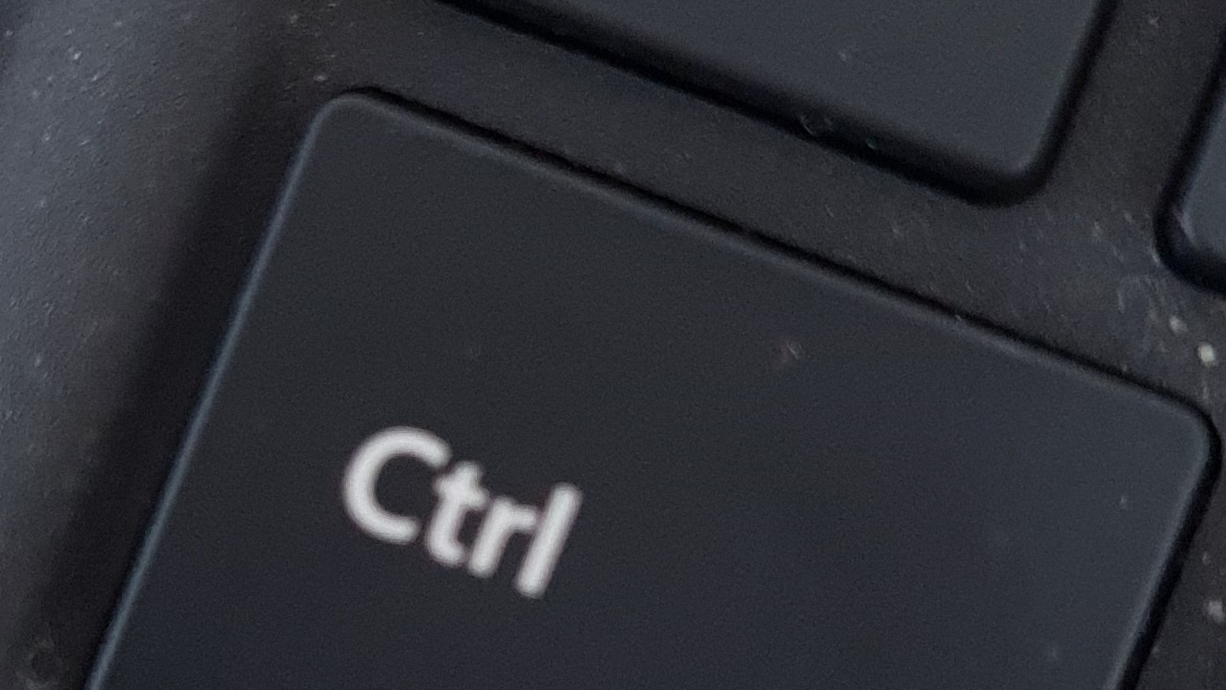

Slide 10
Seeing the whole picture!

Slide 11
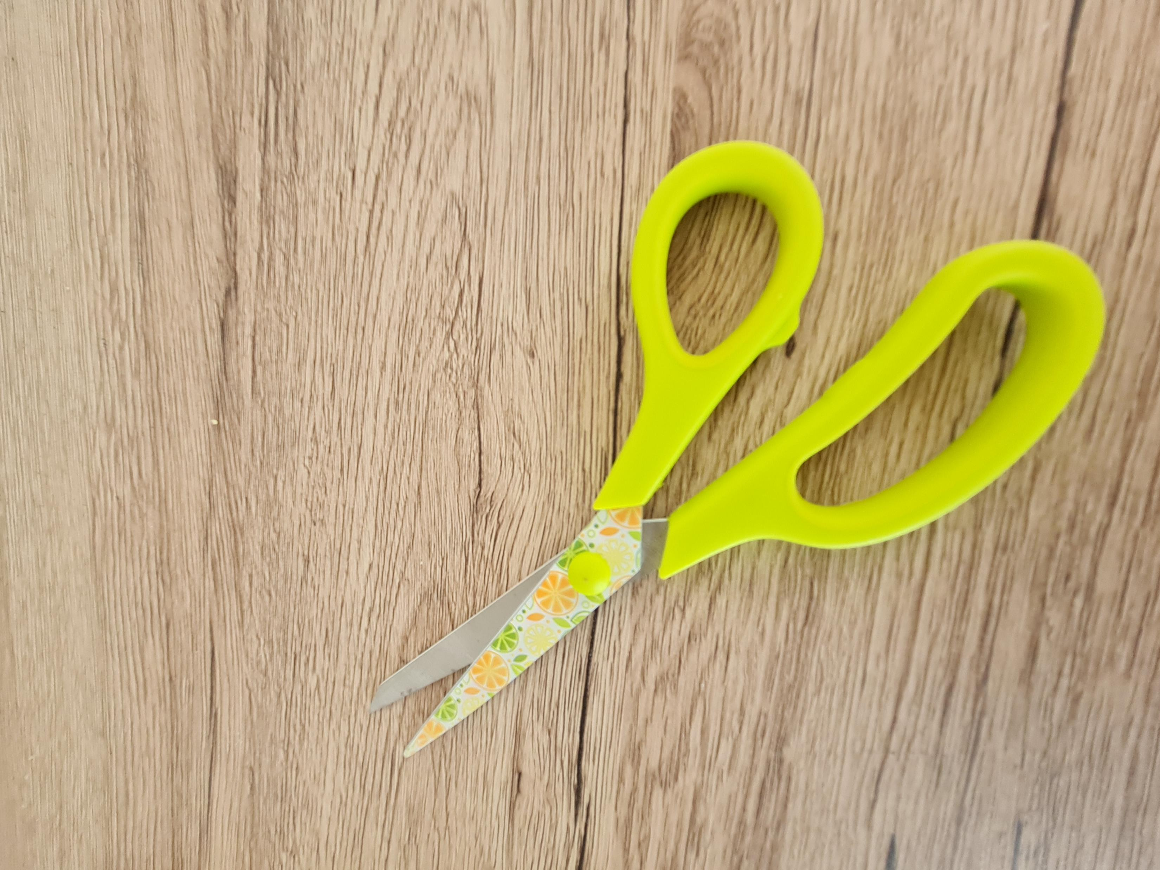

Slide 12
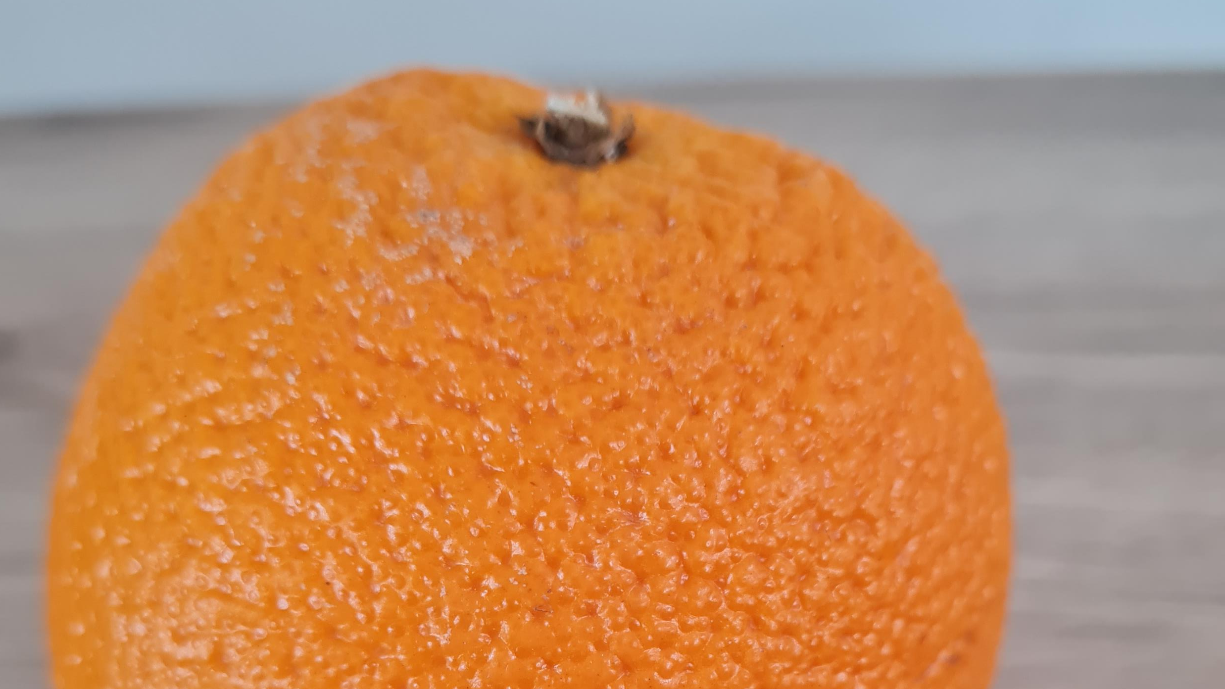

Slide 13
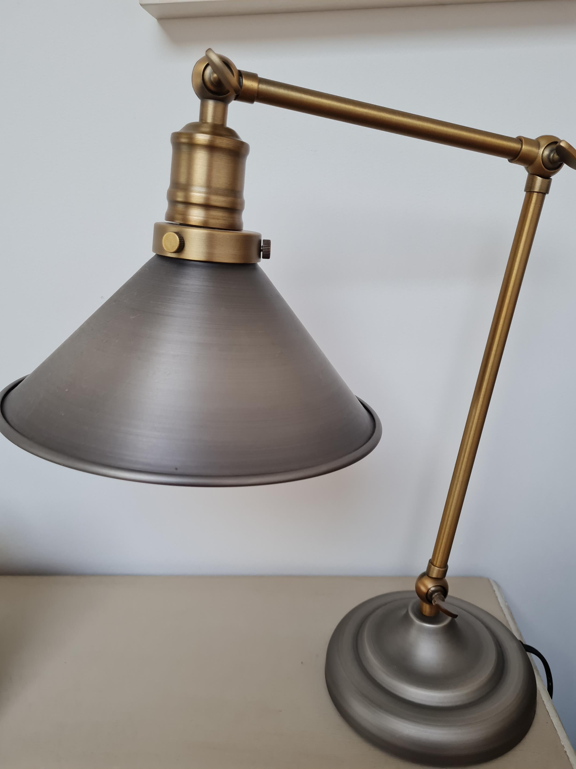

Slide 14
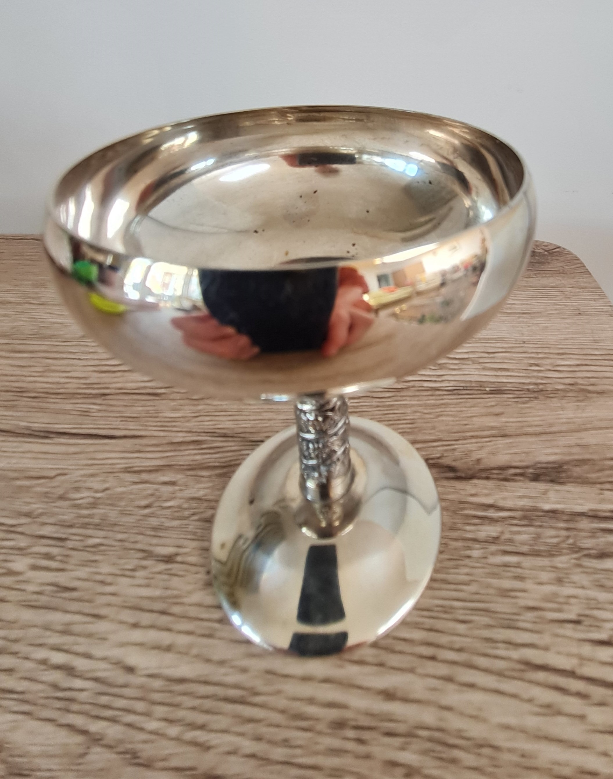

Slide 15
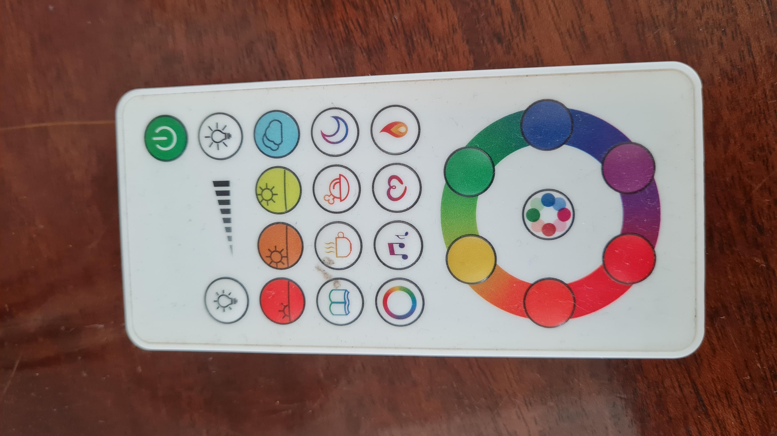

Slide 16
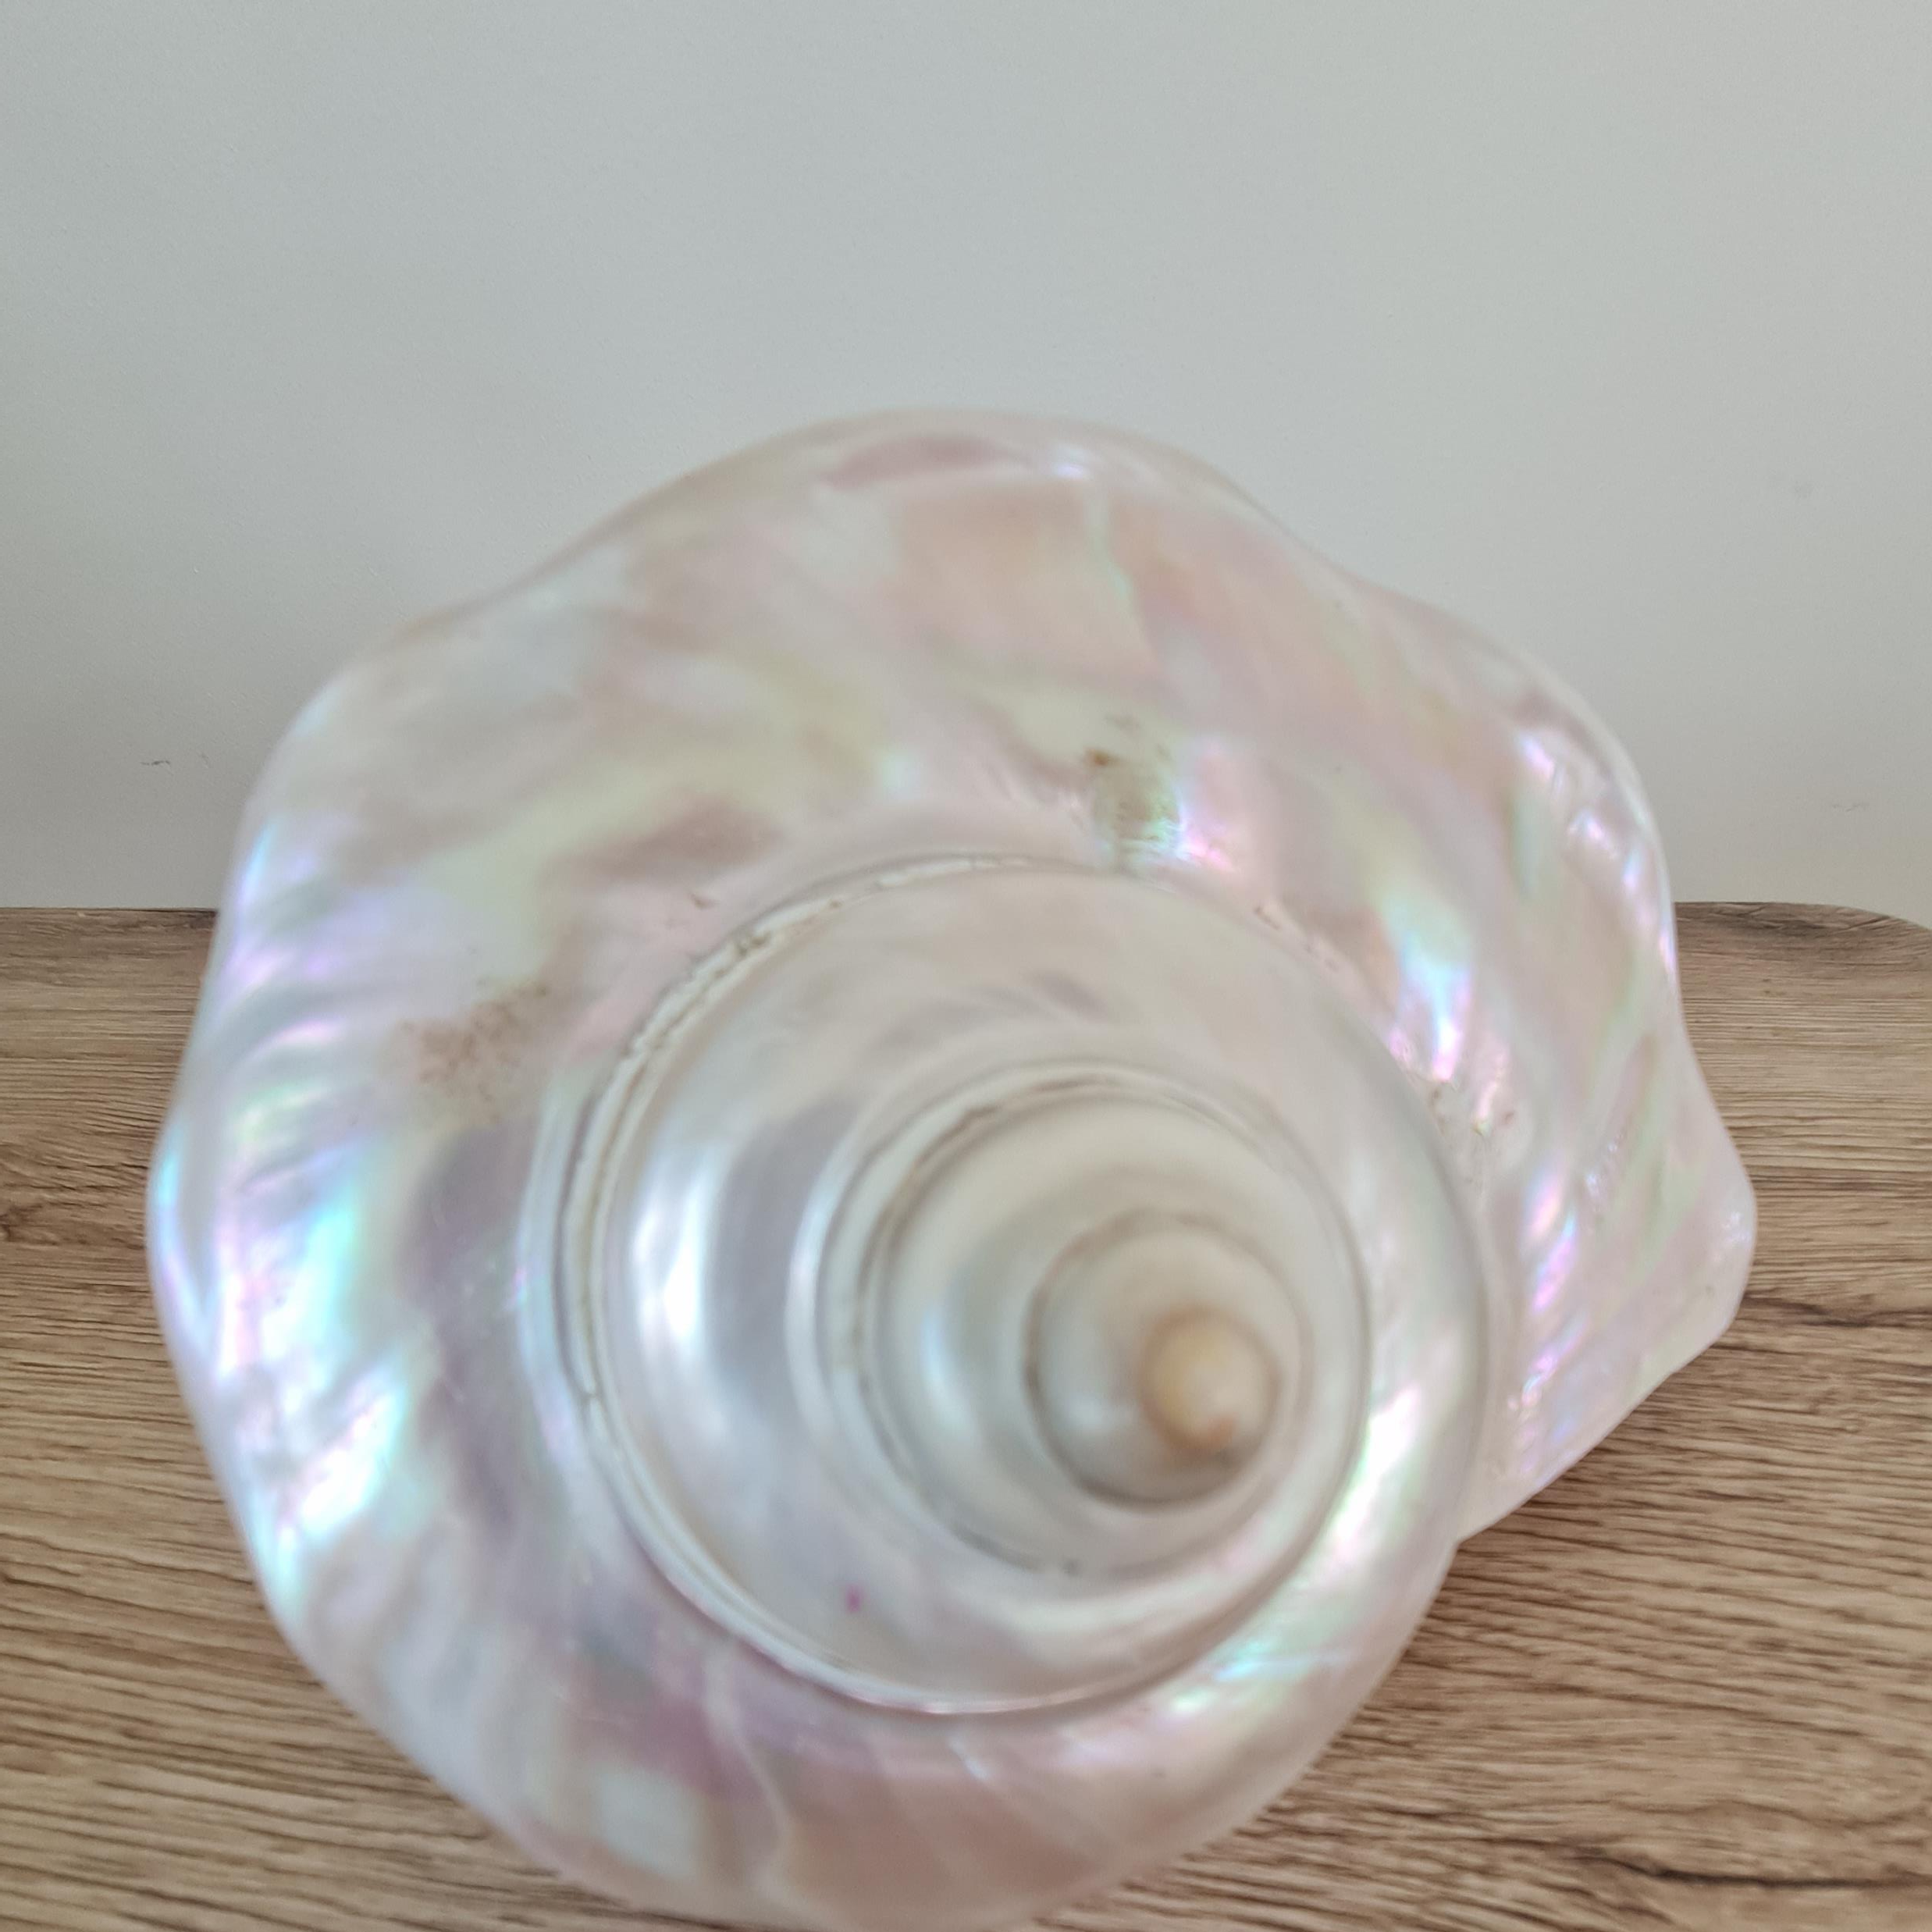

Slide 17
